Slide 1
THE IMPORTANCE
OF COMPLIANCE
District 1150 Compliance Officer 2026-27
Rotarian Mark Evans
Rotary Club of Llanelli

Slide 2
There are THREE overwhelming reasons
why we as clubs and rotarians
Need to actively practice DUE DILIGENCE
in engaging COMPLIANCE
1)Protect our Rotarians in the public activities we pursue.
2)Protect the people with whom we engage.
3)Protect the image of Rotary.

Slide 3


HOW DO YOUR CLUB LEADERSHIP
AND MEMBERS PERCEIVE
ROTARY COMPLIANCE?
HEADACHE
CAN’T BE BOTHERED –PLEASE GO AWAY
REWARDING
EXPERIENCE IN DELIVERING

Slide 4
From my 8 years of experience being District 1150 Compliance Officer, it is the following points that move a club to the “rewarding experience”.
1) An ownership at Club Council where the most long term continuity of club guidance and deployment exists.
2) The election of a Club Compliance Officer (there is now a job description available on compliance website).
3) The knowledge of where to go for support, guidance and answers to any issues.

Slide 5
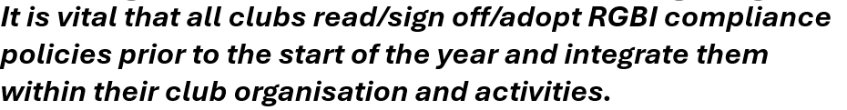





Slide 6
COMPLIANCE IS SEGMENTED INTO FIVE CATEGORIES
HEALTH AND SAFETY
SAFEGUARDING
GDPR
General Data Protection Legislation
EQUALITY DIVERSITY INCLUSION
& EQUITY
DISPUTE MANAGEMENT
HOW OFTEN ARE WE LIKELY TO ENCOUNTER COMPLIANCE EXPECTATIONS?
ALL ACTIVITIES WITH
VULNERABLE PEOPLE
(CHILDREN AND ADULTS AT RISK)
ALL ROTARY ORGANISED
EVENTS
ANNUALLY OR BY AGREED FREQUENCY
OR CONTRACT
ALL PERSONAL
OR GROUP INTERACTION
INFREQUENTLY /
AS AND WHEN REQUIRED

Slide 7
MINIMUM COMPULSORY COMPLIANCE ROLE
REQUIREMENT THAT EACH CLUB NEEDS TO HAVE
HEALTH AND SAFETY
SAFEGUARDING
IT IS ALSO A REQUIREMENT THAT ALL CLUBS HAVE AN UPDATED
POLICY FOR BOTH APPROVED AT CLUB COUNCIL
A HYBRID RGBI VERSION IS AVAILABLE TO DOWNLOAD FROM
THE D1150 COMPLIANCE SECTION TO SIGN OFF

Slide 8
WE HAVE JUST COVERED THE STRUCTURE OF COMPLIANCE
AND THE CLUB COMMITMENTS TO REVIEW AND
SIGN OFF POLICIES
I NOW WANT TO TAKE YOU THROUGH SOME FAMILIAR
EXPECTATIONS AND ALSO NEW BULLETINS
REGARDING COMPLIANCE
NEW BULLETINS CAN BE SEEN ON THE D1150
COMPLIANCE SECTION

Slide 9

ALL EVENTS ORGANISED BY ROTARY CLUBS
MUST HAVE THE FOLLOWING IN PLACE
RISK ASSESSMENT
EVENT PLAN
EMERGENCY PLAN
LINKED TO THAT EMERGENCY PLAN NEEDS TO BE
A DESIGNATED SAFETY OFFICER FOR THE EVENT AND AN
ACCIDENT BOOK WITH GUIDELINES FOR RECORDING
(AGAIN AVAILABLE ON D1150 COMPLIANCE SECTION)
ONE OF THE BEST COMPLETE EXAMPLE I HAVE SEEN RECENTLY IS WHEN
RC SAUNDERSFOOT ORGANISED A FUN RUN

Slide 10
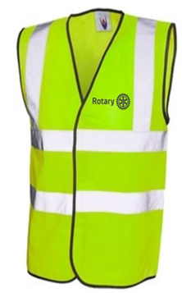

HI VIZ SAFETY JACKETS
OLD STYLE HI VIZ JACKETS ARE NO LONGER COMPLIANT
FOR ROTARY EVENTS DUE TO LACK
OF SIDE REFLECTIVE MARKINGS

Slide 11
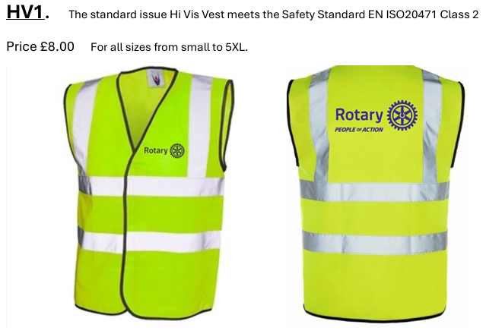
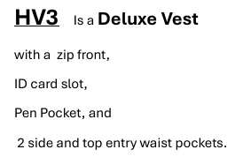
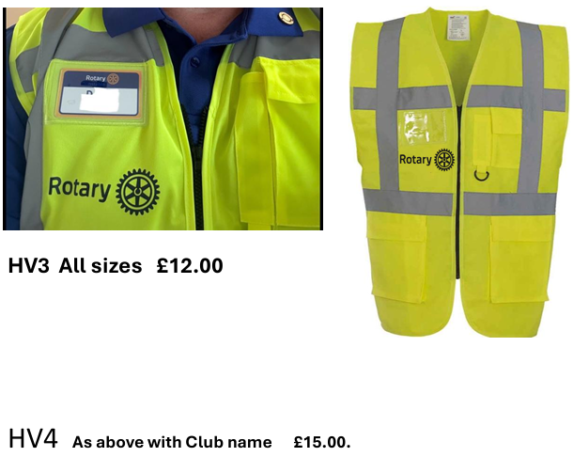


Slide 12
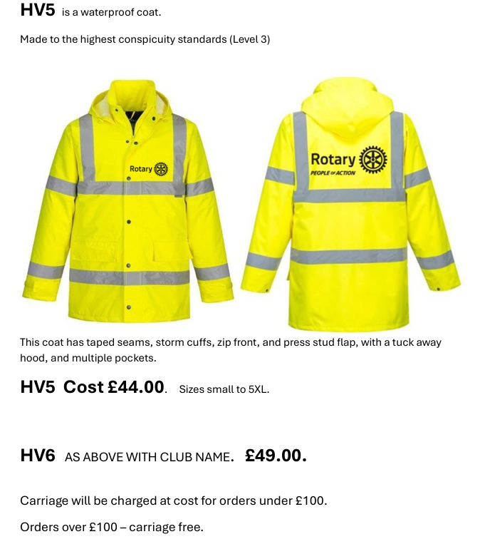
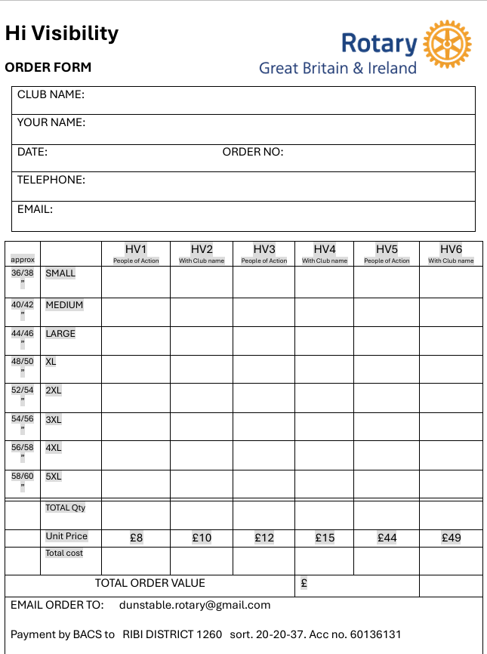

Slide 13
MARTYN’S LAW

Slide 14
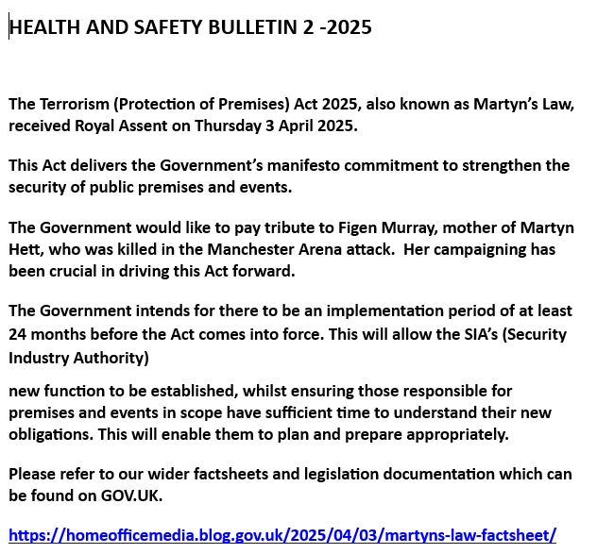

Slide 15
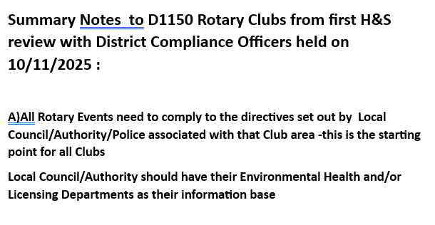
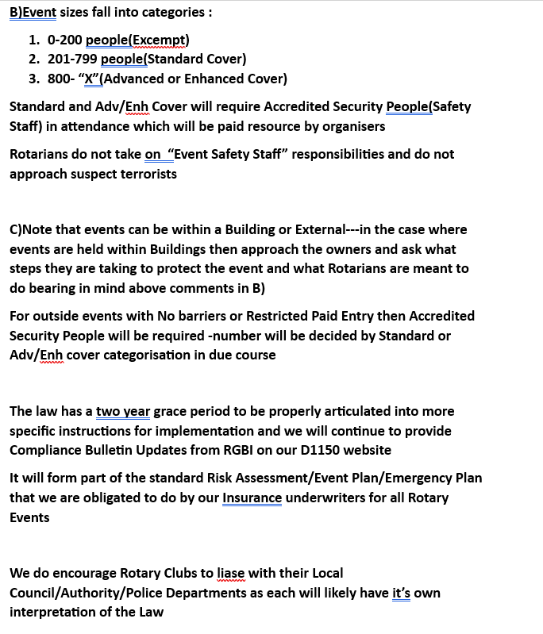

Slide 16
PROCEDURES FOR WELL ESTABLISHED RISK AREAS
THERE ARE ESTABLISHED PROCEDURES ISSUED BY RGBI/BARTLETTS INSURANCE FOR
HIGH RISK EVENTS --- E.G SANTA SLEIGH / FIREWORKS
AS ROTARY CLUBS IT’S UNFORTUNATE THAT WE DO NOT RESPECT THESE CLEAR
GUIDELINES AND THERE ARE CONTINUED EXAMPLES OF INCIDENTS HAPPENING
SO PLEASE CAREFULLY READ THE GUIDELINES AS THEY HAVE BEEN DEVELOPED
BASED ON EXPENSIVE INSURANCE CLAIMS IN THE PAST

Slide 17
SOME DAY TO DAY CHALLENGES THAT HAVE ARISEN IN ROTARY
SALE OF SECOND HAND ELECTRICAL GOODS
MY ADVISE-DON’T GET INVOLVED
PHOTOGRAPHS OF CHILDREN AND VUNERABLE ADULTS
NEW PROCEDURE IN D1150 COMPLIANCE SECTION
APPLICATION ENHANCED DBS REQUIREMENTS
NEW DIGITAL SYSTEM INTRODUCED
MUST BE A REGULATED ACTIVITY TO COMPLY
WORKING WITH CHILDREN
ALWAYS BE IN COMPANY/DO NOT TOUCH(IN CASE OF CHILDREN
WITH LEARNING DIFFICULTIES WHO ARE TACTILE USE A
HIGH 5 OR FIST PUNCH)
➔BE AWARE OF ENTRAPMENT
INAPPROPRIATE BEHAVIOUR
A LIST OF IMMEDIATE RESPONSES AVAILABLE ON D1150
COMPLIANCE SECTION –TACKLE ISSUES IMMEDIETLY AND
MAKE EVERY EFFORT TO RESOLVE DISPUTES WITHIN CLUB
PROVIDING FOOD AS ROTARY MORNINGS
MY ADVISE-PRE PURCHASE WITH ALL INGREDIENTS VISIBLE
FOR CONSUMER ALLERGEN IDENTIFICATION
IF THIRD PARTY LOCATION e.g HOTEL-Report issue to them to act
IF AT A ROTARIAN MANAGED EVENT-Ring Emergency Services
ROTARIANS BEEN TAKEN ILL AT VENUE

Slide 18
WHERE TO GO IF YOU HAVE ANY DOUBT ABOUT COMPLIANCE
BE ENCOURAGED TO FIND YOUR ANSWERS ON D1150 WEBSITE OR RGBI WEBSIGHT
–IT’S A GOOD LEARNING PROCESS
IF IT’S AN INSURANCE QUESTION –CONTACT BARTLETTS DIRECT
HAVE YOUR COMPLIANCE REPRESENTATIVE CONTACT ME DIRECTLY
POLICIES AND PROCEDURES ARE CONSTANTLY CHANGING –PLEASE DON’T ASSUME
YOU HAVE THE CORRECT ANSWER BASED ON A PREVIOUS SIMILAR SITUATION
IN THE DISTANT PAST

