Slide 1
Primary Schools Quiz
Sample Quiz
2024 - 2025

Slide 2
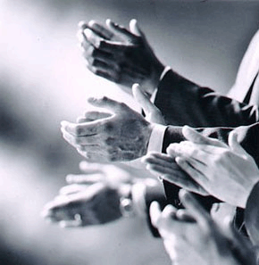
Let’s welcome all the school teams!

Slide 3
Club Heat - Schools
The names of schools participating in the competition will be listed here.

Slide 4
Quiz Subjects
Round 1 Alphabet Quiz
Round 2 Geography
Round 3 Human Body
Round 4 Mathematics
Round 5 Science
Round 6 Music
Round 7 The Written Word
Round 8 General Knowledge
Round 9 Sport
Round 10 Pictures

Slide 5
Competition rules
Please ensure mobile phones and other devices are turned off for the duration of the competition.
Supporters, please ….no shouting out, PLEASE do not even whisper - let’s be fair to all.
There are 6 questions in each of the 10 rounds.
Your answer sheets will be collected and scored at the end of each round.
To give the markers time, questions for Rounds 1 and 2 will directly follow each other.
After round 2, you will be given the answers to round 1. After round 3 you will be given the answers to round 2 and so on.

Slide 6
And ……
Should there be a draw after round 10 there will be a Tie Break round. If there is still a draw we will move on to the Sudden Death questions!
All correct answers will get 2 points (or 1 point for each answer in some questions).
If answer is considered to be close, then 1 point may be awarded – but at the discretion of the Head Marker.
The Head Marker is the Adjudicator.

Slide 7
Round 1 – Alphabet Quiz
What R is the opposite of “wrong”?
What O is the gas that we breathe in?
What T is the collective name for buses, trains and planes?
What A is the name for a person in space?
What R is an appliance used to keep things cold?
What Y means to shout very loudly?

Slide 8
Round 2 - Geography
Name the capital city of Italy?
What is the longest river in Scotland?
In which country would you find New South Wales?
Which cereal crop beginning with “R” is grown in flooded fields?
What is the name given to a “lake” in Scotland?
Which city is the most northerly – Perth or Dundee?

Slide 9
Answers for Round 1- Alphabet Quiz
What R is the opposite of “wrong”?
Right
What O is the gas that we breathe in?
Oxygen
What T is the collective name for buses, trains and planes?
Transport
What A is the name for a person in space?
Astronaut
What R is an appliance used to keep things cold?
Refrigerator
What Y means to shout very loudly?
Yell

Slide 10
Round 3 – Human Body
Which organ pumps blood around the body?
What identifying marks are found on your hands?
In humans, what is the most common colour of eyes?
How many nostrils do humans have?
What 5 letter word describes having an abnormally high temperature?
What do you call the instrument that doctors use to listen to a heart beating and other internal sounds?

Slide 11
Answers for Round 2 - Geography
Name the capital city of Italy?
Rome
What is the longest river in Scotland?
River Tay
In which country would you find New South Wales?
Australia
Which cereal crop beginning with “R” is grown in flooded fields?
Rice
What is the name given to a “lake” in Scotland?
Loch
Which city is the most northerly – Perth or Dundee?
Dundee

Slide 12
Round 4 - Mathematics
What number is represented by the Roman Numerals XXIX?
How many faces are there on a cube?
Calculate 3.8 + 9.7 - 2.2 ?
What is the next number in this sequence – 39, 29, 20, 12, …… ?
Add 3² to 5² ?
What is the mathematical meaning of this symbol < ?

Slide 13
Answers for Round 3 – Human Body
Which organ pumps blood around the body?
Heart
What identifying marks are found on your hands?
Fingerprints
In humans, what is the most common colour of eyes?
Brown
How many nostrils do humans have?
2
What 5 letter word describes having an abnormally high temperature?
Fever
What do you call the instrument that doctors use to listen to a heart beating and other internal sounds?
Stethoscope

Slide 14
Round 5 – Science
At what temperature does fresh water freeze?
Which is the lightest gas?
What do you call the force that resists motion?
What do compass needles point towards?
What is another word for speed that begins with the letter “V”?
Which is the smallest planet in our solar system?

Slide 15
Answers for Round 4 - Mathematics
What number is represented by the Roman Numerals XXIX?
29
How many faces are there on a cube?
6
Calculate 3.8 + 9.7 – 2.2 ?
11.3
What is the next number in the sequence – 39, 29, 20, 12, ….. ?
5
Add 3² to 5² ?
34
What is the mathematical meaning of this symbol < ?
Less than

Slide 16
Round 6 - Music
Which musical instrument has 88 keys?
What notes comes next in the following musical sequence C D E F G ……?
Who sang the song “If I were a boy”?
What was the name of Adele’s first album, released in 2008?
Which group of instruments is named after a metal?
How many musicians are there is a Quartet?

Slide 17
Answers for Round 5 – Science
At what temperature does fresh water freeze?
0ºC or 32ºF
Which is the lightest gas?
Hydrogen
What do you call the force that resists motion?
Friction
What do compass needles point towards?
Magnetic North (for 2 points) or North (for 1 point)
What is another word for speed that begins with the letter “V”?
Velocity
Which is the smallest planet in our solar system?
Mercury

Slide 18
Round 7 – The Written Word
Who wrote the book “An Eagle in the Snow”?
What do you call a word that has the same or similar meaning as another word?
What is the past tense of “catch”?
What is the name of the boy in the David Walliams book “Billionaire Boy”?
What do you call this symbol # ?
What is the opposite of “yesterday”?

Slide 19
Answers for Round 6 - Music
Which musical instrument has 88 keys?
Piano
What note comes next in the following musical sequence C D E F G …..?
A
Who sang the song “If I were a boy”?
Beyonce
What was the name of Adele’s first album, released in 2008?
19
Which group of instruments is named after a metal?
Brass
How many musicians are there in a Quartet?
4

Slide 20
Round 8 - General Knowledge
What colour is “Azure”?
What is the name of Mickey Mouse’s dog?
Which company produced the iPad, the iPod & the iPhone?
How many inches are there in 1 yard?
What kind of food is “Penne”?
What number is also known as a “Century”?

Slide 21
Answers for Round 7 – The Written Word
Who wrote the book “An Eagle in the Snow” ?
Michael Morpurgo
What do you call a word that has the same or similar meaning as another word?
Synonym
What is the past tense of “catch”?
Caught
What is the name of the boy in the David Walliams book “Billionaire Boy”?
Joe Spud
What do you call this symbol # ?
Hash or Hashtag
What is the opposite of “yesterday”?
Tomorrow

Slide 22
Round 9 – Sport
The 5 colours in the Olympic Rings symbol are; Blue, Yellow, Black, Red & …….. what else?
Which Scottish Premier League football club has a home strip of green and white hoops?
Beach volleyball is normally held on a court made up of what substance?
What country does Roger Federer come from?
What is the highest score achievable from throwing a single dart?
How many players are there in a netball team?

Slide 23
Answers for Round 8 – General Knowledge
What colour is “Azure”?
Blue
What is the name of Mickey Mouse’s dog?
Pluto
Which company produced the iPad, the iPod and the iPhone?
Apple
How many inches are there in 1 yard?
36
What kind of food is “Penne”?
Pasta
What number is also known as a “Century”?
100

Slide 24
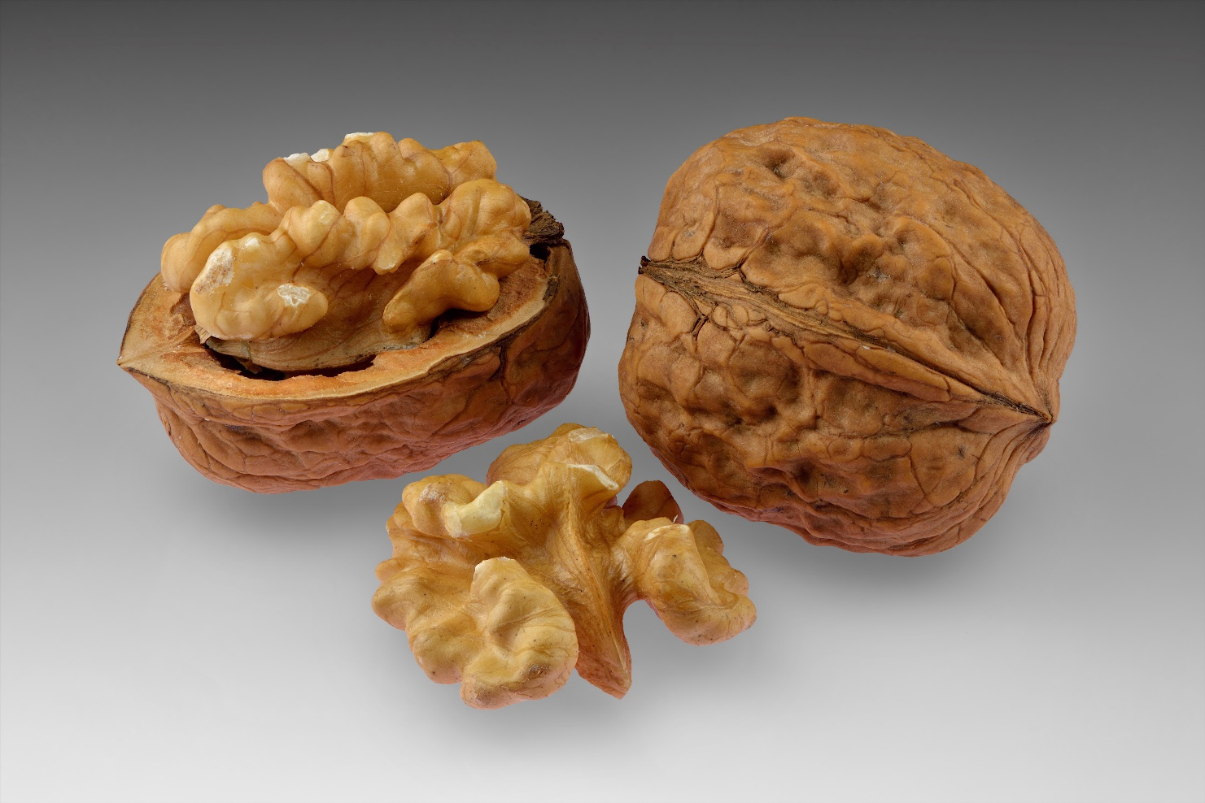
Round 10 - Pictures
What do you call this nut?

Slide 25
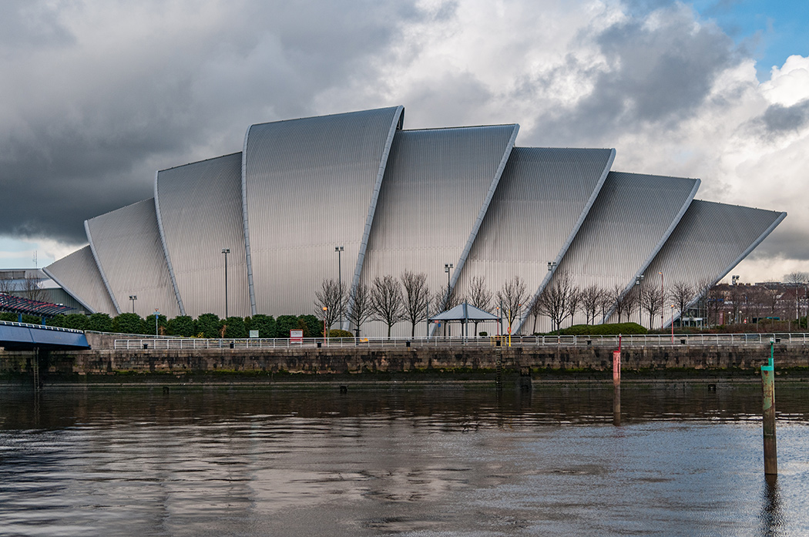
Round 10 - Pictures
What is the name of this Glasgow landmark?

Slide 26
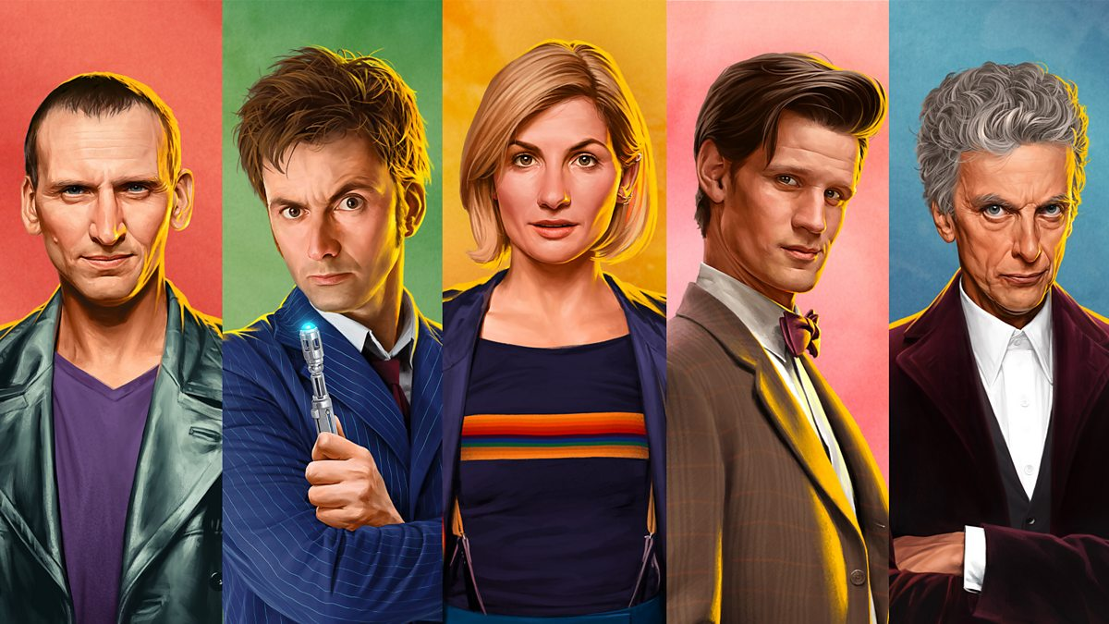
Round 10 - Pictures
Which character has these performers played?

Slide 27
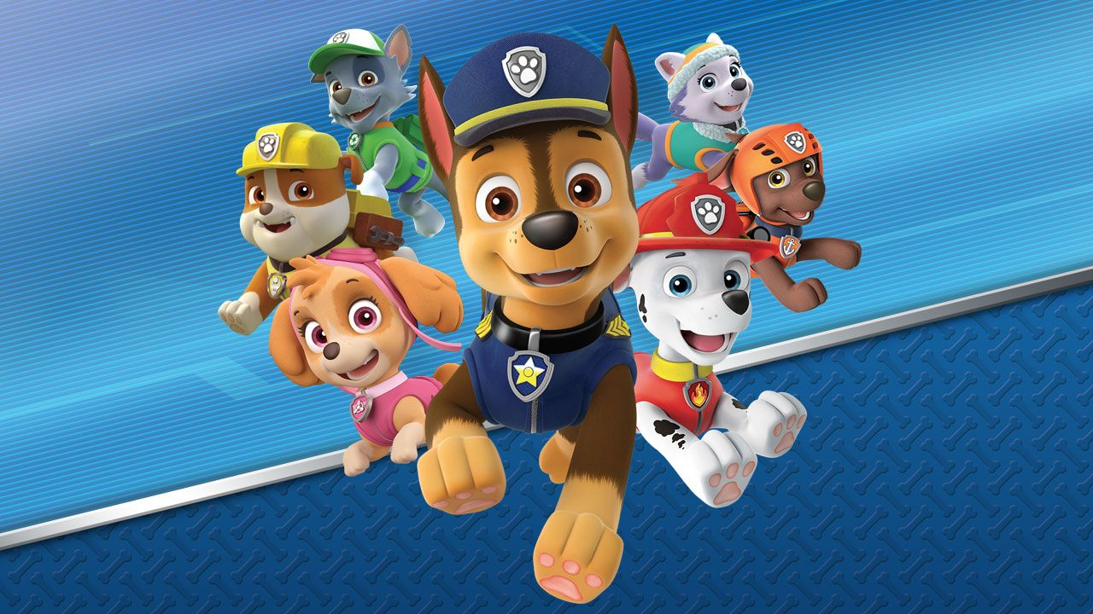
Round 10 - Pictures
What is the name of this cartoon program?

Slide 28
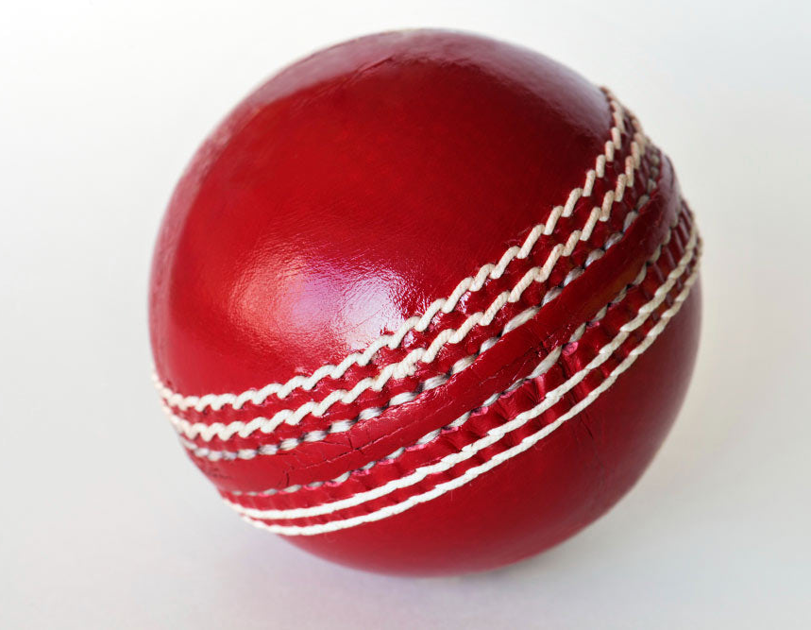
Round 10 - Pictures
In which sport would you use this ball?

Slide 29
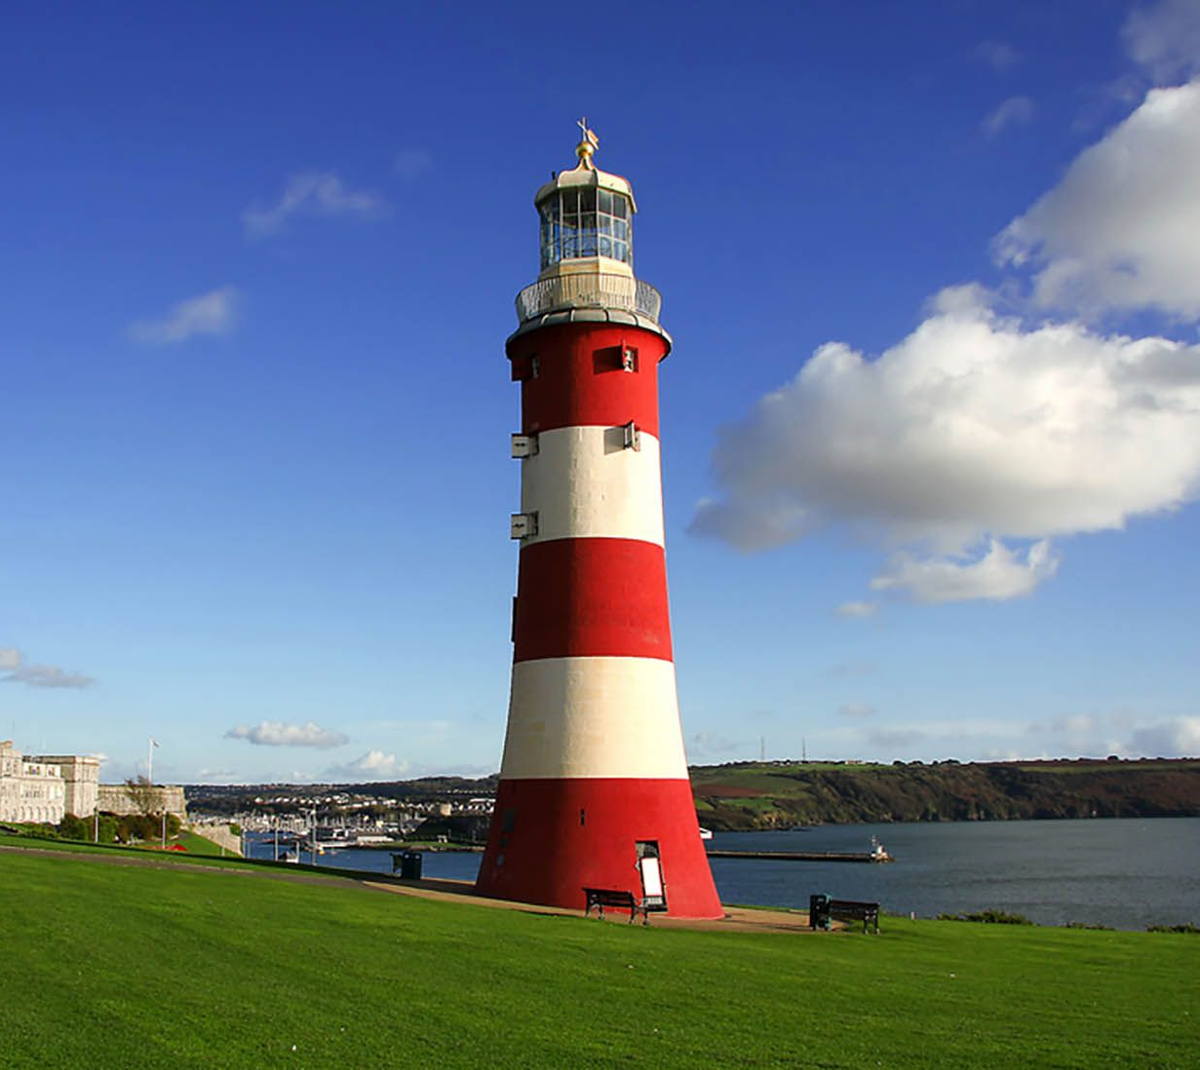
Round 10 - Pictures
What is the name given to this type of structure?

Slide 30
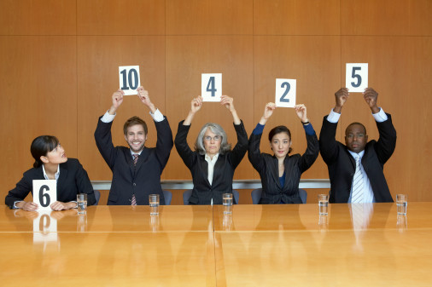
Scorers at work
No pressure guys!

Slide 31
Answers for Round 9 - Sport
The 5 colours in the Olympic Rings symbol are; Blue, Yellow, Black, Red & ……… what else?
Green
Which Scottish Premier League football club has a home strip of green and white hoops?
Celtic
Beach volleyball is normally held on a court made up of what substance?
Sand
What country does Roger Federer come from?
Switzerland
What is the highest score achievable from throwing a single dart?
60
How many players are there in a netball team?
7 in each team

Slide 32
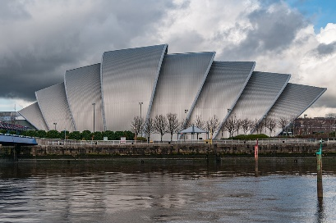
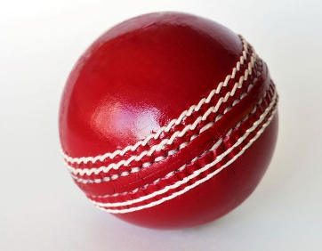
Answers for Round 10 - Pictures
What do you call this nut?
Walnut
What is the name of this Glasgow landmark?
Armadillo
Which character has these performers played?
Dr Who
What is the name of this cartoon program?
Paw Patrol
Which sport would use this ball?
Cricket
What is the name given to this type of structure?
Lighthouse

Slide 33
Rotary District 1010
Sample Primary Schools Quiz

Slide 34
Tie Break Round
Which season comes after Winter?
Which country has Paris as its capital city?
How many sides has a Nonagon?
Divide the number of legs on an Ant by the number of legs on an Ostrich?
Which flower does the spice Saffron come from?
What is the hardest form of Carbon?

Slide 35
Answers for Tie Break Round
Which season comes after Winter?
Spring
Which country has Paris as its capital city?
France
How many sides has a Nonagon?
9
Divide the number of legs on an Ant by the number of legs on an Ostrich?
3
Which flower does the spice Saffron come from?
Crocus
What is the hardest form of Carbon?
Diamond

Slide 36
Rotary District 1010
Sample Primary Schools Quiz

Slide 37
Sudden Death
Maximum of three questions in this round.
First team to call out the correct answer wins.
If the team calling out first gets the wrong answer the other team wins if their answer is correct.

Slide 38
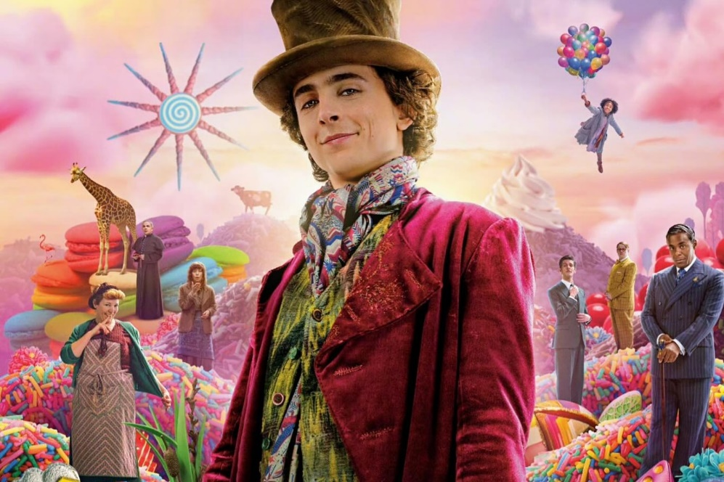
Sudden Death 1
What is the title of this 2023 film?
Wonka

Slide 39
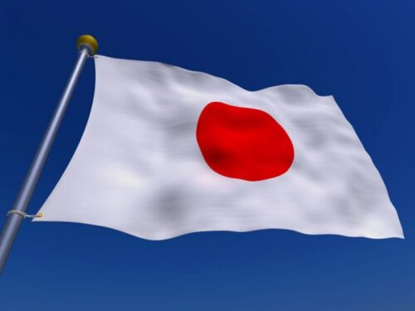
Sudden Death 2
This is the national flag of which
country?
Japan

Slide 40
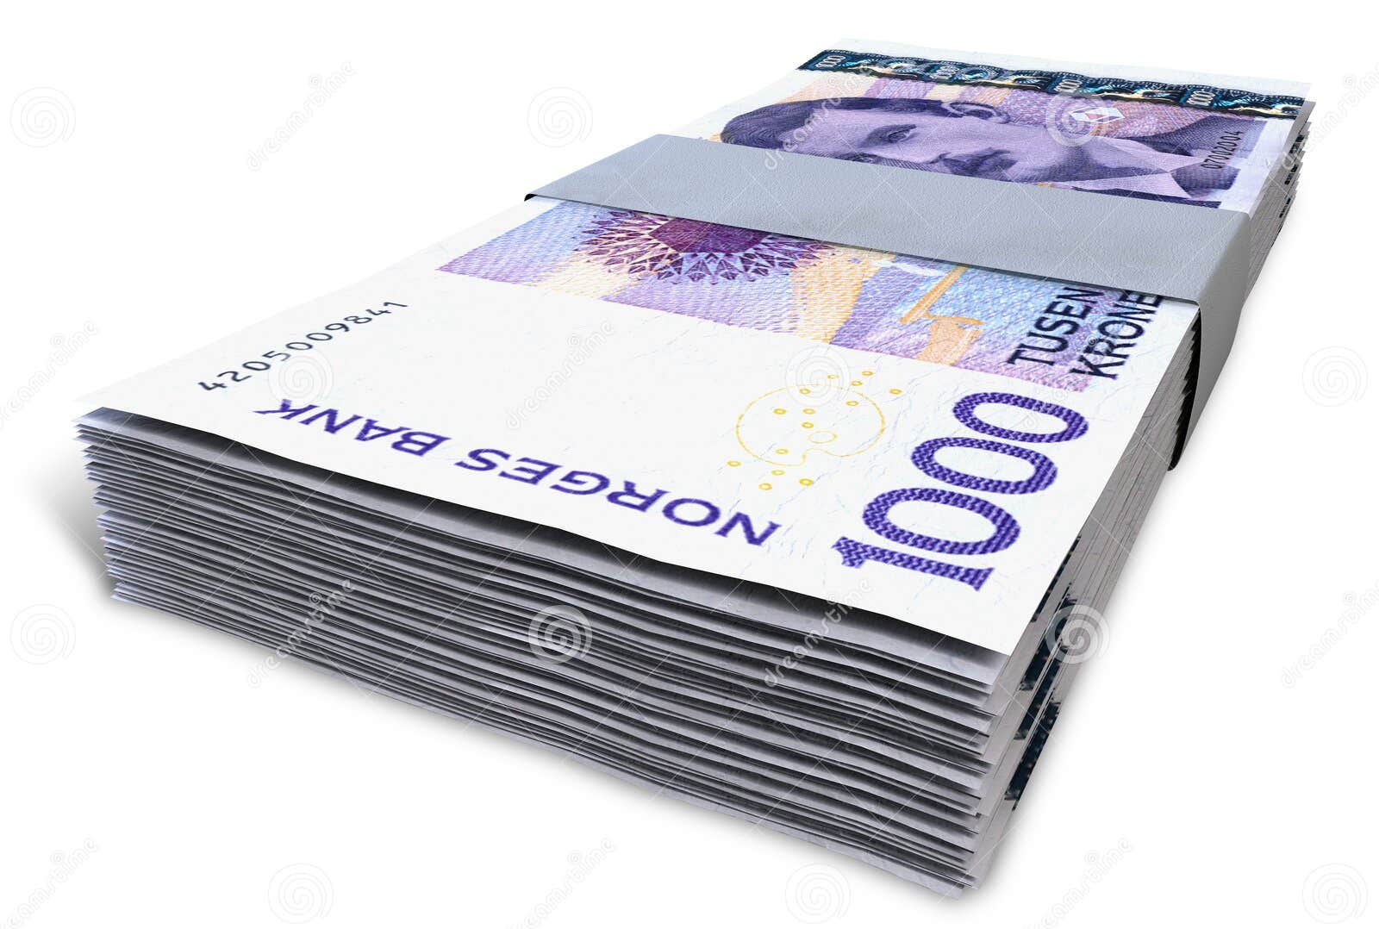
Sudden Death 3
What is the currency of Norway?
Krone

Slide 41
Rotary District 1010
Sample Primary Schools Quiz

