Slide 1
Notes:
Today, over 70 million people are displaced as a result of conflict, violence, persecution, and human rights violations. Half of them are children.
We refuse to accept conflict as a way of life. Rotary projects provide training that fosters understanding and provides communities with the skills to resolve conflicts.
Rotary creates environments of peace
As a humanitarian organization, peace is a cornerstone of our mission. We believe when people work to create peace in their communities, that change can have a global effect.
By carrying out service projects and supporting peace fellowships and scholarships, our members take action to address the underlying causes of conflict, including poverty, discrimination, ethnic tension, lack of access to education, and unequal distribution of resources.

Slide 2
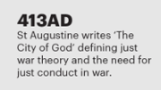
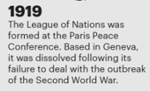
THE ROAD TO POSITIVE PEACE/1
1917
Rotarians adopted a Resolution of Peace as an organizational focus. The resolution called for " a plan of education as to the causes of war".
1921
At the Edinburgh Convention, Rotarians unanimously agreed to incorporate peacemaking into Rotary's constitution and by-laws with these words, "The advancement of international understanding, goodwill, and peace through a world of fellowship of business and professional persons united in the ideal of service."

Slide 3
THE ROAD TO POSITIVE PEACE/2
1940
The Rotary Convention adopted a Resolution that called for "freedom, justice, truth, sanctity of the pledged word, and respect for human rights."
1945
Rotarians served as delegates, advisers and consultants at the UN Charter Conference and the 1940 Resolution was used as a draft for what became the UN's Universal Declaration of Human Rights.
1960s/70s
Development of peace studies and peace theory (Galtung Norway) and positive peace studies. Rotary redefines and broadens its service programme
1999
Establishment of Rotary Peace Centers programme. Bradford opened 2002.
2012
Establishment of Rotarian Action Group for Peace.
2017
Partnership between Rotary International and Institute for Economics and Peace (IEP)

Slide 4
Dr. Johan Galtung promoted the idea that we’re trained to think of peace as reducing or minimizing violence — as taking away the bad. But if you want sustainable [positive] peace, you have to work on promoting the good: creating the conditions of well-being for all. Rotary has been doing this for over 100 years.
The IEP’s Pillars of Positive Peace is a framework of eight factors that research shows work together to make for more peaceful societies. All eight pillars matter — it’s a systemic view — but the IEP advises focusing on which one or two may be the weakest. A focus there can be a basis for the design of any project.

Slide 5
What is Positive Peace?
Notes:
Ask Darren if more intro slides are available/needed

Slide 6
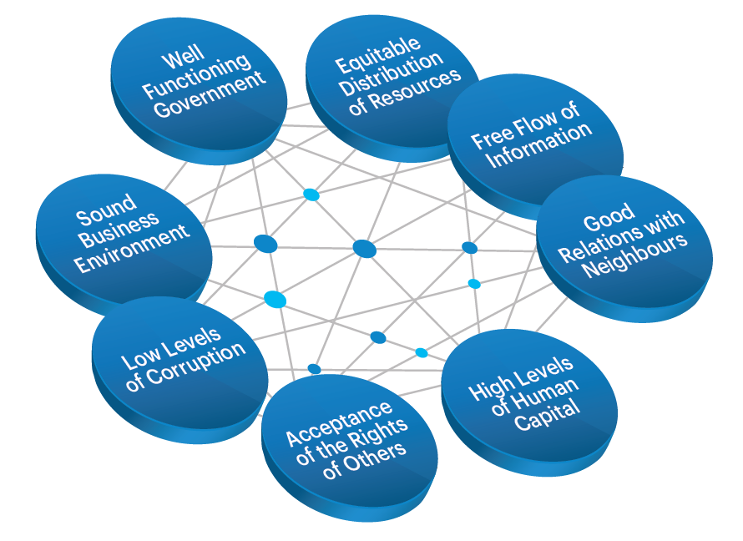
Positive Peace
Positive Peace creates the optimum environment for human potential to flourish.
High levels of Positive Peace are associated with:
Higher per capita income
Resilience
Better environmental outcomes
Higher measure of wellbeing
Better performance on MDGs

Slide 7
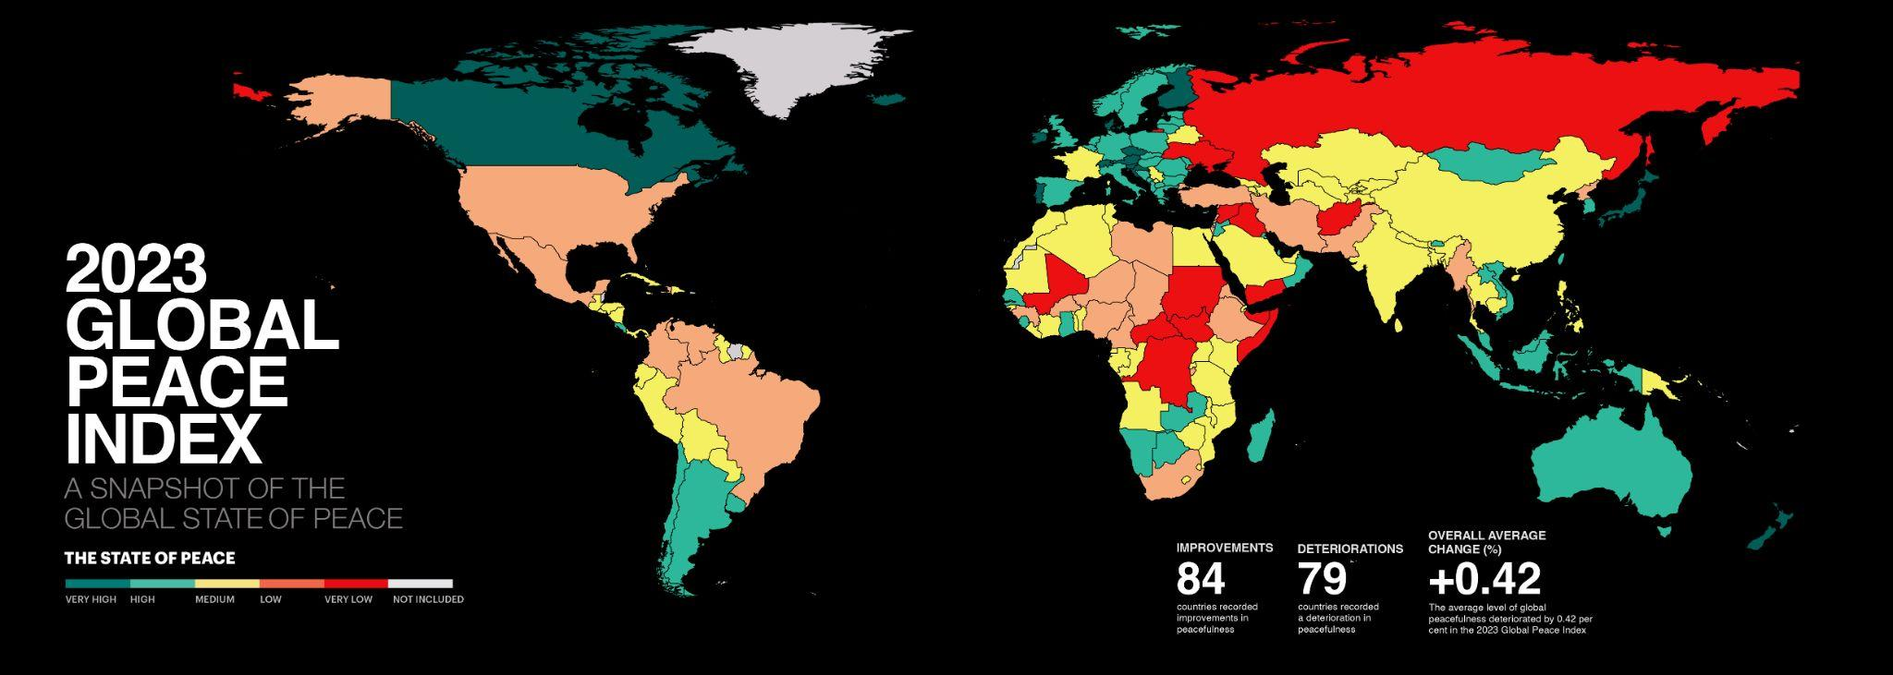

Slide 8
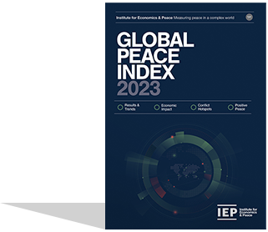
2023 key highlights
Iceland remains as the most peaceful country in the world
Libya and Burundi had the largest improvements
Middle East and North Africa (MENA) improved significantly for the last three consecutive years
Europe remains the most peaceful region, and recorded a slight improvement in the past year

Slide 9
2023 key highlights - continued
Afghanistan remains the world’s least peaceful nation. However, it recorded one of the largest increases in peacefulness
Conflict deaths increased by 96%
Russia and Eurasia recorded the steepest regional deterioration
Six of the nine GPI regions recorded deteriorations

Slide 10
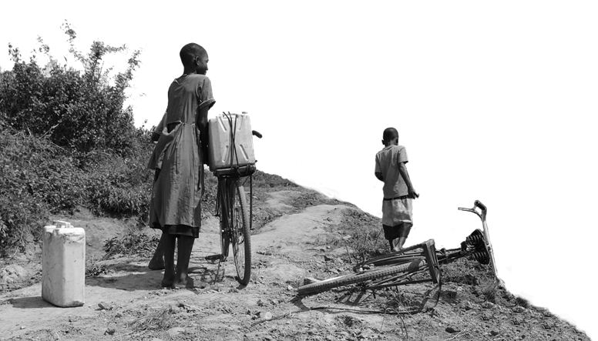
2023 key highlights
The average level of global country peacefulness has deteriorated by
84
countries became more peaceful
0.42%
79
countries deteriorated
This is the 13th deterioration in the last 15 years.
Improvements were driven by changes in:
Terrorism Impact
Political Terror Scale
Military expenditure (% of GDP)
Deteriorations primarily driven by changes in:
External Conflicts Fought
Political Instability
Deaths from Internal Conflict

Slide 11
10 most peaceful countries
1
ICELAND
Rank change:
6
SINGAPORE
Rank change: 4
2
DENMARK
Rank change: 1
7
PORTUGAL
Rank change: 1
3
IRELAND
Rank change: 1
8
SLOVENIA
Rank change: 4
4
NEW ZEALAND
Rank change: 2
9
JAPAN
Rank change:
5
AUSTRIA
Rank change:
10
SWITZERLAND
Rank change: 1

Slide 12
10 least peaceful countries
163
AFGHANISTAN
Rank change:
158
RUSSIA
Rank change: 2
162
YEMEN
Rank change:
157
UKRAINE
Rank change: 14
161
SYRIA
Rank change:
156
SOMALIA
Rank change: 2
160
SOUTH SUDAN
Rank change:
155
SUDAN
Rank change:
159
CONGO, DRC
Rank change:
154
IRAQ
Rank change: 3

Slide 13
5 most improved countries
BURUNDI
LIBYA
Rank: 128
Rank: 137
Rose 6 places
Rose 14 places
OMAN
COTE D’IVOIRE
Rank: 48
Rank: 90
Rose 18 places
Rose 18 places
AFGHANISTAN
Rank: 163
No Change in Rank

Slide 14
5 most deteriorated countries
UKRAINE
Rank:157
Fell 14 places
MALI
Rank:153
Fell 4 places
ISRAEL
Rank:143
Fell 8 places
HAITI
Rank:129
Fell 17 places
RUSSIA
Rank:158
Fell 2 places

Slide 15
GLOBAL PEACE INDEX 2023: rankings
Iceland 1
Denmark 2
Ireland 3
UK 26
France 67
Jamaica 77
Kenya 117
India 126
USA 131
Palestine 134
Pakistan 146
Somalia 156
Ukraine 157
Russia 158
Syria 161
Afghanistan 163

Slide 16
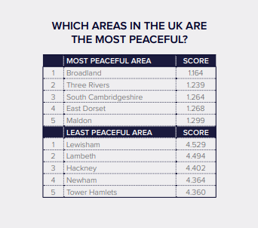
Notes:
2013 data

Slide 17
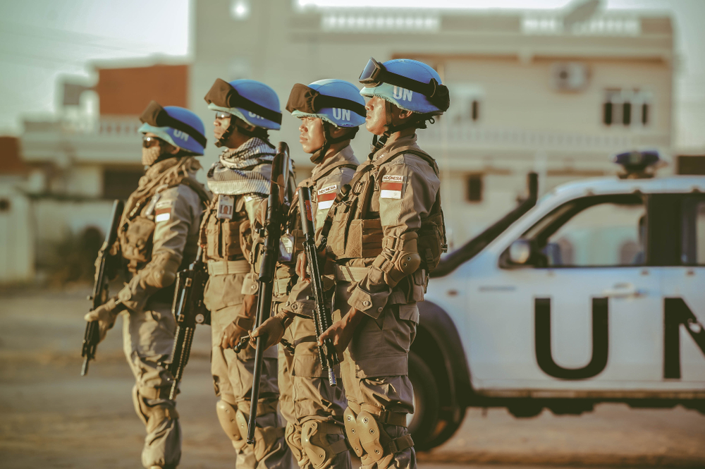
TRENDS IN
PEACE
15 year trends
Improvements & deterorations
Conflict & militarisation trends

Slide 18
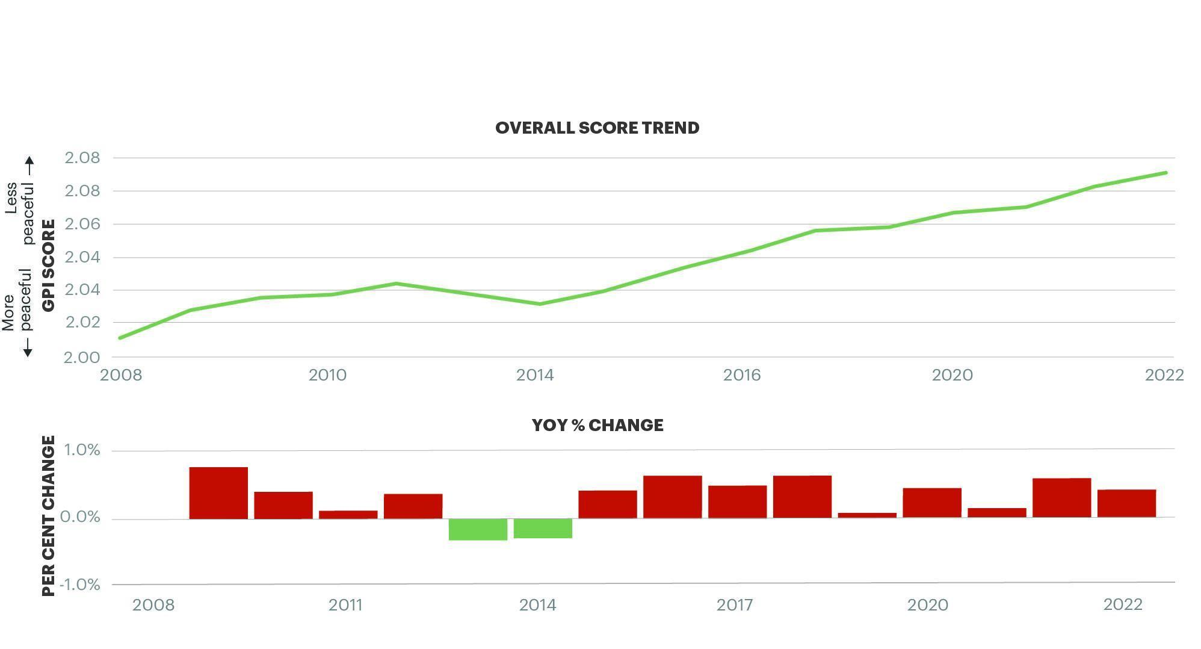
Peacefulness since 2008
Peacefulness has declined year on year for 13 of the last 15 years.
Source: IEP
97 countries deteriorated while 66 improved

Slide 19
Peace over the last 15 years
Militarisation was the only domain to improve since 2008. Ongoing conflict deteriorated substantially since the mid 2010s.
Source: IEP

Slide 20
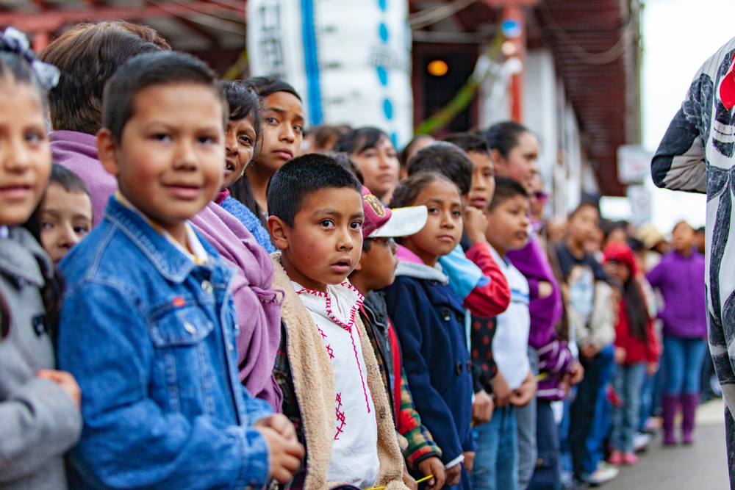
ECONOMIC
VALUE OF
PEACE
Economic impacts
Impact breakdown
Ten year trends

Slide 21
Economic impact of violence, 2022
$17.5
trillion
Which is equivalent to
12.9%
of total world GDP
OR
$2,200
per person
If the world decreased
violence by 10%
$1.75tr
Could be directed to
other economic activities
Notes:
The economic impact of violence was $17.5 trillion PPP in 2022, equivalent to 12.9 per cent of global GDP or $2,200 per person.
The economic impact increased by 6.6 per cent, owing to increases in military expenditure. The economic impact of military expenditure rose by 16.8 per cent in PPP terms.
Ukraine, Afghanistan and Sudan incurred the highest relative economic cost of violence in 2022, equivalent to 63.1, 46.5 and 39.7 per cent of GDP, respectively.
In the ten countries most economically affected by violence, the average economic cost was equivalent to 34 per cent of GDP. In the ten most peaceful countries the average economic cost was 2.9 per cent of GDP.

Slide 22
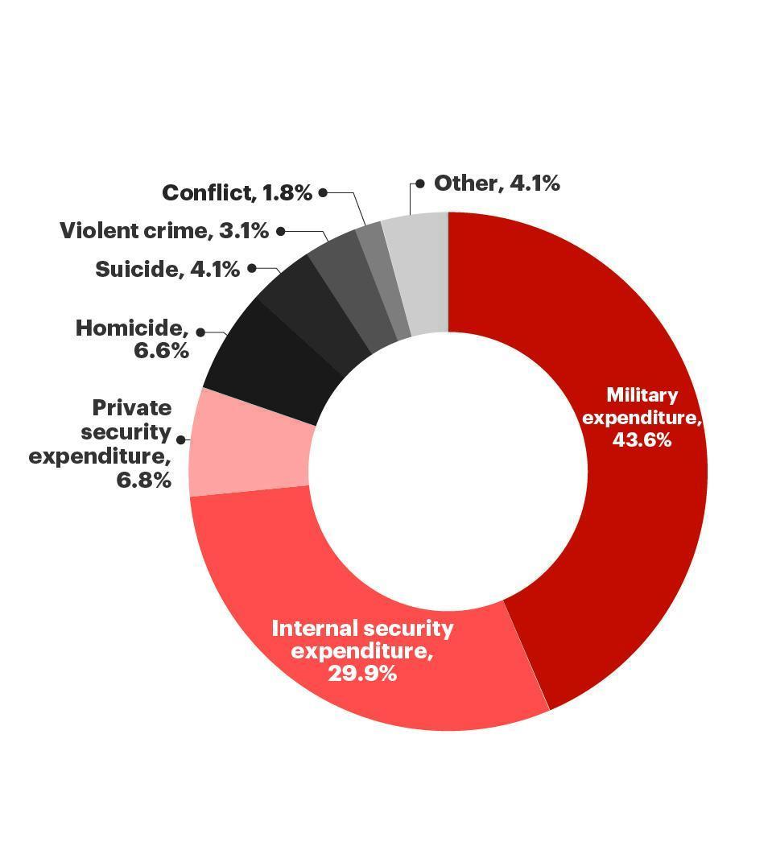
Breakdown of the economic impact of violence
Military and internal security expenditure combined account for almost 75 per cent of the economic impact of violence.
10 most affected countries average GDP loss 34%
10 most affected countries average GDP loss 2.9%
Source: IEP

Slide 25
Some examples of projects where the Positive Peace framework could be used to make a difference in Hounslow are:
• Literacy (reading and ESOL)
• Leadership (in our own club and in local groups.)
• Economic development – encouraging small businesses and investing in community enterprises, improving youth employment.
• Effective and fair community governance.
• Available and reliable information sources for residents and disadvantaged, securing multilingual communications
• Food security (food banks, tackling food waste).
• Community cohesion.
• Sustainable water and sanitation (wasting water, environmental projects, feminine hygiene, incontinence)
• Improved childhood and maternal health – childrens oral health; sponsoring baby changing rooms.
• Reducing knife crime and domestic violence
• Preventing violent extremism

Slide 26
