Slide 1
Agona Swedru School Ghana
History of involvement with the school from 2017 to 2024 culminating in the building of the
Rotary District 1070 Science Laboratory and STEM resource centre

Slide 2
History and background
Alfred Hanson as a child was a pupil at the school and on his retirement and subsequent return to his home town in 2016 was distressed to find the school in a poor state of repair and with limited resources for teaching skills for the 21st Century.
He met with Paul Bertin with whom he had worked in the NHS and together they began to plan how they might do something about it. These plans became clearer after Paul visited the school in January 2017. Starting small with fixing the buildings to build trust and confidence before moving on the bigger builds.

Slide 3
Agona Swedru School
There are approx. 800 pupils aged from 4 to 15. The IT suite and the new Laboratory will be used by children aged 10 to 15.
There are five other schools in close proximity with another 3300 pupils, none of which have an IT suite or science Laboratory.
Both buildings are open for an extended school day to allow all schools to use it.
Previously science was taught from text books. The temporary facility ( in an existing classroom) enhanced that teaching with some practical experience, and the new purpose built classroom has taken teaching to a whole new level.
Teachers are provided via a national service scheme, in which graduates work in the school.

Slide 4
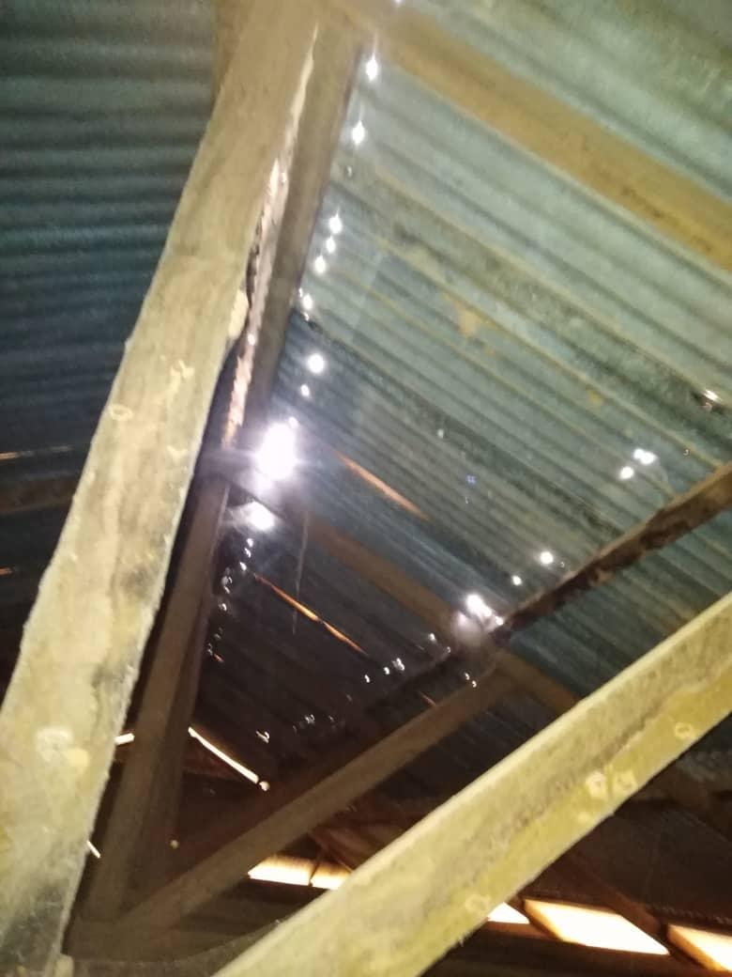

Slide 5
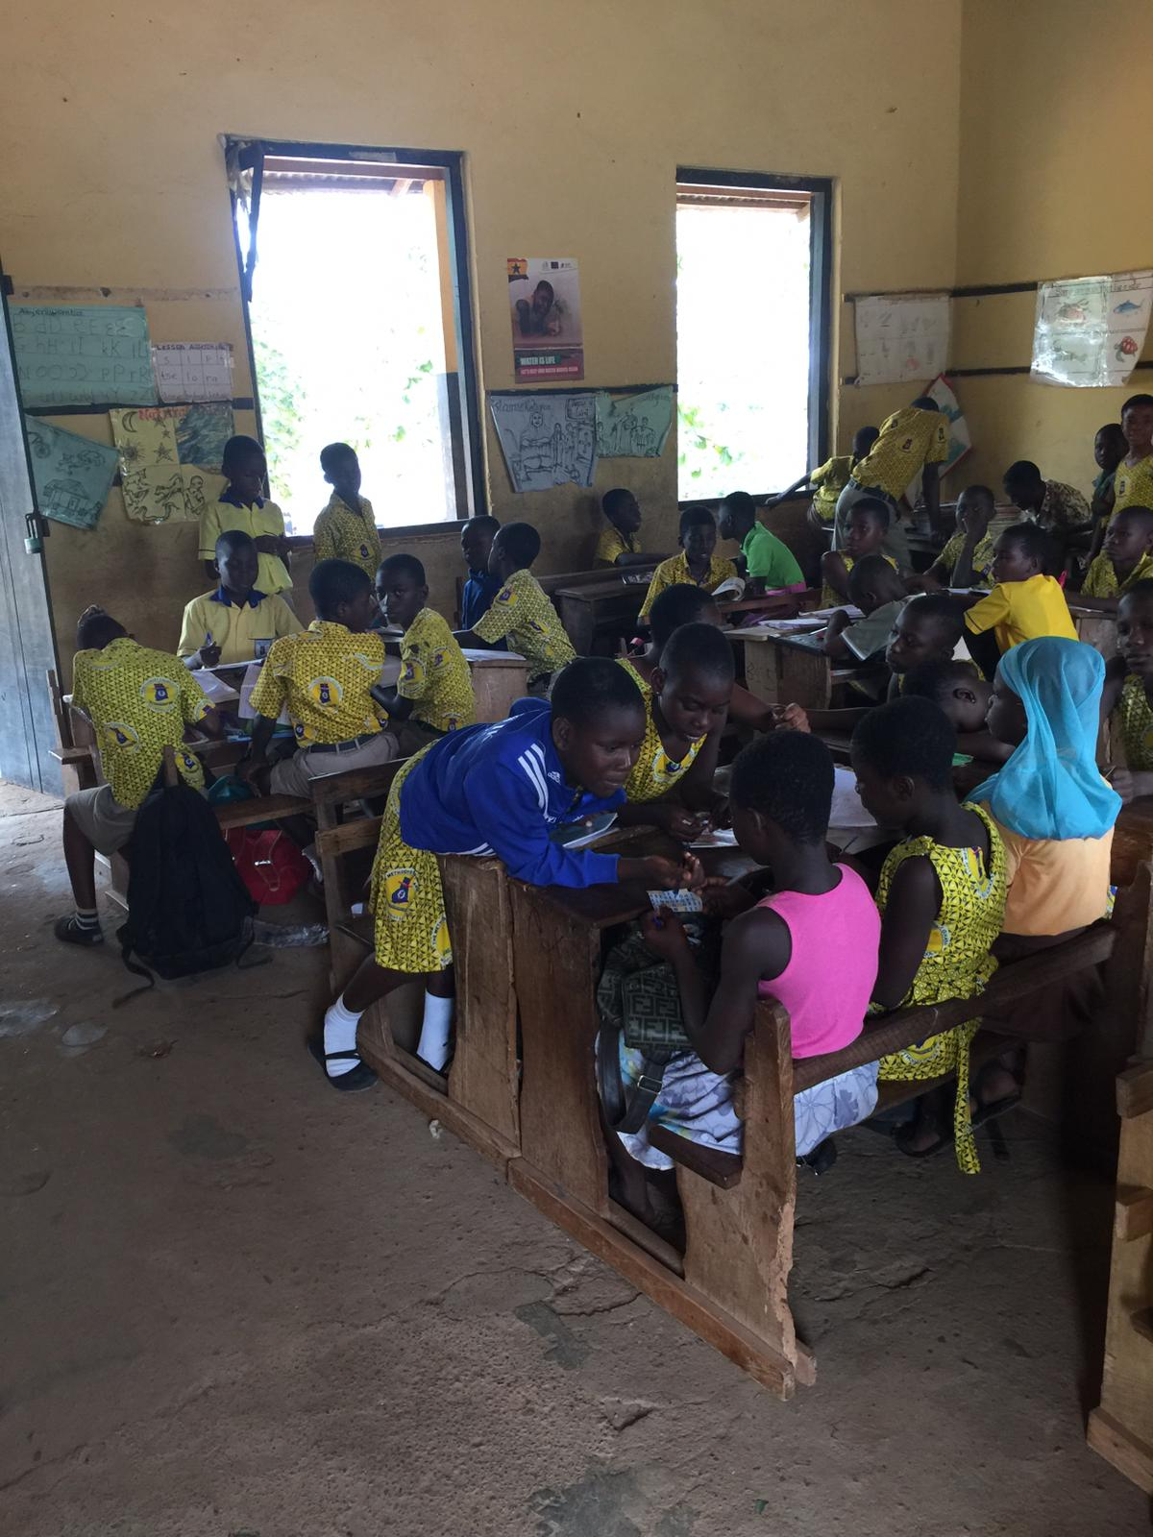

Slide 6
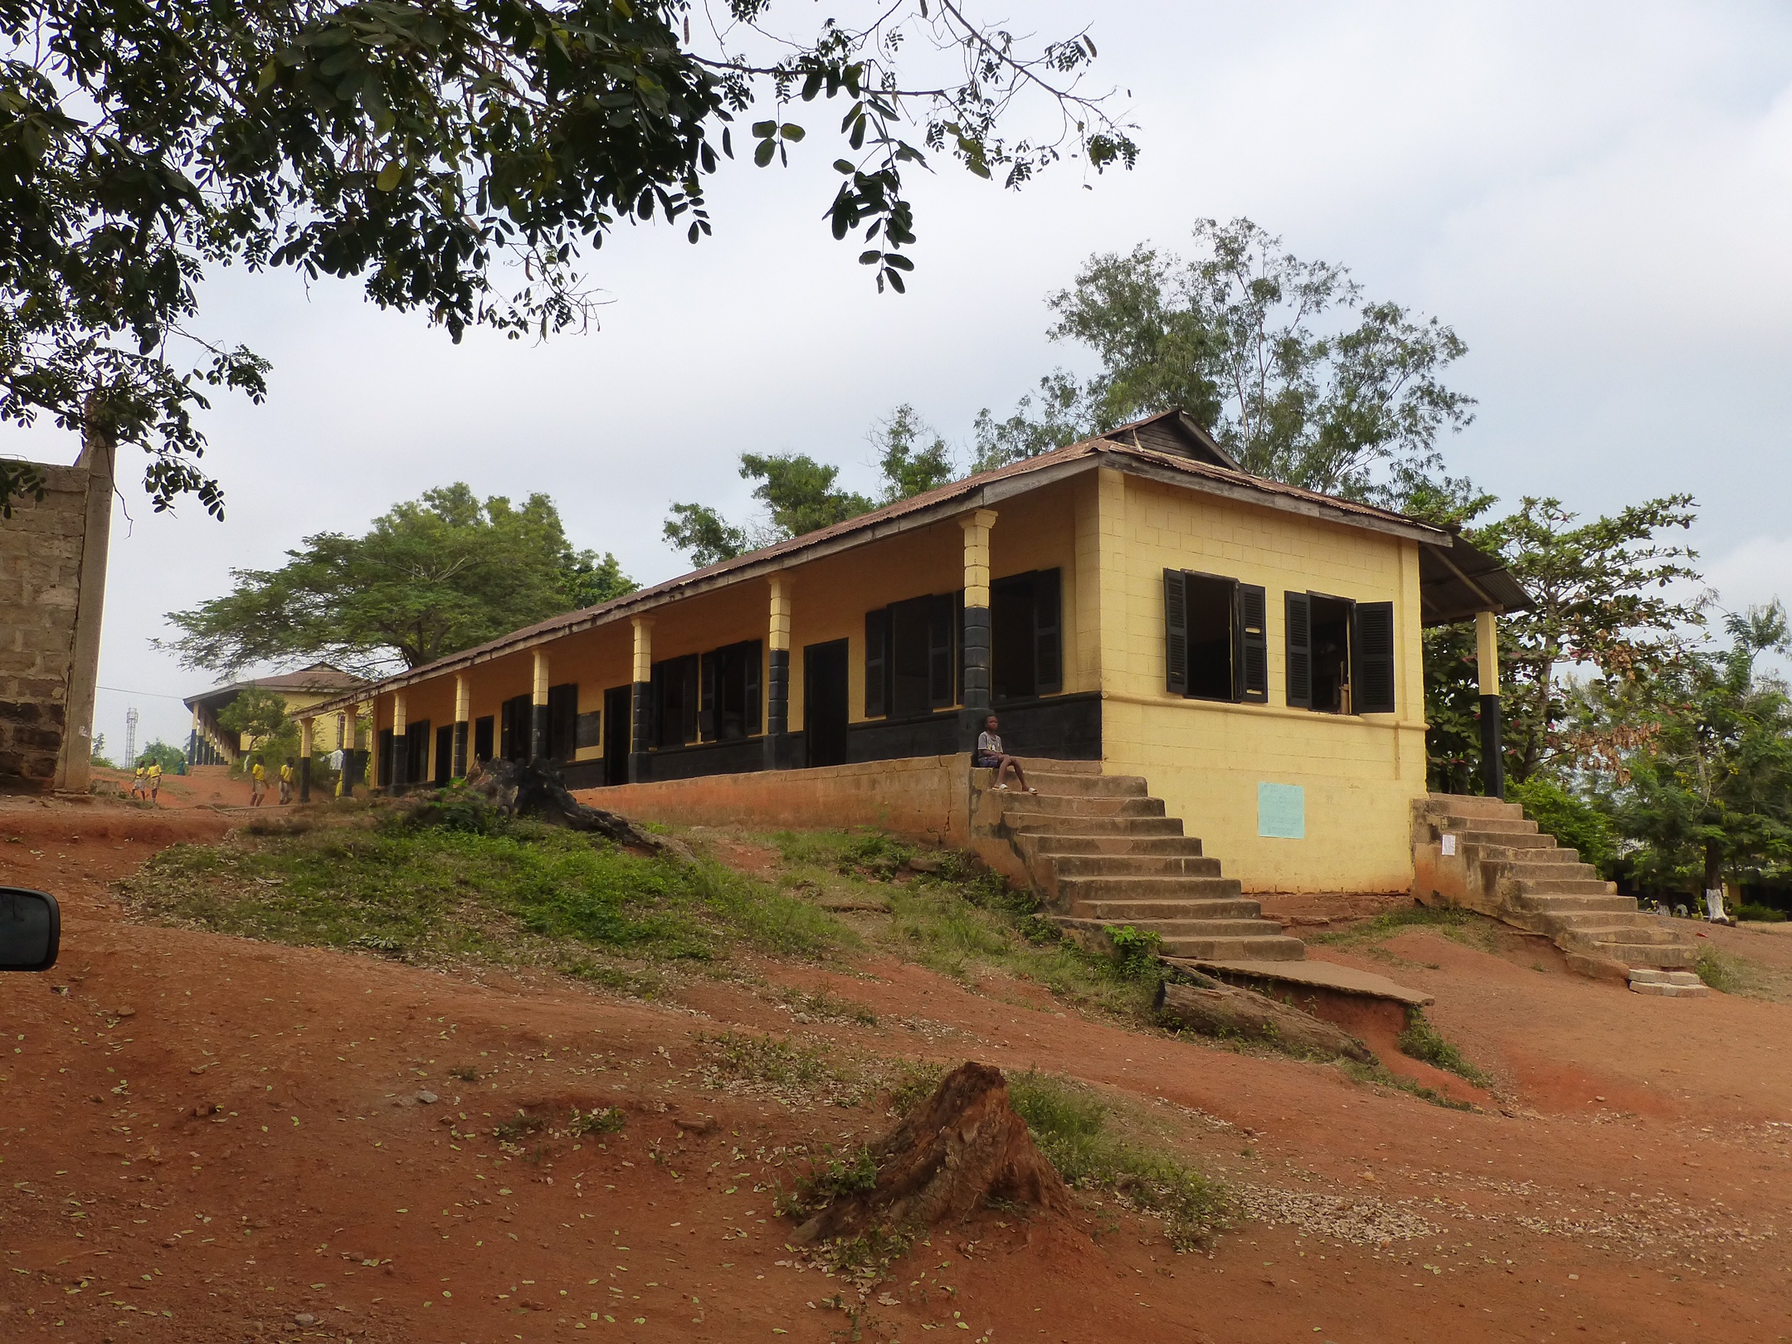

Slide 7
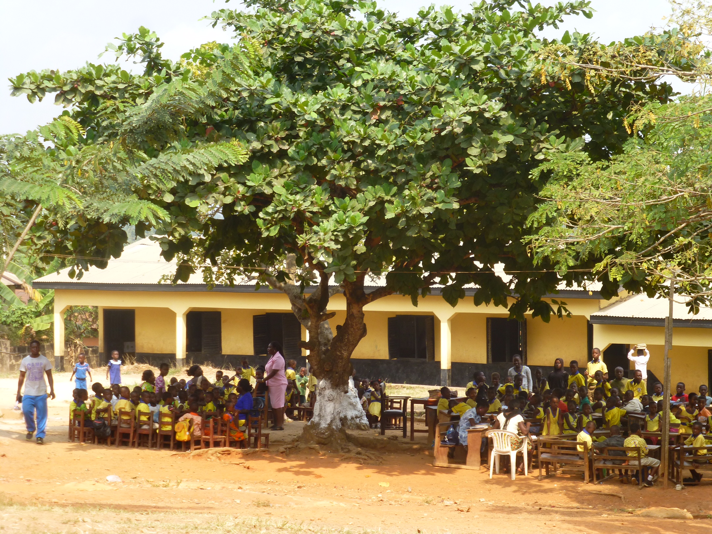

Slide 8
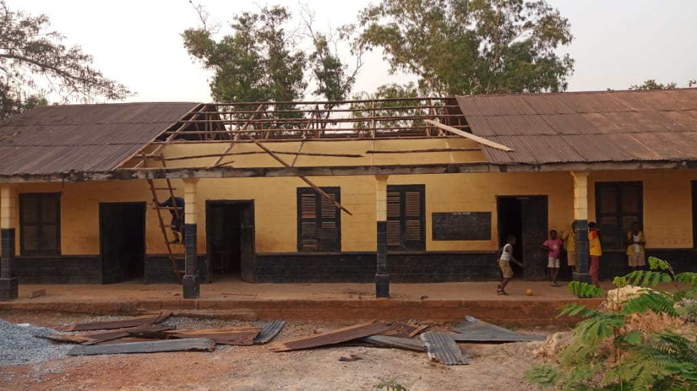

Slide 9
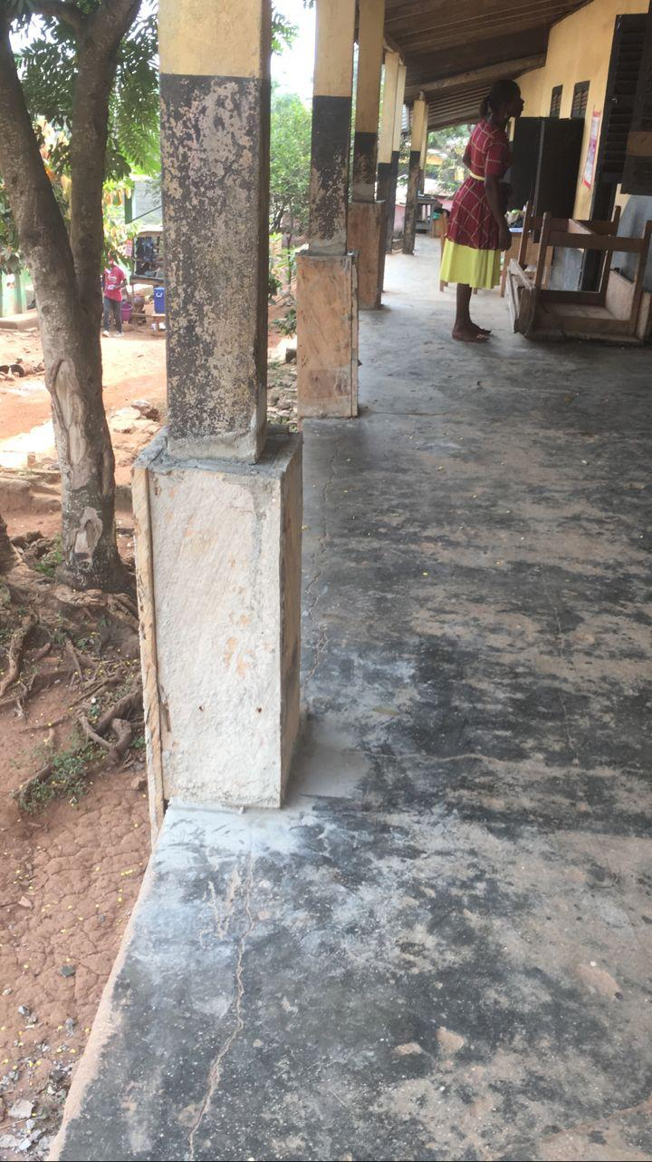

Slide 10
Since then
Close working contacts have been established with the local management committee and we have had complete visibility and oversight of the work being done.
Since 2017, Kettering Huxloe with support from Kettering have built and fully equipped an IT suite with full internet access.
This has enabled pupils of the school to enhance their general education and some have gone on to win national prizes for IT skills.
A new classroom and meeting room for the head teacher and staff has been built.

Slide 11
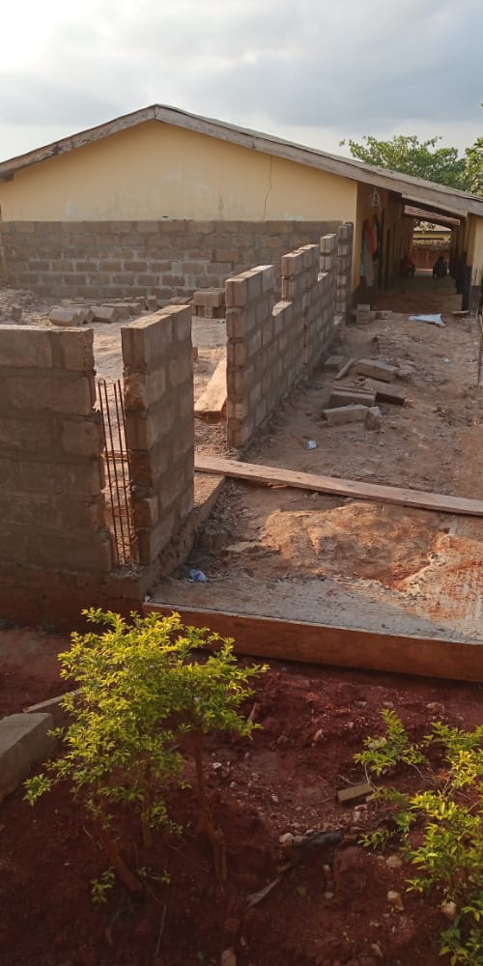

Slide 12
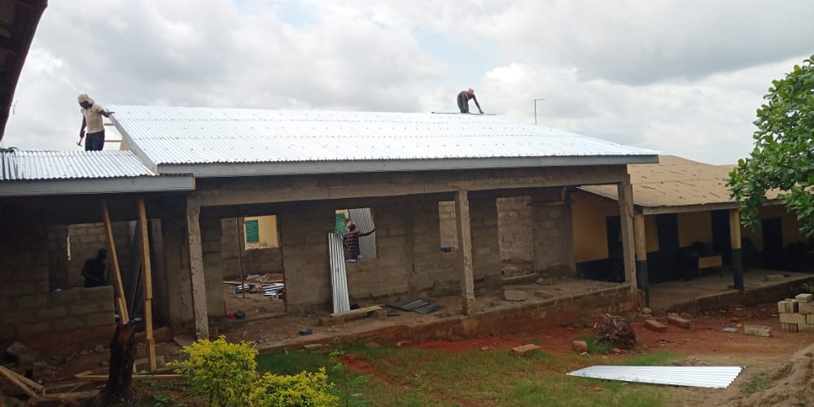

Slide 13
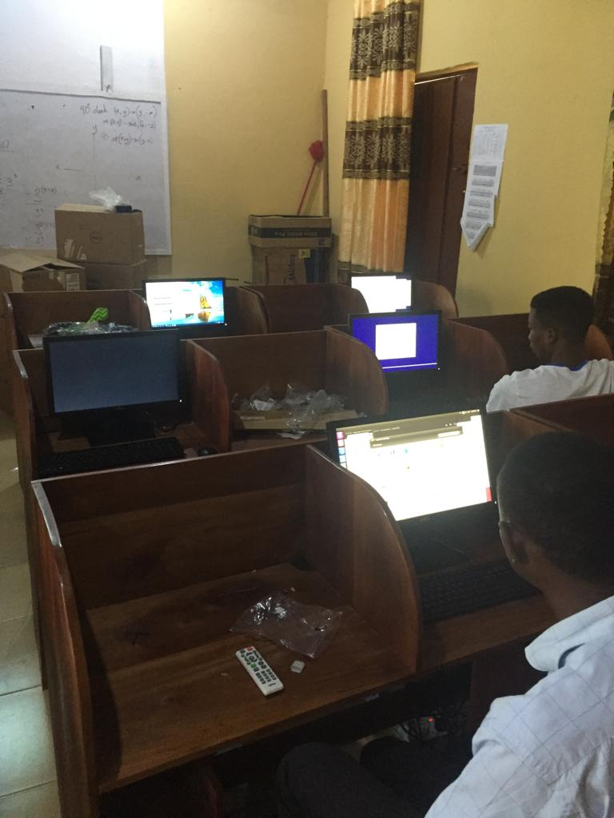

Slide 14
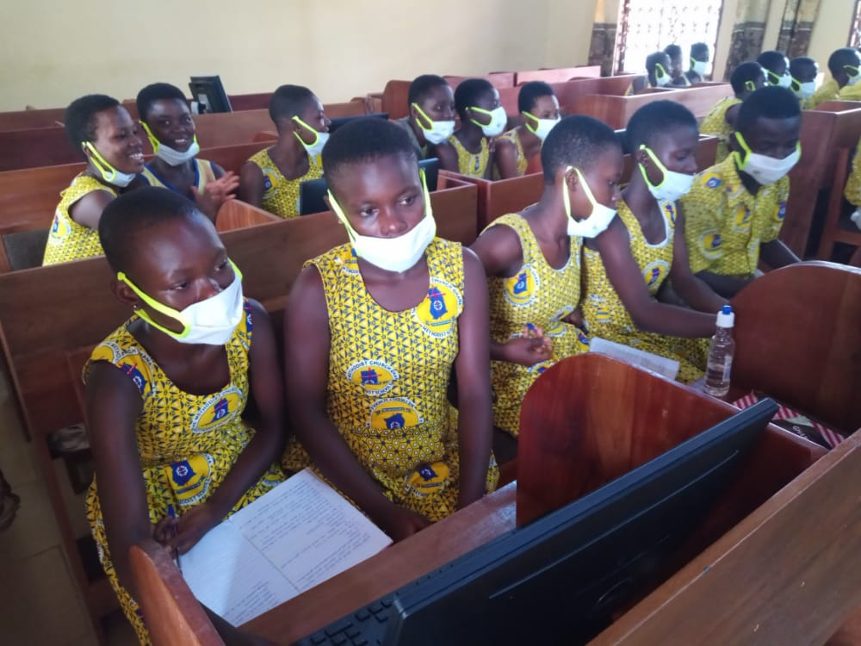

Slide 15
STEM (Science, Technology, Engineering, Mathematics) education in Ghana
The below are quotes from a paper by the local government education authority.
Government of Ghana has STEM education at the heart of the new educational reform which is being implemented and the Ministry of Education and Ghana Education Service is poised to ensure full implementation STEM.
The effective implementation of STEM education requires relevant resources such as technological tools, robotics, science laboratory, IT tools etc. to make instructions practical base and child centered
The establishment of Science Laboratory at the Methodist Basic school to serve cluster of schools by Rotary Club, UK coordinated by Mr. Hanson has further boosted the science practical lesson in the beneficiary schools.
The establishment of STEM Laboratory in the Agona West Municipality will be the first of its kind in the Central Regional of Ghana and will be the major STEM Resource Centre for all the schools in the Municipality to enhance practical lessons since none of the schools in the Municipality has science laboratory.

Slide 16
Finance (Building)
In Q3 2022 the cost of the building was estimated at £25K. Since that time increases in the cost of materials have been significant and even with the improvement in the Pound/Ceti exchange rate the cost rose to £27270 in May 2023. A further improvement in exchange rate puts the costs back to just over £25K. The work was completed in May 2024 ahead of time and on budget.
We had pledges totalling £8K from clubs in the district, and our application for matching funds from district was approved in Q4 2023 giving a total of £16K.
A further £2K from Kettering Huxloe, and £7K from other clubs and individual Rotarians giving us a total of £25K.
School Alumni who have gone on to make successful careers around the world have been approached to support the school. The pledges from these individuals would have been sufficient to cover any cost overrun should it have happened. This money will now be donated to the Trust fund.
NOTE: as part of the work to date a Trust Fund has been established for the school which will provide monies going forward to ensure that the project is sustainable with all school buildings, including the science laboratory being properly maintained.

Slide 17
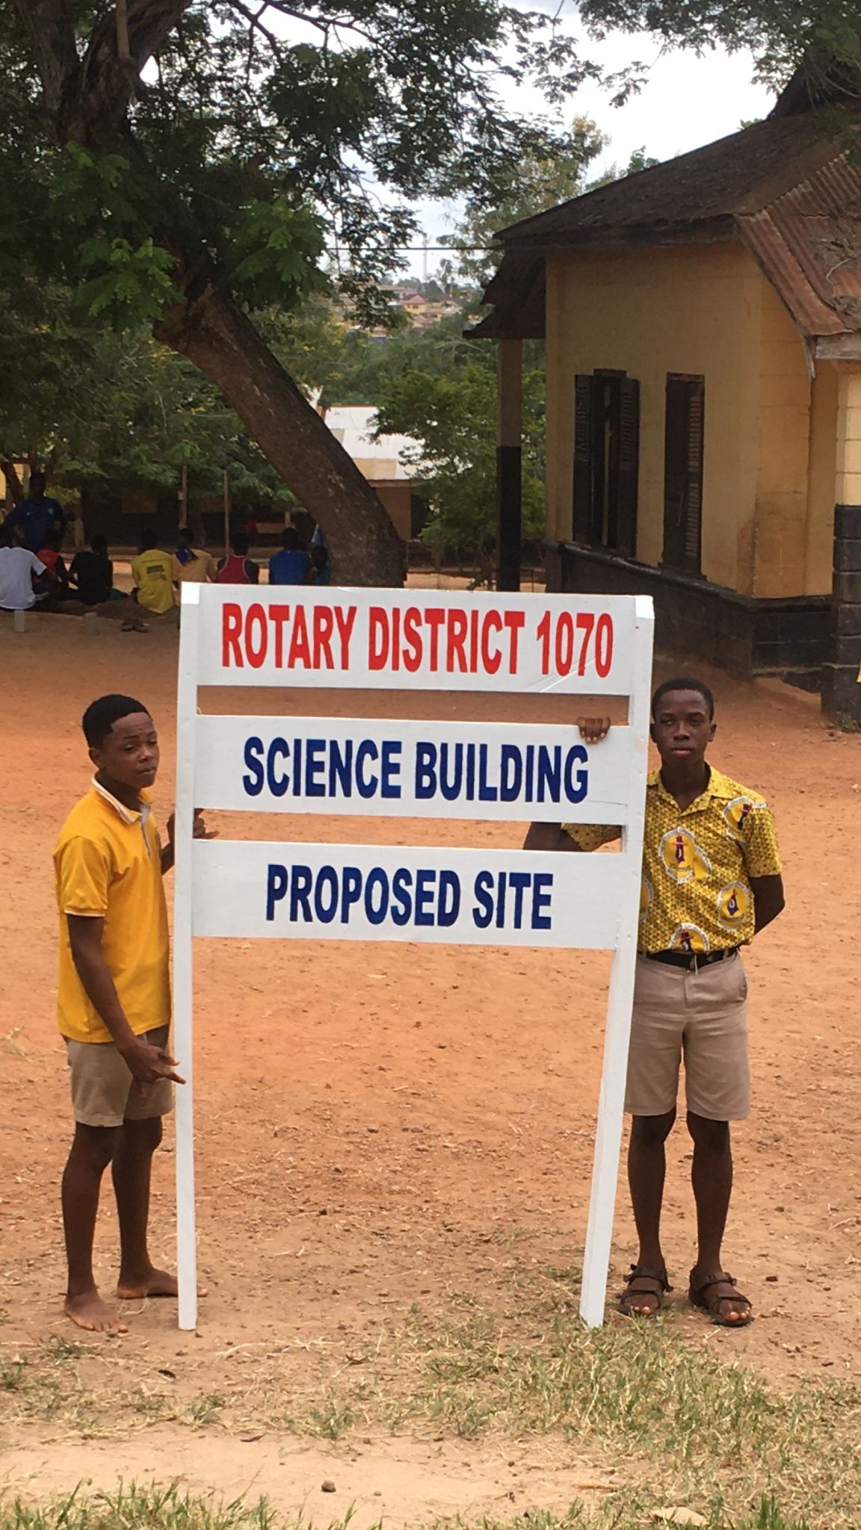

Slide 18
Finance (Equipment)
With the help of a 2022/23 District grant of £2K, and £2K from Kettering Huxloe, the school has purchased a good range of science equipment, materials and furniture for the new laboratory.
Until the lab was built, these items were being used to a limited extent in an existing classroom, 50% of which has to be kept clear for other classes. This has now been transferred into the new building.
A number of clubs and individual Rotarians have made donations towards the project but are not part of the Multi club district grant application, and this money, along with a donation from a local church in Northamptonshire, will be used to further enhance the science equipment in the new building.

Slide 19
The official opening with the Local Chief 5th June 2024

Slide 20
The visiting team of Rotarians with Alfred Hanson

Slide 21
A warm welcome

Slide 23
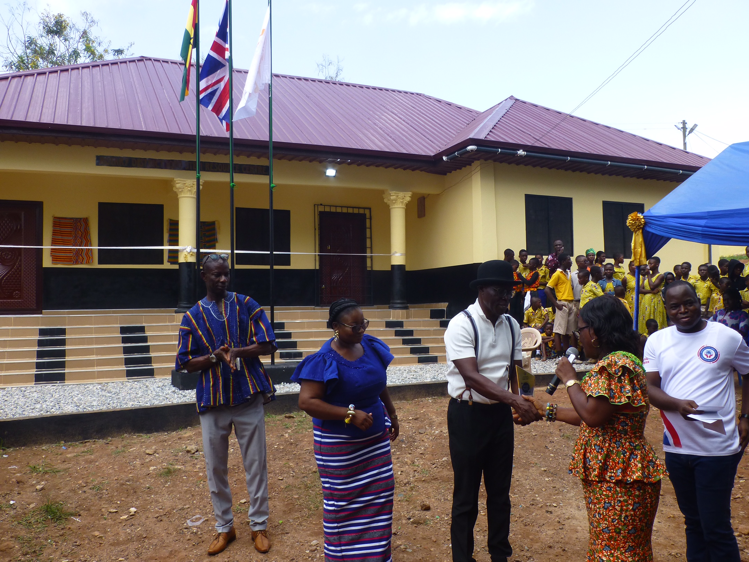

Slide 24
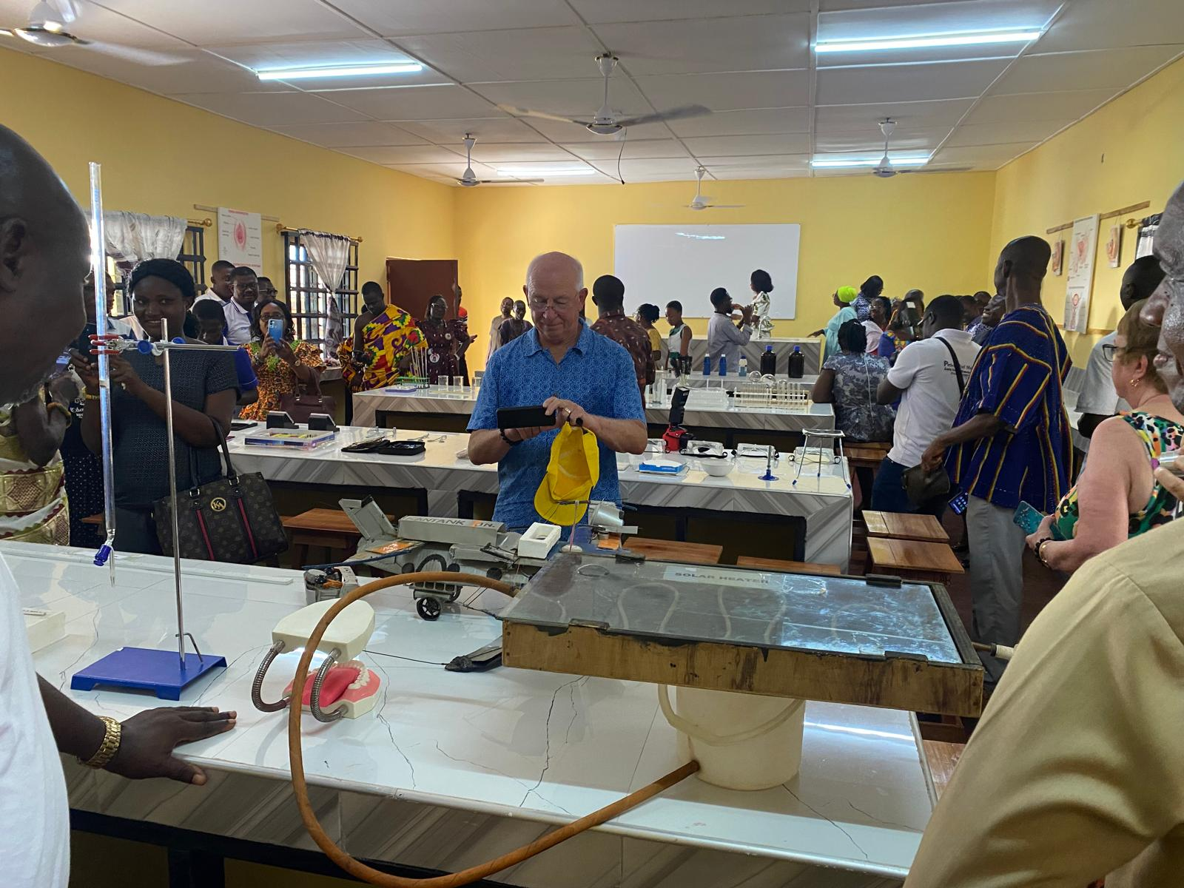

Slide 25
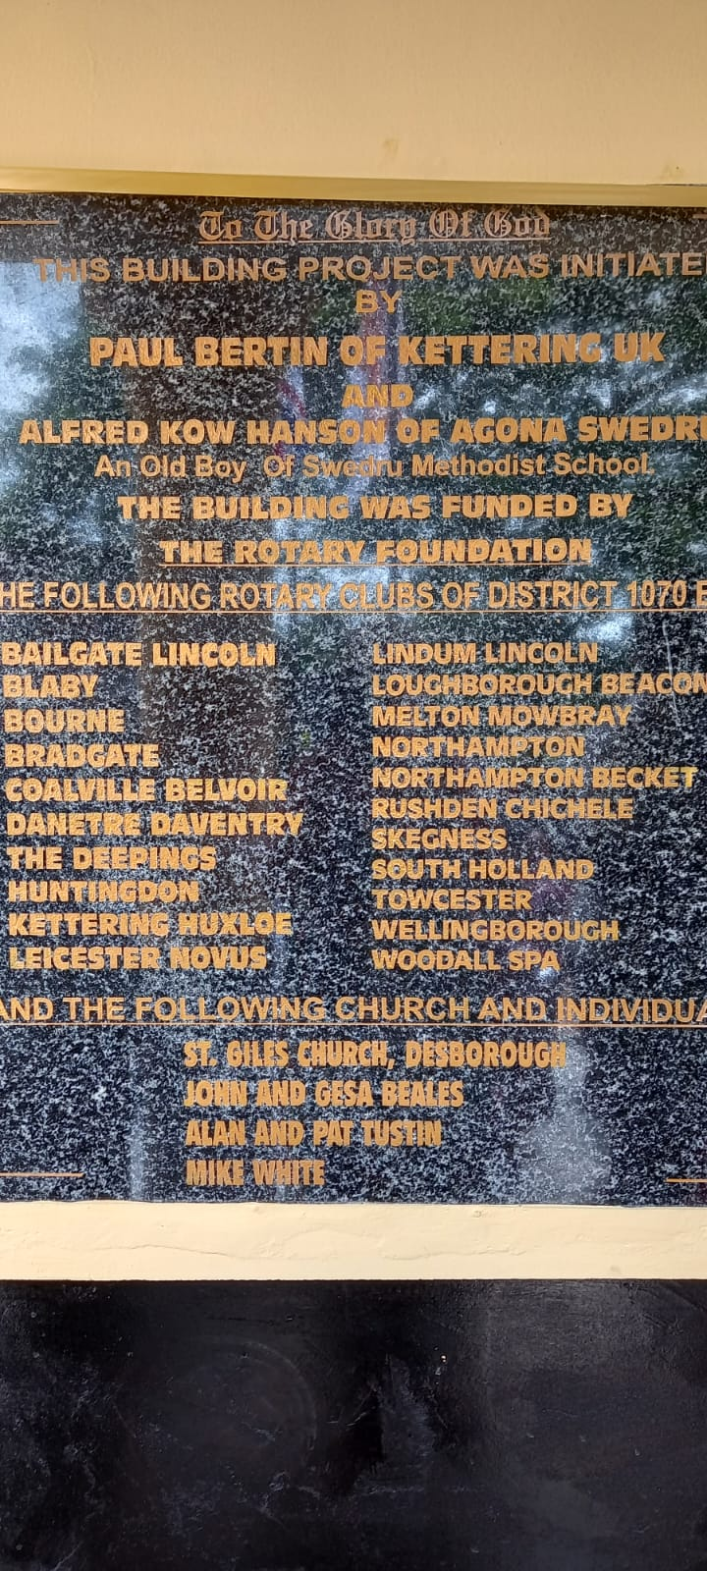

Slide 26
Presentation of the Citation to Rotary district 1070

Slide 27
The Citation awarded to Rotary District 1070

Slide 28
A joyful day because It’s all about the children

Slide 29
What Next?
Now that the Science laboratory, STEM centre has been built and equipped we believe that we have completed the process of making the school a centre of learning excellence, which will not only benefit its own pupils but also pupils of other schools in the vicinity.
The Trust fund will ensure that the both buildings and equipment is properly maintained and updated when necessary.
We will continue to work with the school and to monitor the progress of pupils to measure the impact of the new facility.

Slide 30
Thank you for your support

