Slide 1
COP26 – What it is and why
Jill Duggan,
Executive Director,
Environmental Defense Fund Europe

Slide 2
Contents
1. Evidence
2. History of COP
3. What can we expect from COP26?

Slide 3
1. Evidence
“Scientific evidence for warming of the climate system is unequivocal.”
- Intergovernmental Panel on Climate Change

Slide 4
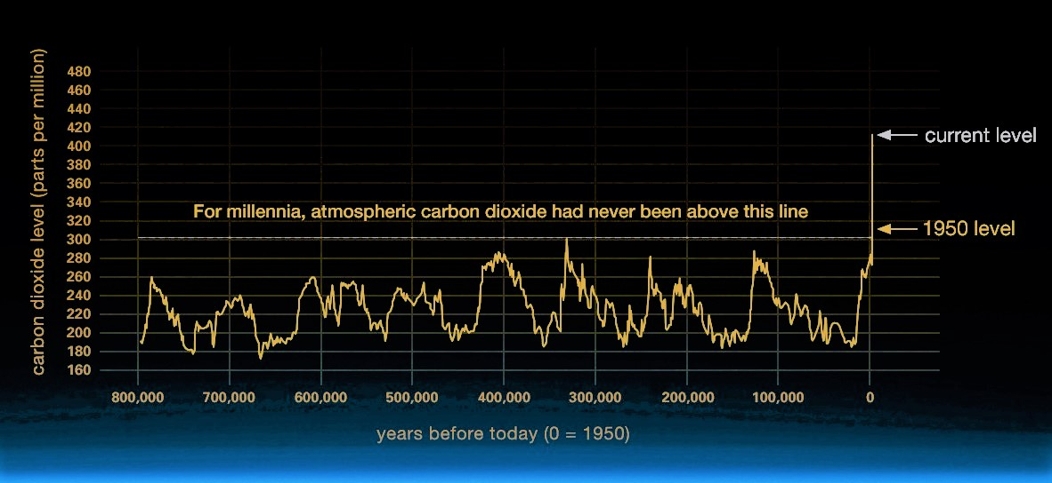
Climate Change: How Do We Know?
There has been a substantial increase of atmospheric CO₂ between 1950- 2021
Source: Nasa
https://climate.nasa.gov/evidence/
Notes:
That all changed starting in the 1850s with massive deforestation around the world. Then in the 1950s, a dramatic increase in the burning of fossil fuels — coal to make electricity and steel, oil for vehicles and manufacturing

Slide 5
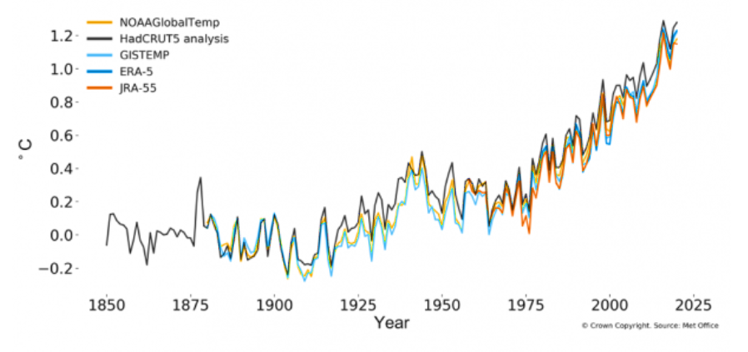
Global Mean Temperature Change From Pre-industrial Levels
Comparing projected temperatures with those of 1850-1900 shows a clear rise.
"What it means is that we're approaching 1.5 °C - we're not there yet but we're getting close… Time is running out for the strong action which we need now.“
- Leon Hermanson (Senior Met Office scientist)
Source: Met Office
The World Meteorological Organization
Notes:
https://public.wmo.int/en/media/press-release/2020-was-one-of-three-warmest-years-record
https://www.bbc.co.uk/news/science-environment-57261670

Slide 6
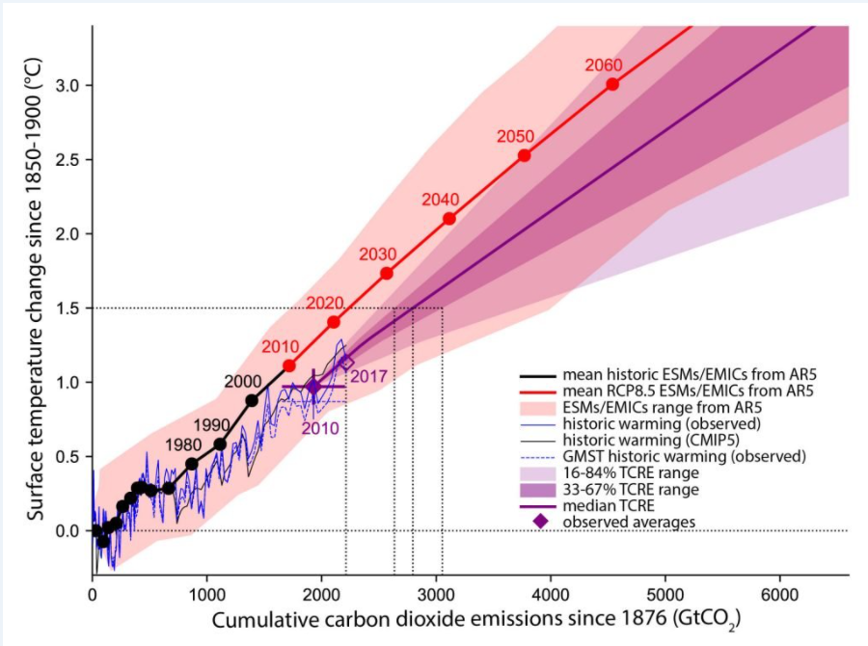
Temperature changes from 1850–1900 versus cumulative CO₂ emissions since 1876
Source: IPCC
Notes:
https://www.ipcc.ch/sr15/chapter/chapter-2/2-2/2-2-2/2-2-2-1/figure-2-3/

Slide 7
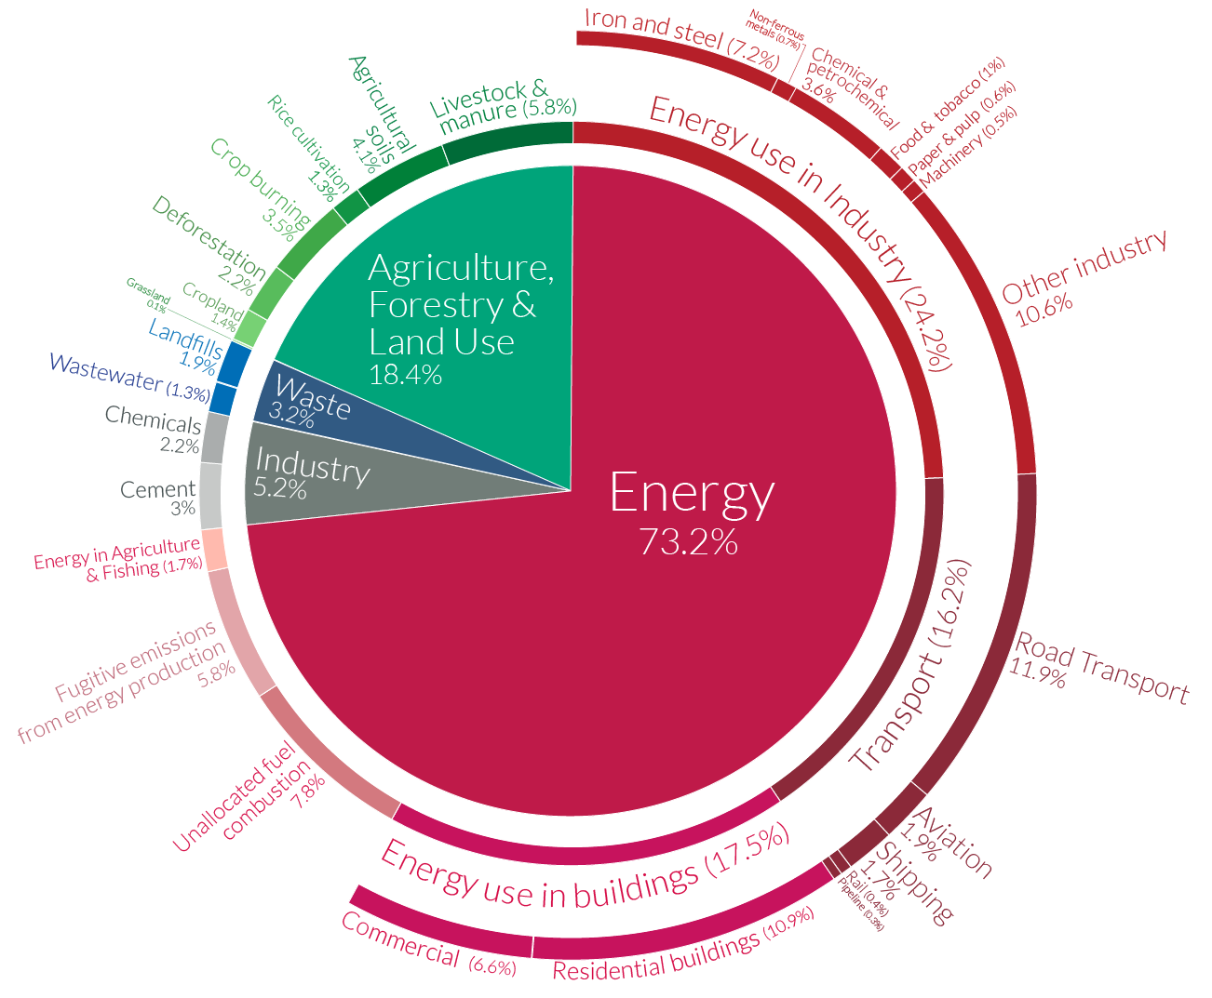
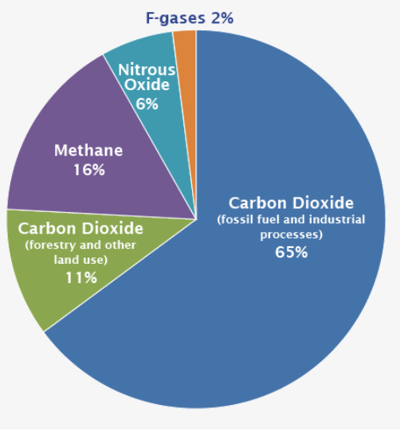
Global Greenhouse Gas Emissions by Gas and Sector
Source IPCC
Details about the sources included in these estimates can be found in the Contribution of Working Group III to the Fifth Assessment Report of the Intergovernmental Panel on Climate Change
Source: Climate Watch, the World Resources Institute (2020)

Slide 8
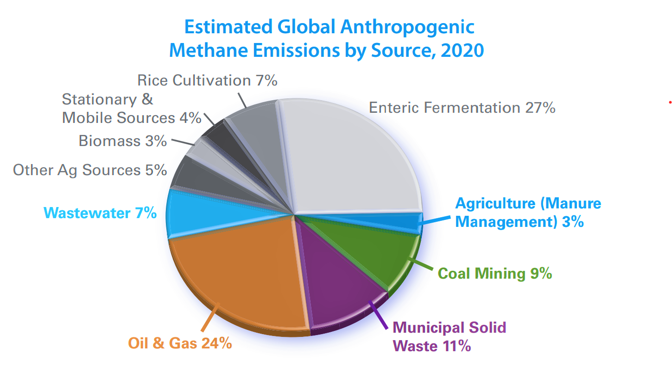
Methane: Global Warming Potential
Methane has more than 80 times the warming power of carbon dioxide over the first 20 years after it reaches the atmosphere.
Although CO₂ has a longer-lasting effect, methane sets the pace for warming in the near term. At least 25% of today's warming is driven by methane from human actions.
Video from Nasa: https://climate.nasa.gov/climate_resources/225/video-methane-sources/
Notes:
https://www.globalmethane.org/documents/gmi-mitigation-factsheet.pdf

Slide 9
Global Warming: Potential Impacts and Associated Risks
There are significant differences in regional climate characteristics between global warming of 1.5°C compared to 2°C.
Ocean – Sea Level Rise
Climate – Hot Extremes
Rain – Heavy Precipitation
Drought – Precipitation Deficits
A slower rate of sea level rise enables greater opportunities for adaptation in the human and ecological systems of small islands, low-lying coastal areas and deltas
Climate-related risks to health, livelihoods, food security, water supply, human security, and economic growth are projected to increase with global warming of 1.5°C and increase further with 2°C.
Limiting global warming to 1.5°C limits risks of increased heavy precipitation events on a global and regional scale compared to 2°C. Including tropical cyclones
Land – Biodiversity Threats
Impacts on biodiversity and ecosystems (e.g., species loss and extinction), are lower at 1.5°C
Limiting global warming to 1.5°C will lower the impacts on terrestrial, freshwater and coastal ecosystems and to retain more of their services to humans
By 2100, global mean sea level rise is to be 0.1 metre lower at 1.5°C compared to 2°C
Regions most at risk have high-latitude or are mountainous
Risks associated with increases in drought frequency and magnitude are projected to be substantially larger at 2°C than at 1.5°C in the Mediterranean region.
Notes:
https://www.ipcc.ch/site/assets/uploads/sites/2/2019/06/SR15_Full_Report_High_Res.pdf

Slide 10
Intergovernmental Panel on Climate Change (IPCC)
Created in 1988 by the World Meteorological Organization (WMO) and the United Nations Environment Programme (UNEP)
To provide governments “at all levels with scientific information that they can use to develop climate policies.” IPCC reports key input into international climate change negotiations.
The IPCC is an organization of governments that are members of the United Nations or WMO. The IPCC currently has 195 members.

Slide 11
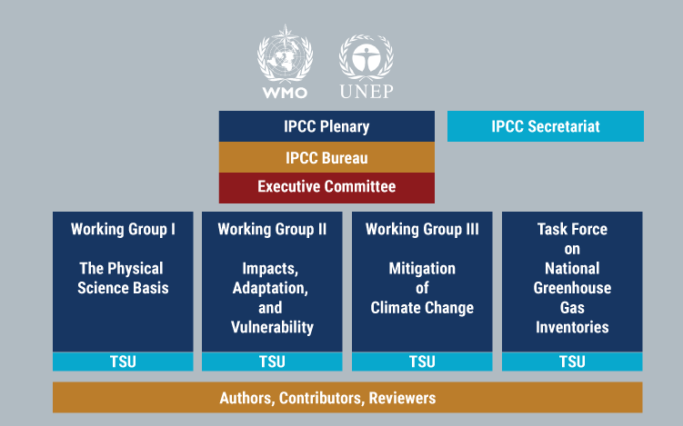
Structure of the IPCC
More Information: https://www.ipcc.ch/working-groups/
Notes:
More Information: https://www.ipcc.ch/working-groups/

Slide 12
2. The History of COP (Conference of Parties)
“We called for strong ambition, for remarkable partnerships, for mobilization of finance, and for implementation of national climate plans.
Paris delivered. Now the job becomes our shared responsibility.”
- Jim Yong Kim
(World Bank Group President)

Slide 13
History of COP
The United Nations Framework Convention on Climate Change (UNFCCC) entered into force in March 1994. It has been ratified by 197 countries (called State Parties)
COP takes place each year in November or December. This year is the 26th COP (was planned for 2020)
At COPs, parties negotiate protocols and agreements to push progress on tackling climate change. The most significant of these were:
The Kyoto Protocol:
1997, entry into force 2005
Set targets for the then ‘developed’ or so-called Annex 1 Nations
Introduced the option to trade emissions reductions between developed nations and ‘developing’ or non-Annex 1 Countries (who did not hold targets)
The Paris Agreement:
2015
Set a global ambition to keep post-industrial temperature increases to below 2°C – and to aim for an increase of just 1.5°C
Parties agreed to offer up their ‘Nationally Determined Contributions’ (NDCs) of what they would do to tackle the climate crisis
The Agreement, recognizing that action needs to be accelerated, set out a series of stock takes and ratchets of ambition every 5 years
Notes:
https://www.metoffice.gov.uk/weather/climate/cop/what-is-cop

Slide 14
The Importance of the Paris Agreement
COP21 took place in Paris in 2015.
For the first time every country agreed to work together to limit global warming to well below 2°C and aim for 1.5°C; to adapt to the impacts of a changing climate; to make money available to deliver on these aims.
Under the Paris Agreement, countries committed to bring forward national plans setting out how much they would reduce their emissions – known as Nationally Determined Contributions (NDCs).
They agreed that every five years they would come back with an updated plan to reflect their highest possible ambition at that time – the first of these is COP26.
Notes:
https://ukcop26.org/uk-presidency/what-is-a-cop/

Slide 15
3. What can we expect from COP26?
“Some people have said that COP is a large gathering of people without much progress, but I feel much more optimistic.
The fact that international communities and governments are coming together demonstrates that this really is at the top of their agenda, and with climate change growing and with the evidence of the impacts of climate change growing, this collaboration is really needed, and it is really timely.”
- Albert Klein Tank
(Scientific Director of the Met Office Hadley Centre)
Notes:
What COP26 is/ its goals source: official website https://ukcop26.org

Slide 16
Why is COP26 Important?
COP26 is the first opportunity for closing the gap between the Paris Agreement ambition and the actual offers of countries at that time.
The commitments laid out in Paris did not come close to limiting global warming to 1.5°C, and the window for achieving this is closing.
The decade out to 2030 will be crucial.
Countries must go much further to keep the hope of holding temperature rises to 1.5°C alive. COP26 needs to be decisive.
Notes:
https://ukcop26.org/uk-presidency/what-is-a-cop/

Slide 17
COP26 Goals (1)
1. Secure global net zero by mid-century and keep 1.5 degrees within reach
Countries are asked to create ambitious 2030 emissions reductions targets that align with reaching net zero by 2050.
To deliver on targets, countries can:
Accelerate the phase-out of coal
Curtail deforestation
Speed up the switch to electric vehicles
Encourage investment in renewables.
2. Adapt to protect communities and natural habitats
The climate is already changing and it will continue to change even as we reduce emissions, with devastating effects.
COP26 can enable and encourage countries affected by climate change to:
Protect and restore ecosystems
Build defenses, warning systems and resilient infrastructure and agriculture to avoid loss of homes, livelihoods and even lives
Notes:
https://ukcop26.org/cop26-goals/

Slide 18
COP26 Goals (2)
3. Mobilise finance
To deliver the goals, developed countries must make good on their promise to mobilise at least $100bn in climate finance per year by 2020.
International financial institutions must play their part – unleashing the trillions in private and public sector finance required to secure global net zero.
4. Work together to deliver
working together is crucial for tackling the climate crisis
COP26 must:
Finalise the Paris Rulebook (detailed rules that make the Paris Agreement operational)
Accelerate action to tackle the climate crisis through collaboration between governments, businesses and civil society.
Notes:
https://ukcop26.org/cop26-goals/

Slide 19
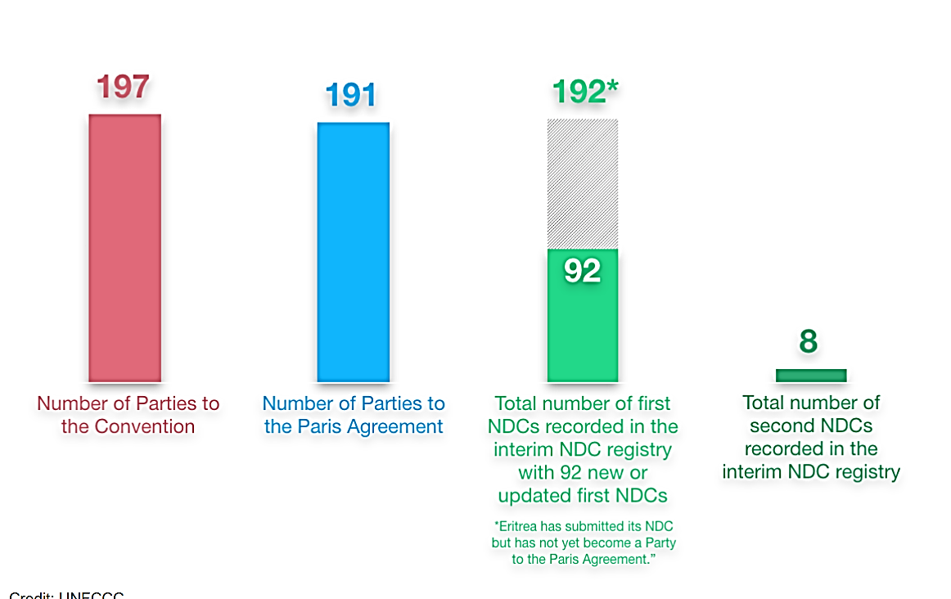
Count of NDC’s
Source: The United Nations Framework Convention on Climate Change (UNFCCC)
Updated: 24th June 2021
Notes:
https://unfccc.int/process-and-meetings/the-paris-agreement/nationally-determined-contributions-ndcs/nationally-determined-contributions-ndcs

Slide 20
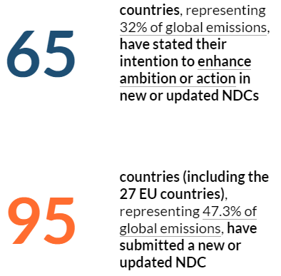
Stepping up NDC’s – Some countries are more ambitious than others…
The initial commitments that countries put forward in Paris are not enough to avoid crossing over dangerous temperature thresholds.
According to the ICPP, human-caused emissions must be slashed by almost half from recent levels by 2030 and then reach net zero by early in the second half of the century to avoid the most dangerous and costly consequences of climate change.
Source: World Resources Institute (2020)
Notes:
https://www.wri.org/ndcs

Slide 21
COP26 Formal Negotiations
Important aspects of the Rule Book for the Paris Agreement that still need to be negotiated are:
Developing carbon market mechanisms - Article 6 provides that countries can cooperate in delivering their NDCs, for instance through a carbon market. Disagreement persists on the exact mechanisms of this new carbon market, and the rules for international transfers, such as how it will coexist with existing carbon markets
Funding for loss and damage - Countries will need to address a funding mechanism for dealing with the impact of climate change, especially where developing countries, who are often impacted more directly (e.g., through flooding or forest fires), experience loss/ damage
$100B finance target - developed nations committed to financing $100 billion per year by 2020 to support developing countries to build resilience to climate impacts and protect nature. COP26 will allow countries to assess progress
The enhanced transparency framework for mitigation, adaptation & finance – countries still need to agree technical issues so it can be implemented (reporting modalities, training etc.)
A new discussion on 'Nature-based solutions’
Focuses on how forestry, agriculture and ecosystems can help in the fight against global warming by absorbing emissions will become increasingly important in helping countries reach their net zero carbon commitments. COP26 will start to discuss how to integrate NBS into the Paris implementation strategy
Makes link with COP15 to the Convention on Biological Diversity in Kunming, China (Oct 2021). They need to agree and adopt the 'Post-2020 Global Biodiversity Framework'

Slide 22
What will Constitute Success at COP26?
Scaling up climate finance
Action on adaptation & loss and damage
Agreement to close gaps between finance and adaptation (rule book negotiations)
Environmental integrity of market rules
Greater accountability and transparency
Roadmap for ramping up near term mitigations ahead of next Paris Cycle (rule book negotiations)
Finance shifting from fossil to clean fuels
Shifts in economic sectors (energy, transport, industry)
Credible pathways to net zero transformation (e.g., UK, UNFCCC campaigns)

Slide 23
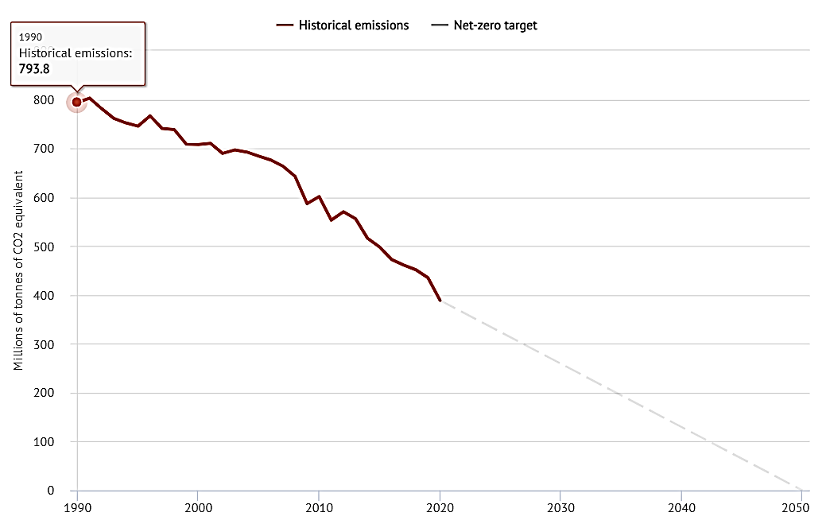
The UK is Halfway to Net-zero GHG Emissions
40% Cleaner industry
10% Smaller fossil fuel supplies
25% Manufacturing and waste industry: Emission controls on landfill methane, halocarbons and nitrous oxide
15% Efficient industrial processes. A shift away from carbon-intensive manufacturing
40% Electric Supplies
No longer relying on coal
Lower methane emissions from coal mines/ leaky gas distribution pipes.
Cleaner fossil fuel industry
The fall in emissions between 1990- 2019 is due to major changes in three areas, which together account for roughly 90% of the decline:

Slide 24
Mother Nature is not waiting. The past decade was the hottest on record. Dangerous greenhouse gases are at levels not seen in 3 million years. Global temperature has already risen 1.2°C– racing toward the threshold of catastrophe. We see ever rising sea-levels… devastating tropical cyclones and epic wildfires. We need a green planet — but the world is on red alert. We are at the verge of the abyss. We must make sure the next step is in the right direction. Leaders everywhere must take action.
- António Guterres
Secretary-general of the United Nations
Remarks at Leaders Summit on Climate - April 22nd, 2021
Notes:
https://www.un.org/sg/en/content/sg/speeches/2021-04-22/remarks-leaders-summit-climate

Slide 25
Further Reading
IPCC Fifth Assessment Report, Summary for Policymakers
NOAA National Centers for Environmental Information, State of the Climate: Global Climate Report for April 2021, https://www.ncdc.noaa.gov/sotc/global/202104
National Aeronautics and Space Administration / Goddard Institute for Space Studies, (2021), News & Feature Articles, https://www.giss.nasa.gov/research/
Met Office (2021). New climate science programme to meet climate challenge, https://www.metoffice.gov.uk/about-us/press-office/news/weather-and-climate/2021/hadley-centre-work-program-2021
UNFCC (2021). Glasgow Climate Change Conference, https://unfccc.int/process-and-meetings/conferences/glasgow-climate-change-conference
T. Westerhold et. al., (2020) "An astronomically dated record of Earth’s climate and its predictability over the last 66 million years," Science vol. 369, 1383-1387.
B.D. Santer et.al., (1996) “A search for human influences on the thermal structure of the atmosphere,” Nature vol 382, 4, 39-46
R. S. Nerem, B. D. Beckley, J. T. Fasullo, B. D. Hamlington, D. Masters and G. T. Mitchum. (2018) "Climate-change–driven accelerated sea-level rise detected in the altimeter era."

Slide 26
Jill Duggan jduggan@edf.org

