Slide 1




PORTHOLE
Edition 550 April 2025
$18.4 million
in Foundation global grant funding has been allocated to environment-related causes in the past five years through our support of community economic development and water, sanitation, and hygiene projects
President Stan Knight Editor Mark Townsend
April is Environment Month
Rotary shares an interest in protecting our common legacy: the environment.
Protecting and restoring land, coastal, marine, and freshwater resources
Enhancing the capacity of communities to support natural resource management and conservation
Supporting sustainable agriculture, fishing, and aquaculture practices
Addressing the cause of climate change by reducing the emission of greenhouse gases
Strengthening ecosystems and communities affected by climate change
Supporting education initiatives that promote behavior that protects the environment
Advocating for sustainable consumption to build an economy that uses resources more efficiently
Addressing environmental justice issues and public health concerns
Graphic Rtn Debbie Vance
We are committed to supporting activities that strengthen the conservation and protection of natural resources, advance ecological sustainability, and foster harmony between communities and the environment. We empower communities to access grants and other resources, embrace local solutions, and spur innovation in an effort to address the causes and reduce the effects of climate change and environmental degradation.
Our District 1200 is International Sponsor for a reforestation project in Scotland
Locally Poundbury had been involved in constructing a wildlife pond near Dorchester
Our club has helped on ICA litter picks and other environmental issues.

Slide 2


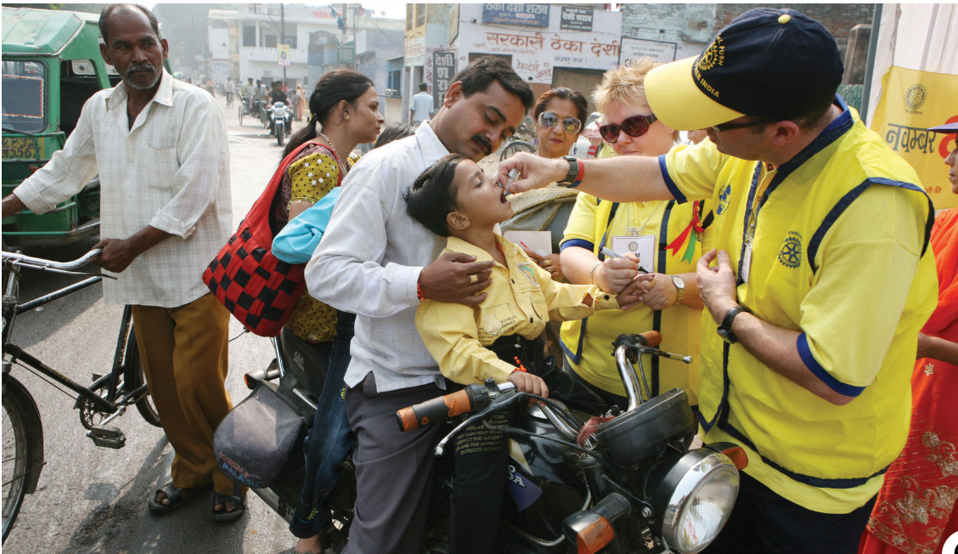
Rotary Action Group for Endangered Species
World Immunisation Week 24-30 April 2025
“Our purpose is to mobilize Rotarians and provide global awareness and focused ACTION in the continuing struggle to preserve and protect endangered species. We will be supporting and promoting new and ongoing joint projects with Rotary and Rotaract clubs located in the areas of concern.
Our efforts will start with a particular focus on the rhinos, elephants and mountain gorillas in Africa, the Orangutans and Pygmy Elephants in Borneo, where poaching and habitat loss is a danger not only to these rare animals, but to the economic survival of the indigenous people who rely on eco-tourism for their livelihood .”
Learn more about Rotary Action Groups
Increasing awareness about the power of vaccines and closing immunization gaps could protect millions of people worldwide from vaccine-preventable diseases, including polio.
According to the World Health Organization. World Immunization Week, 24-30 April, is an opportunity to focus on that work, and the robust polio eradication infrastructure built by Rotary and our partners in the Global Polio Eradication Initiative (GPEI) provides a model for it.
Graphic Rtn Debbie Vance

Slide 3
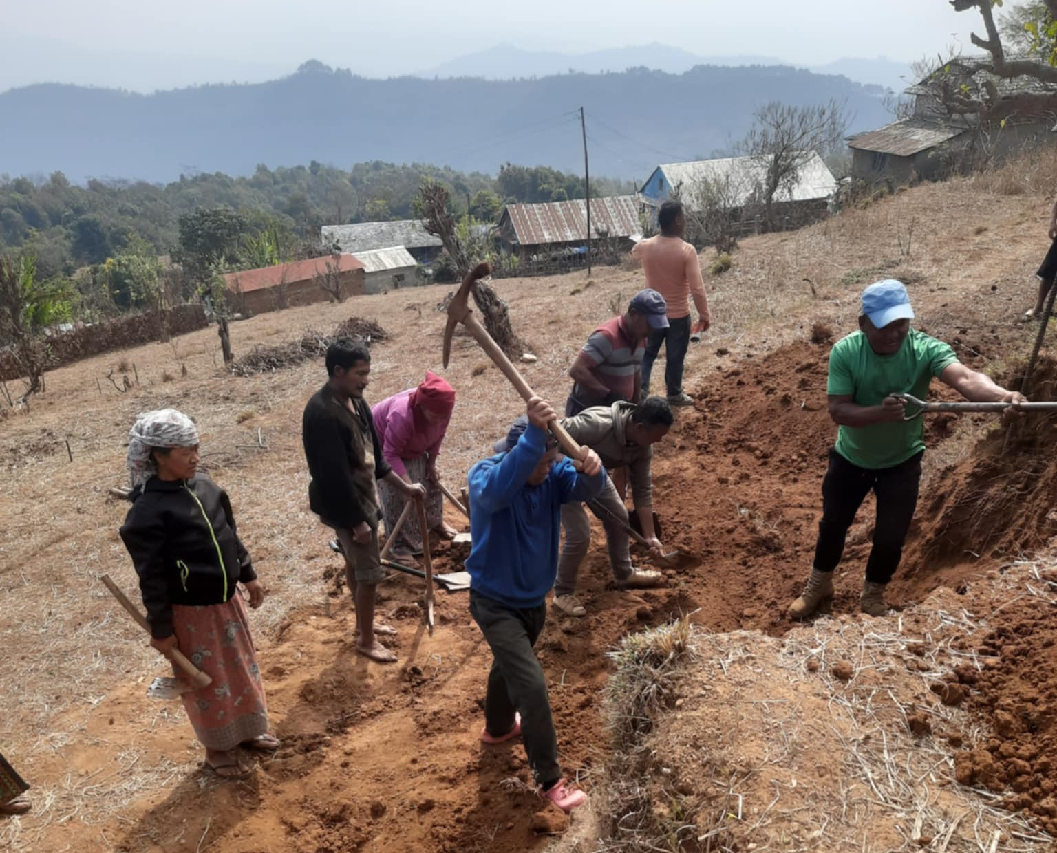
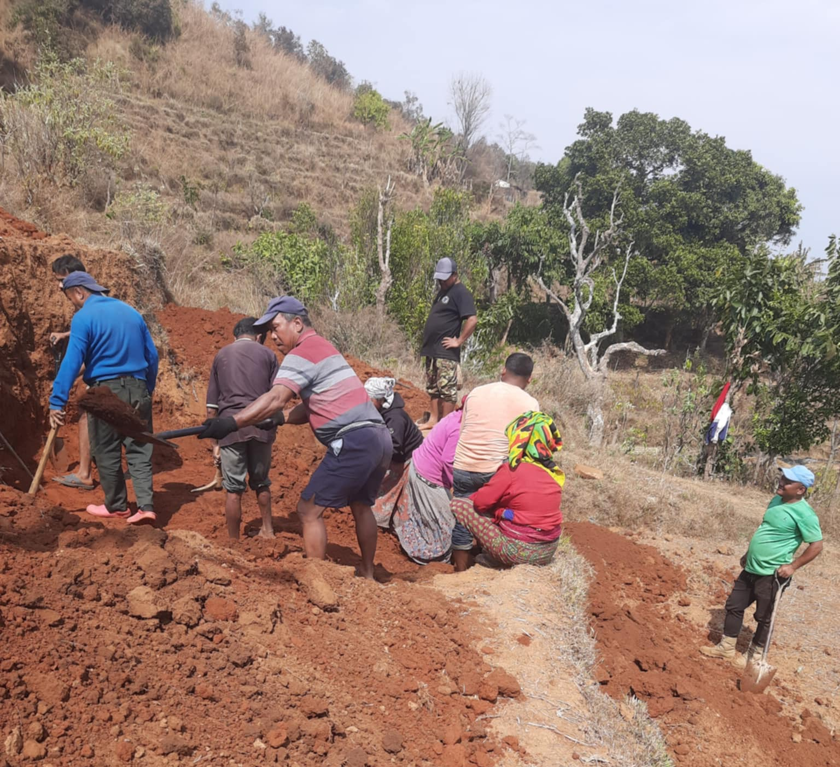
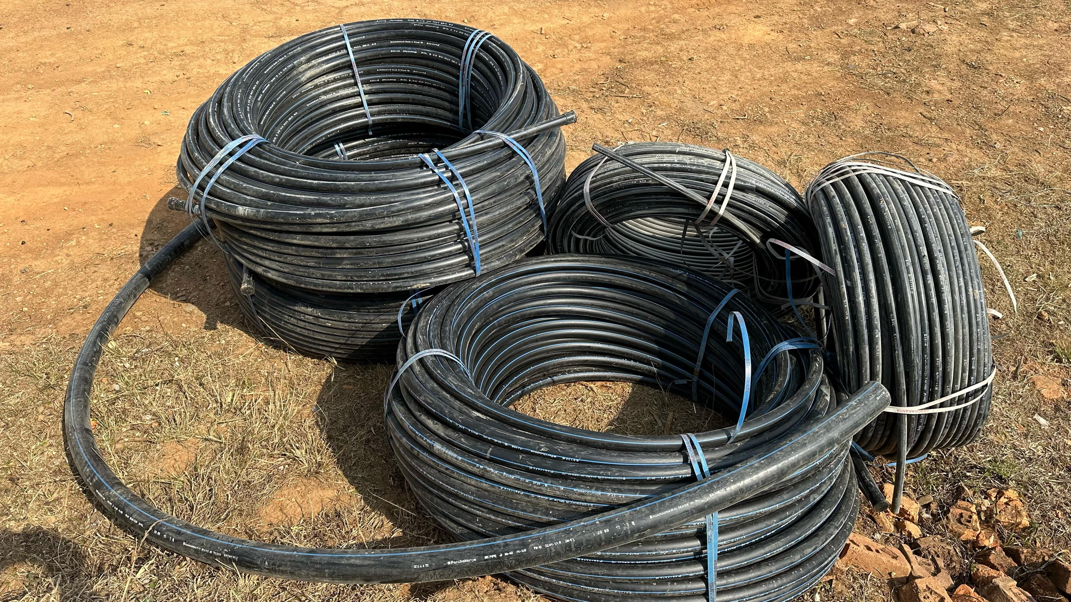
Work on Gahateri has started
High above the village the locals have turned out to start digging the base for the water tank.
The residents are keen to help with the work. Not only does it reduce costs, but it shows they have a vested interest in the project and are taking ownership. This is one of the mainstays of ensuring success and sustainability.
Top left the base is being cut out in the hill, close to the spring. Bottom left the water pipe has been purchased and that will carry the supply from the tank to the individual houses.
Above. The tank is significantly higher than the village, giving a good pressure. Note, as always, the women take part in the labour.
28 taps and meters have also been purchased. One for each house. There is no charge for water, but it means costs of future maintenance, repairs and funding a local to regulate the supply can be apportioned.

Slide 4
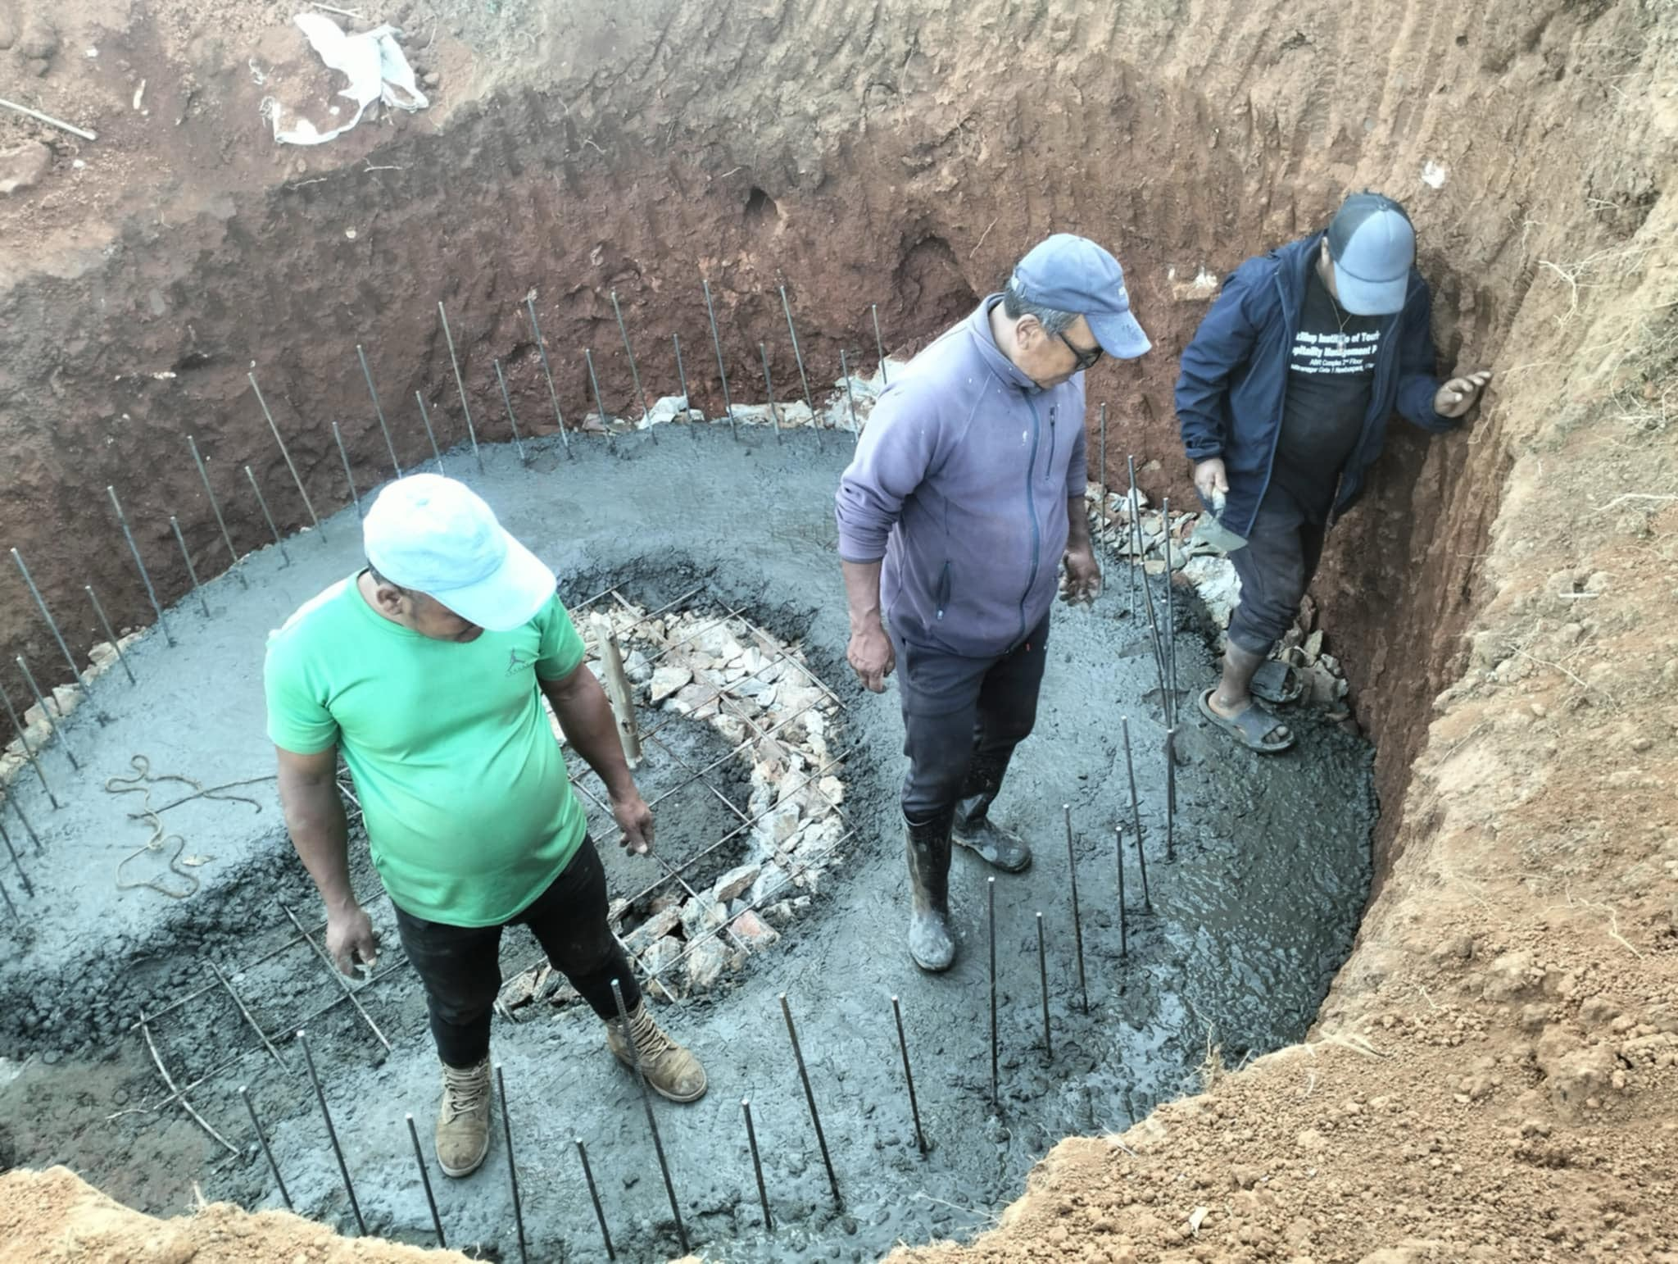
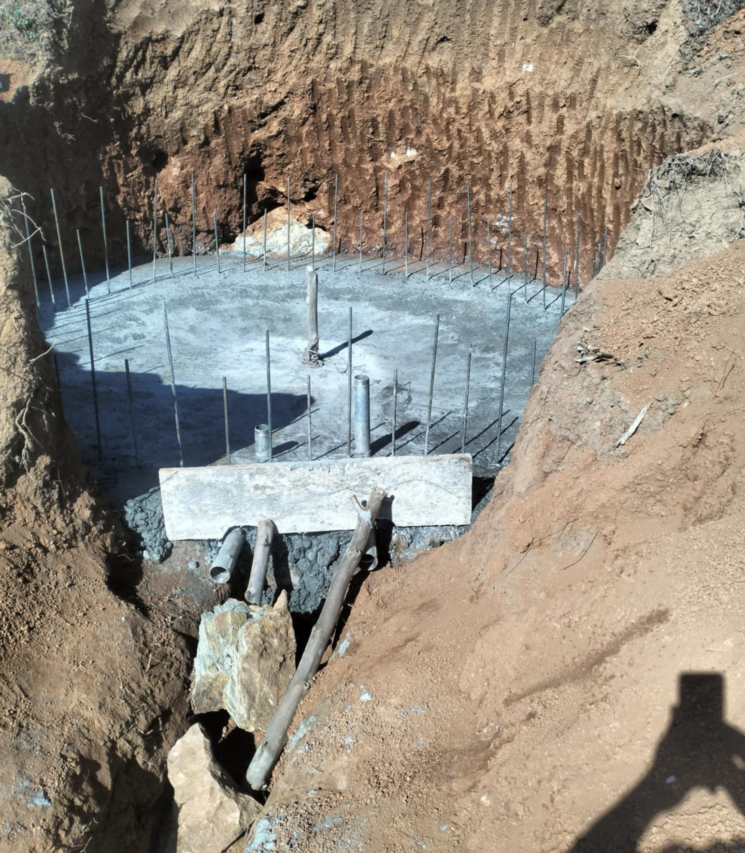
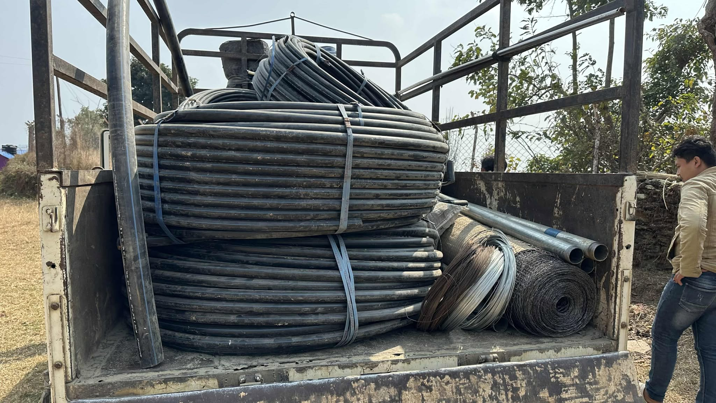
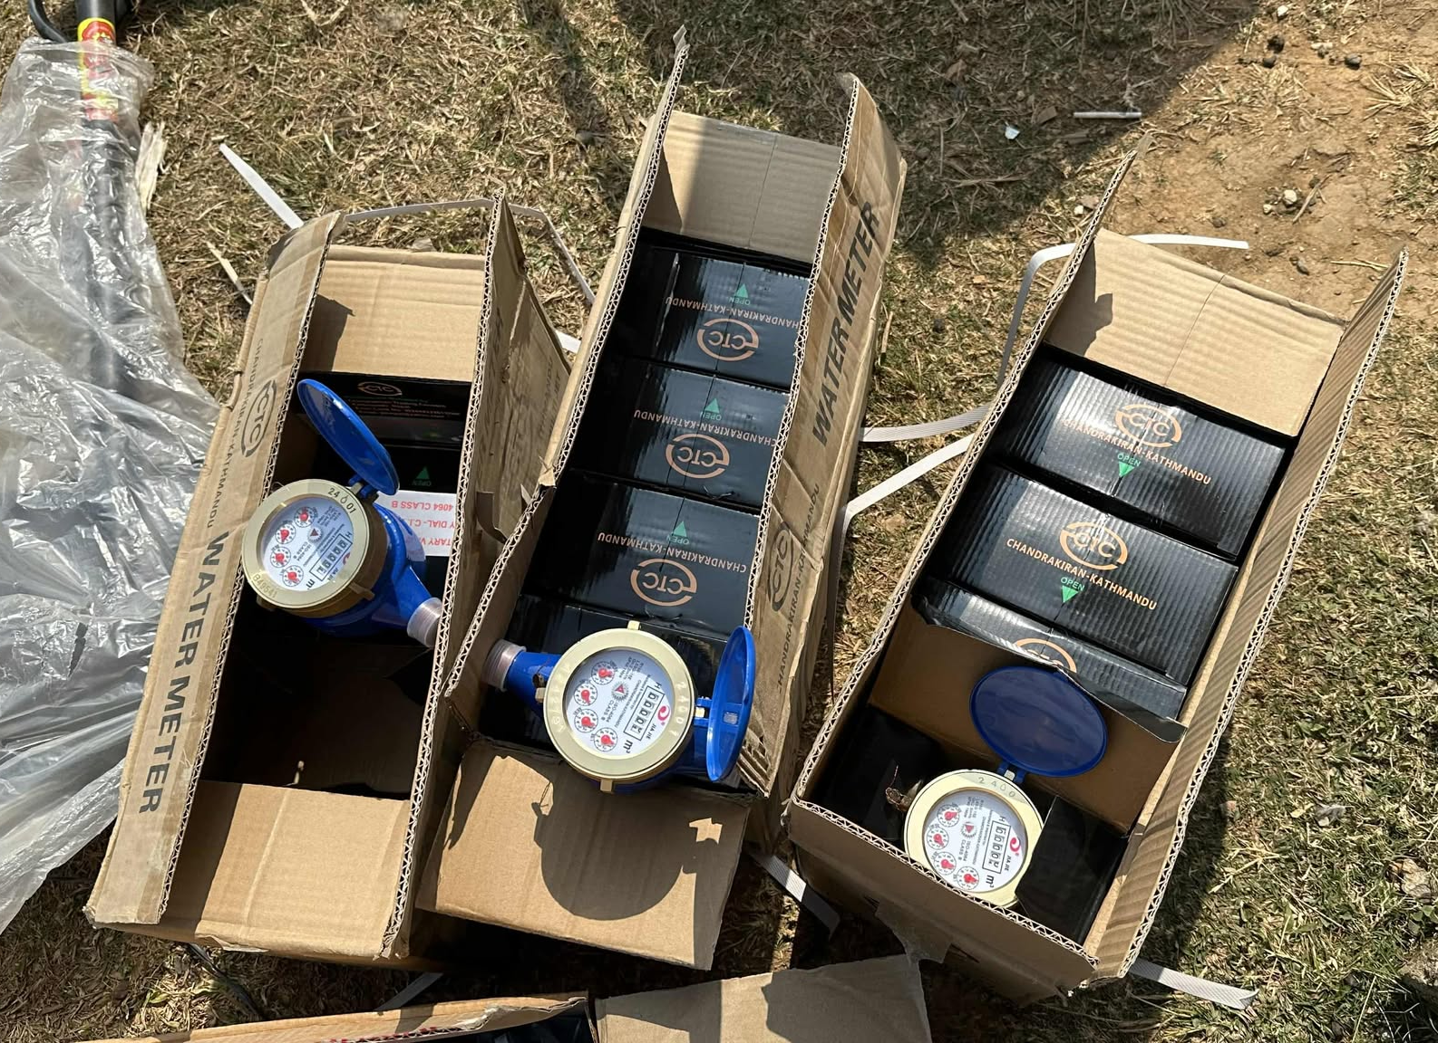
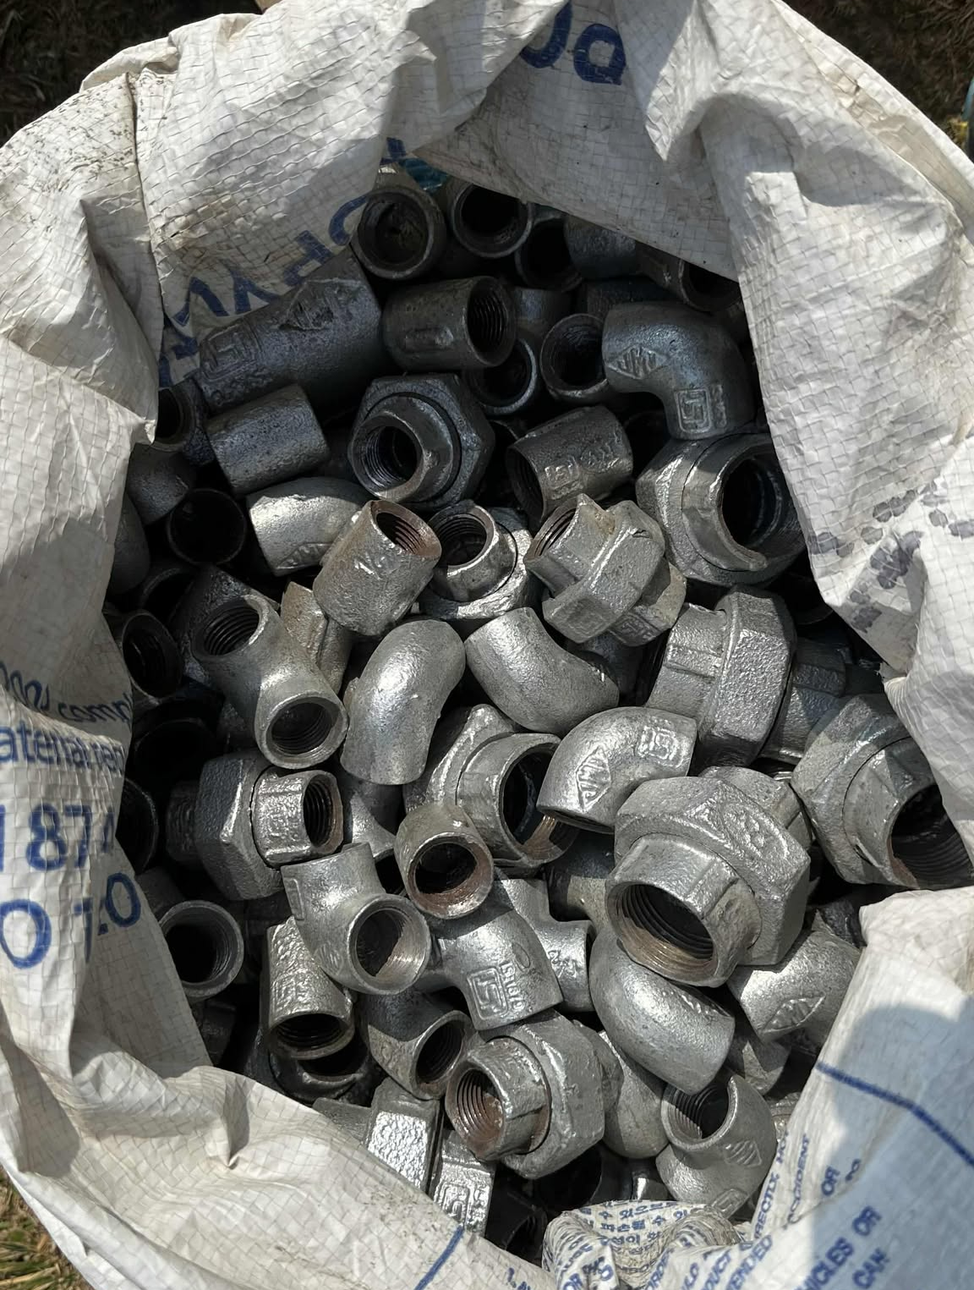

Slide 5
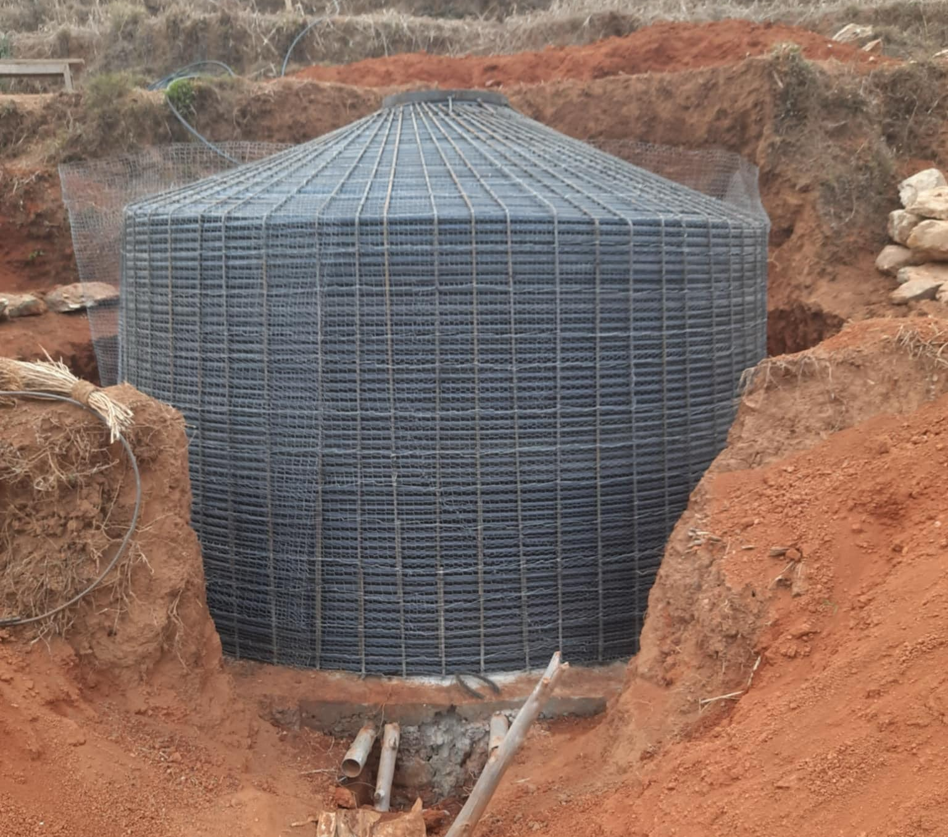
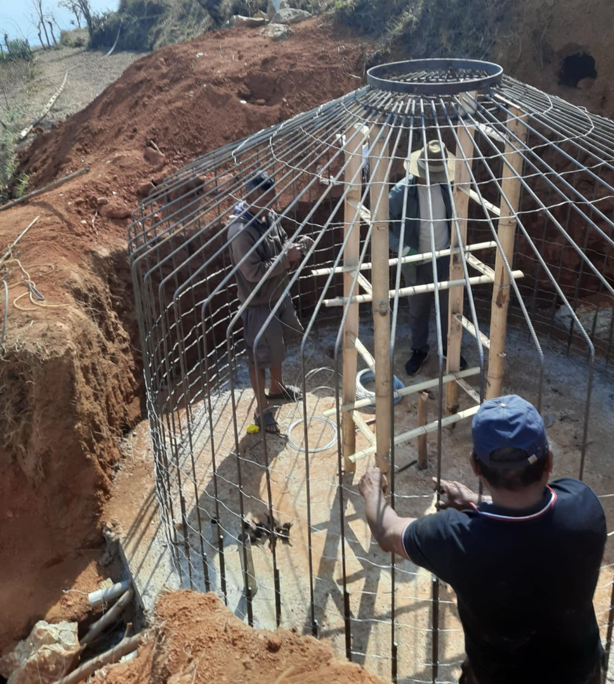
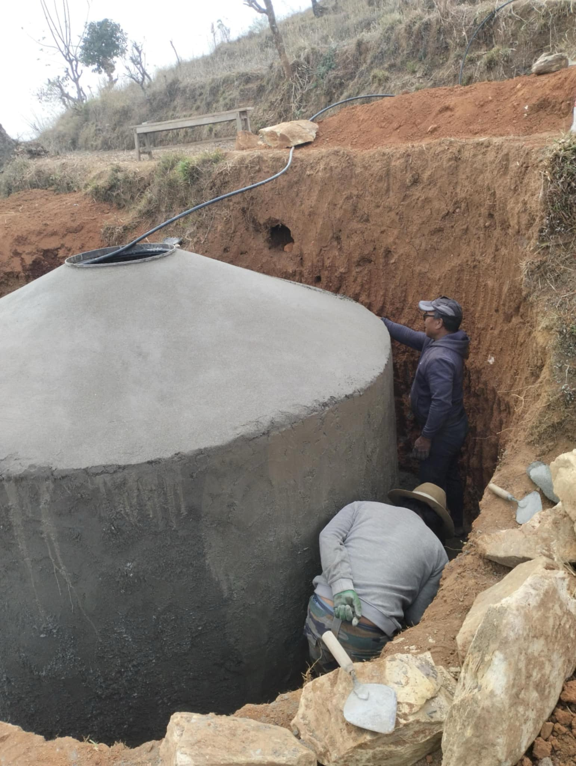
Above. The steel cage is constructed from the inside .
Top right. Hose is run around to give a key for the cement.
Bottom right. Cement is used to coat inside and out.
This is where the skilled labour comes in.
Later the tank surround will be filled with earth to support it.

Slide 6
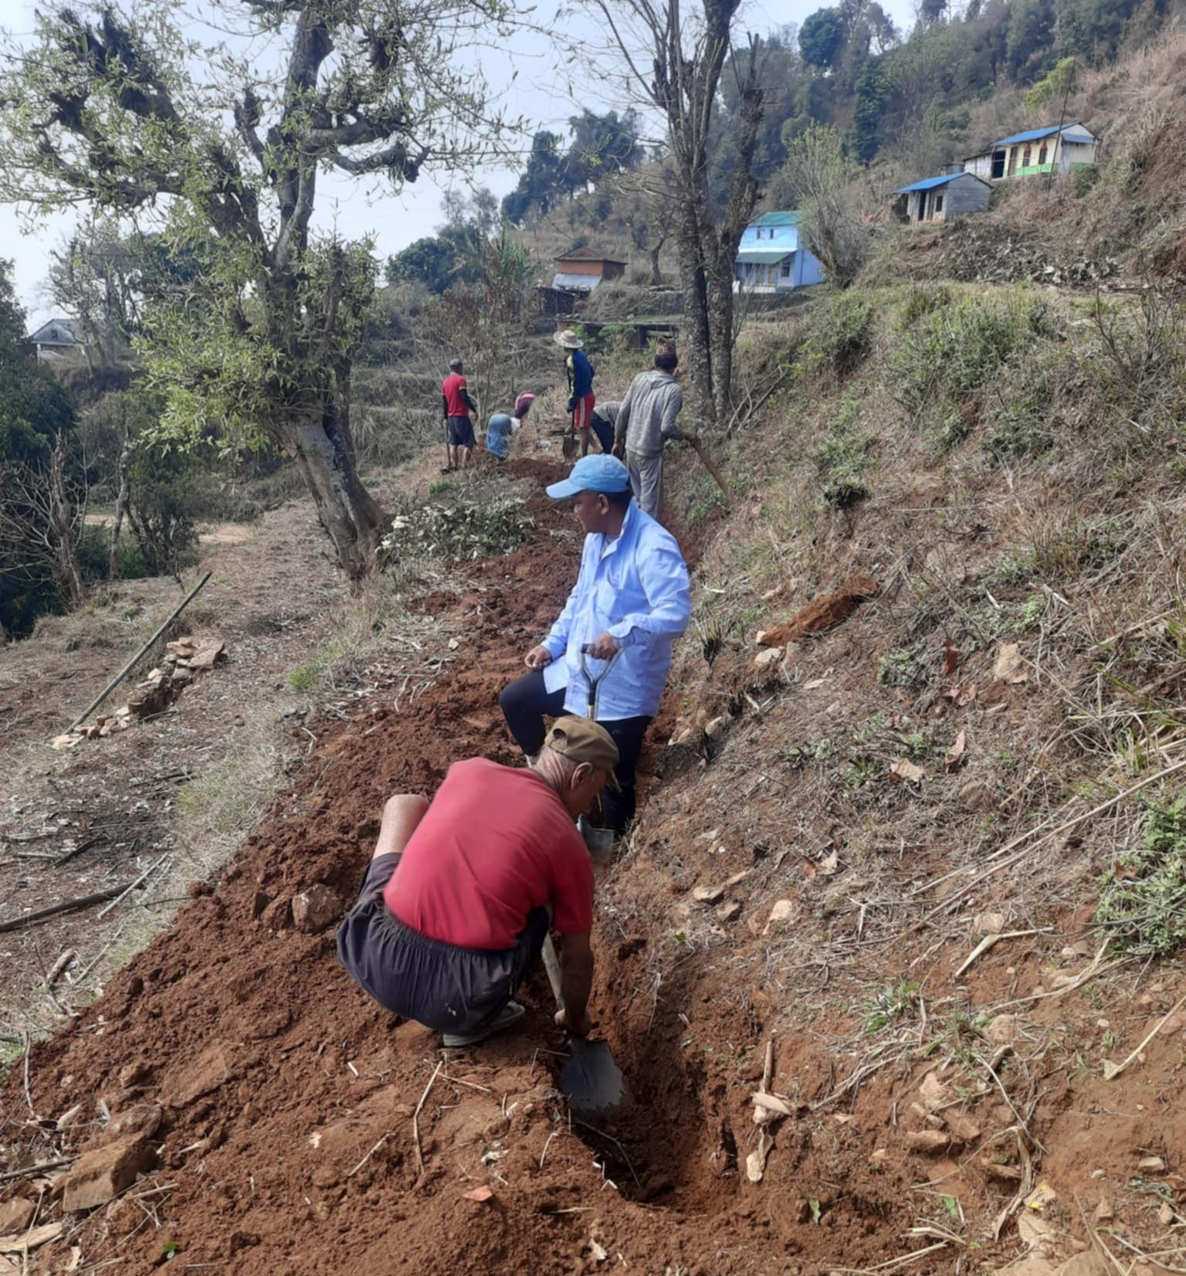
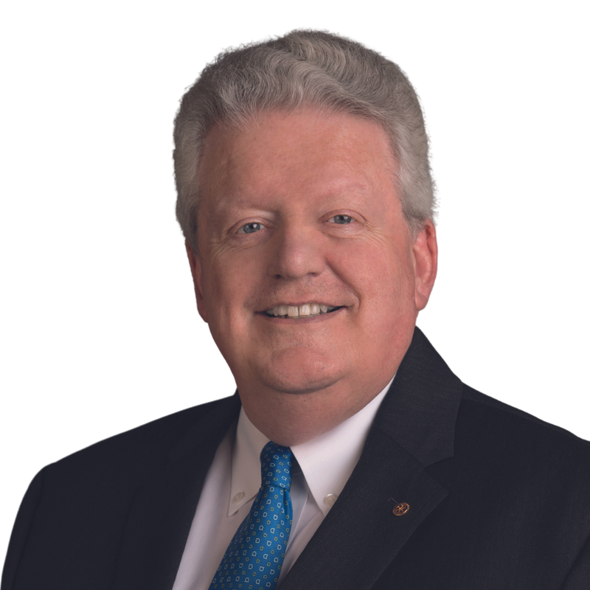
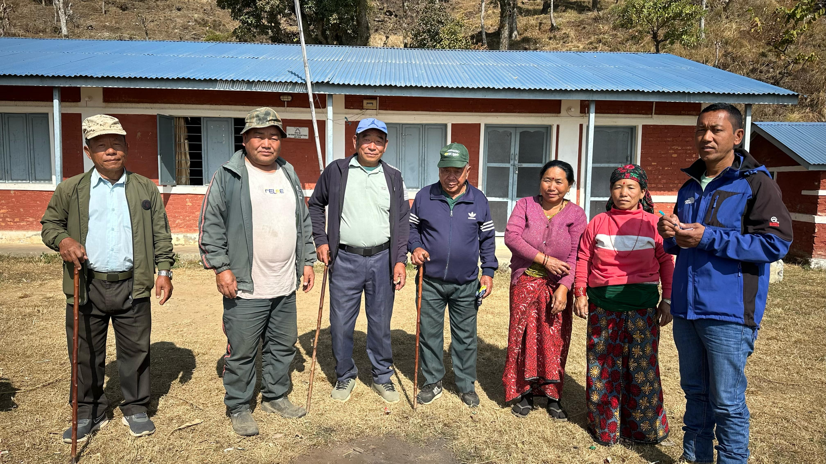

Glass Half Full
1
“After joining Rotary, you never look at a glass of water the same way again.
Holding it, you are humbled by the privilege of access to drinkable water. Then, you recall how Rotary brings communities and water experts together to deliver safe drinking water to places in need of it, transforming lives.
According to the United Nations, two billion people lack access to safely managed drinking water, and 3.6 billion lack safely managed sanitation.”
Mark Maloney RI Trustee Chair 2024-25
Madkina
Bimal and Robin met with the villagers of Madkina to discuss the project to bring a water supply to the community centre (in the background) and to the toilets.
Funded by Kathy who came to Nepal with us several times and a donation from Wareham Rotary, we have given the go ahead.
Here water carrying pipework is laid in a trench , bringing the supply to the village.
Mark
Did you Know?
Rotarians in Great Britain and Ireland have contributed $48M and the UK Government has contributed $1.76Bn to the campaign to eradicate polio since 1988. Mark
Mark

Slide 7

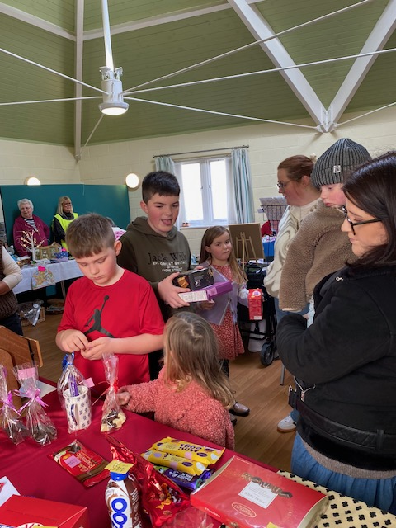
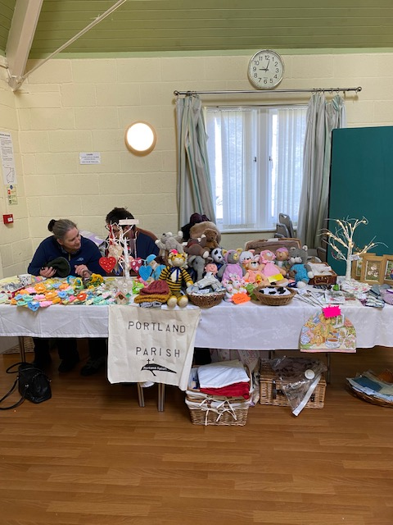
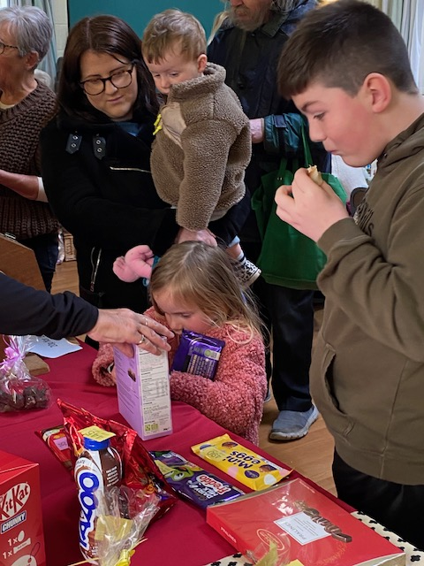
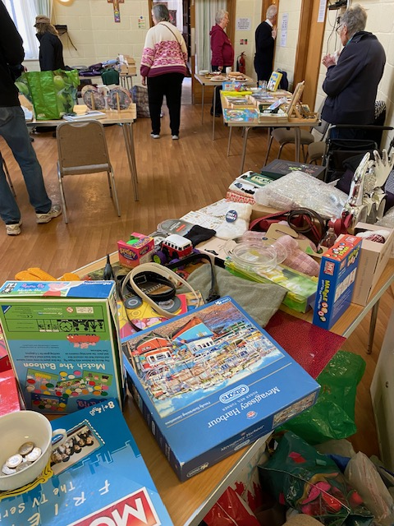
Tabletop Sale
8th March for
Read Easy
“2.4 million adults in England alone cannot read at all or can barely read.
Our vision is for all adults in the UK to have the literacy skills they need to fulfil their potential and live life to the full.”
Read Easy
Janet

Slide 8
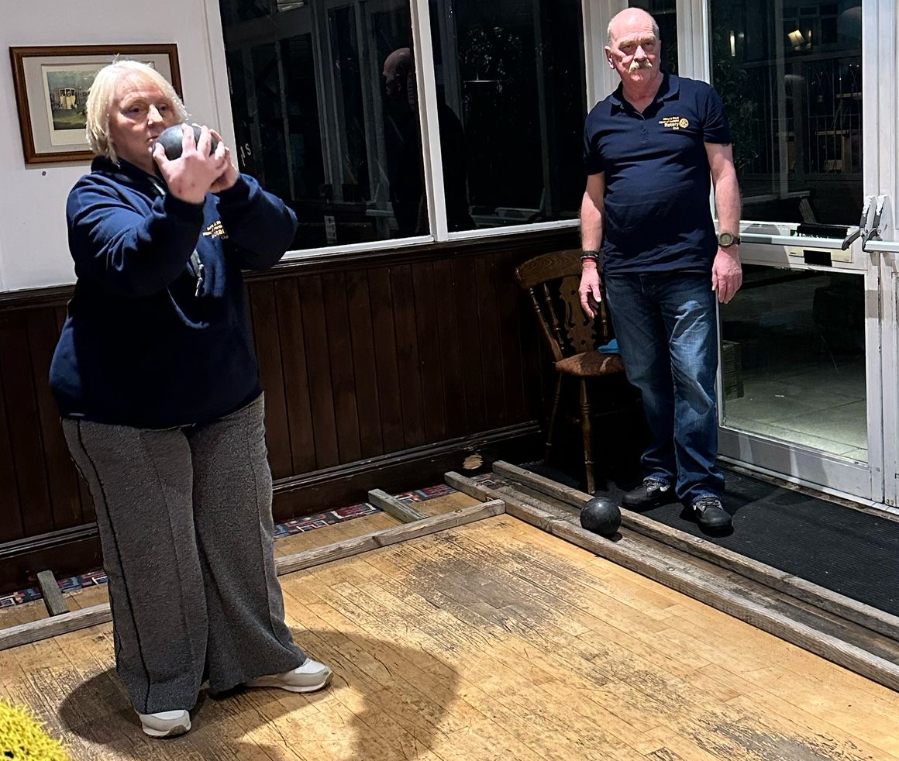
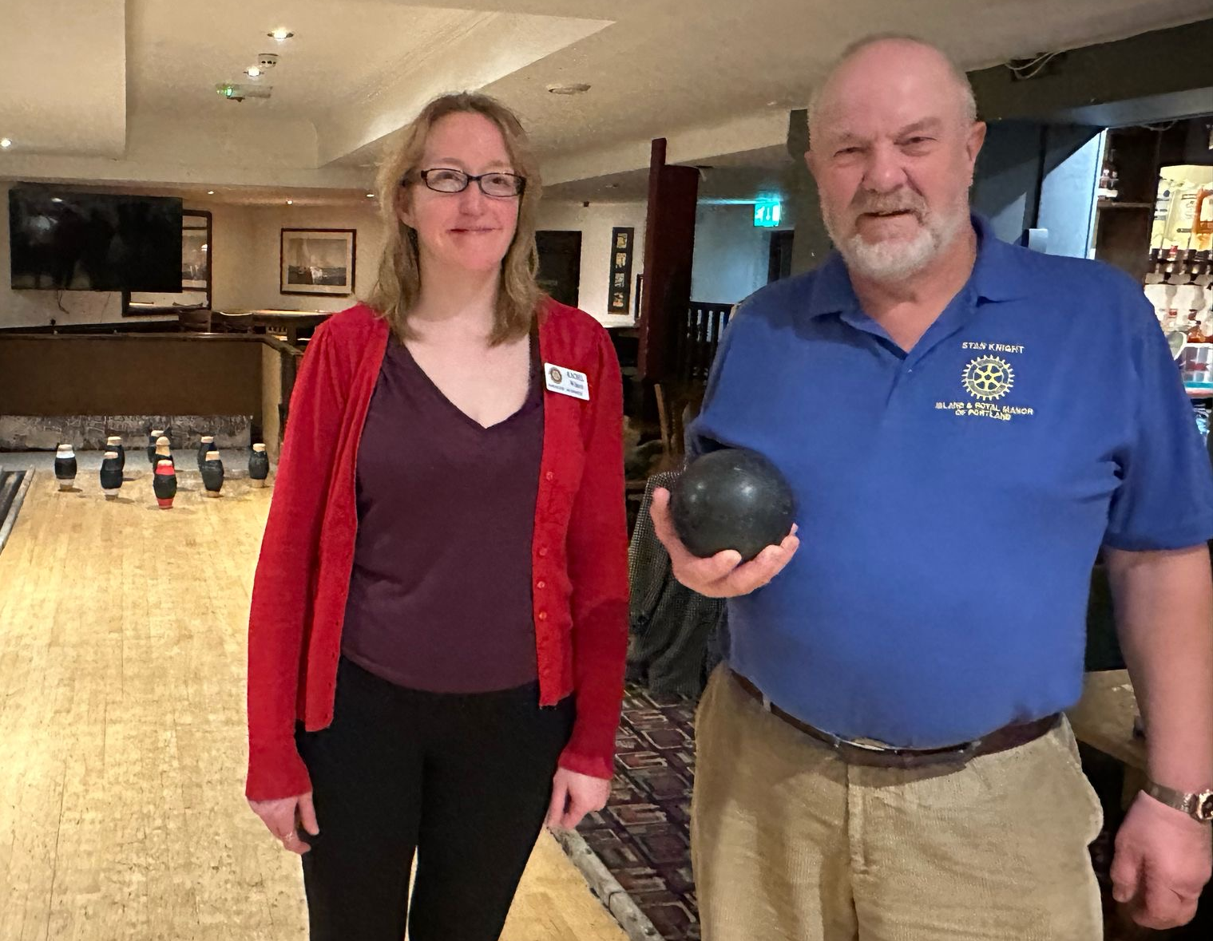
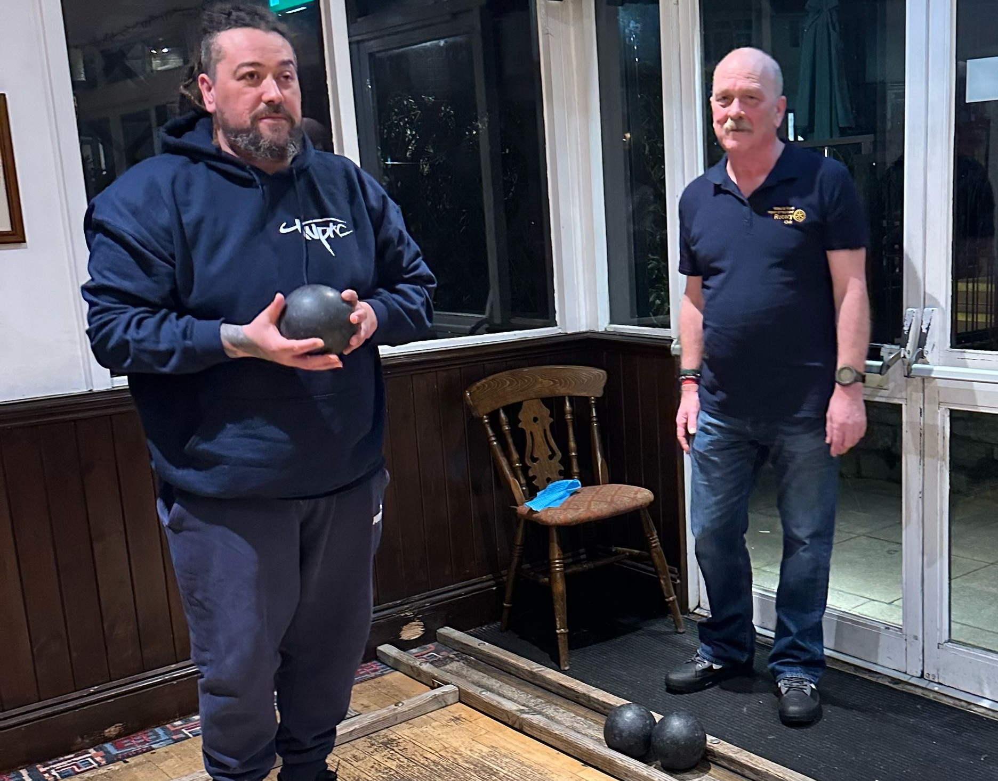
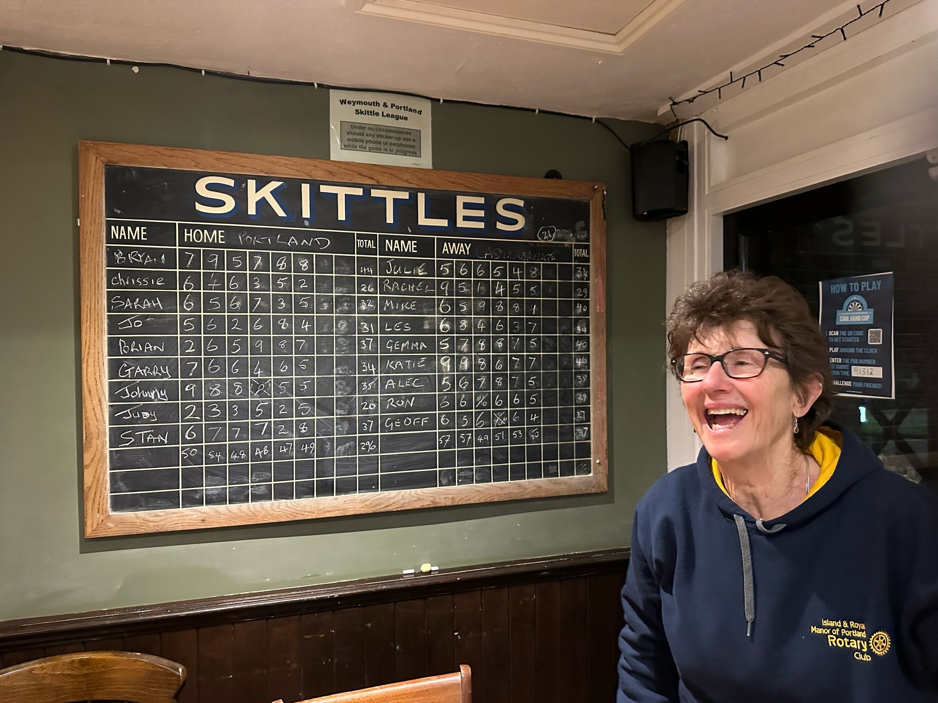
Skittles with Casterbridge for the
Runners-up plate
A chance to chat with old friends. Sadly, we lost. (Again!)
Jo had the best time
Sarah

Slide 9
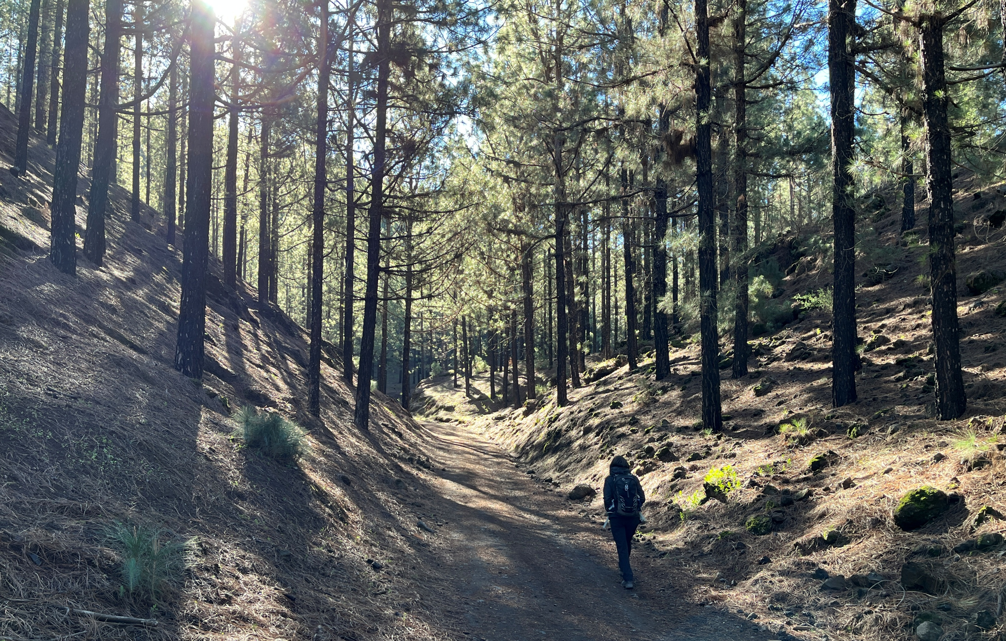
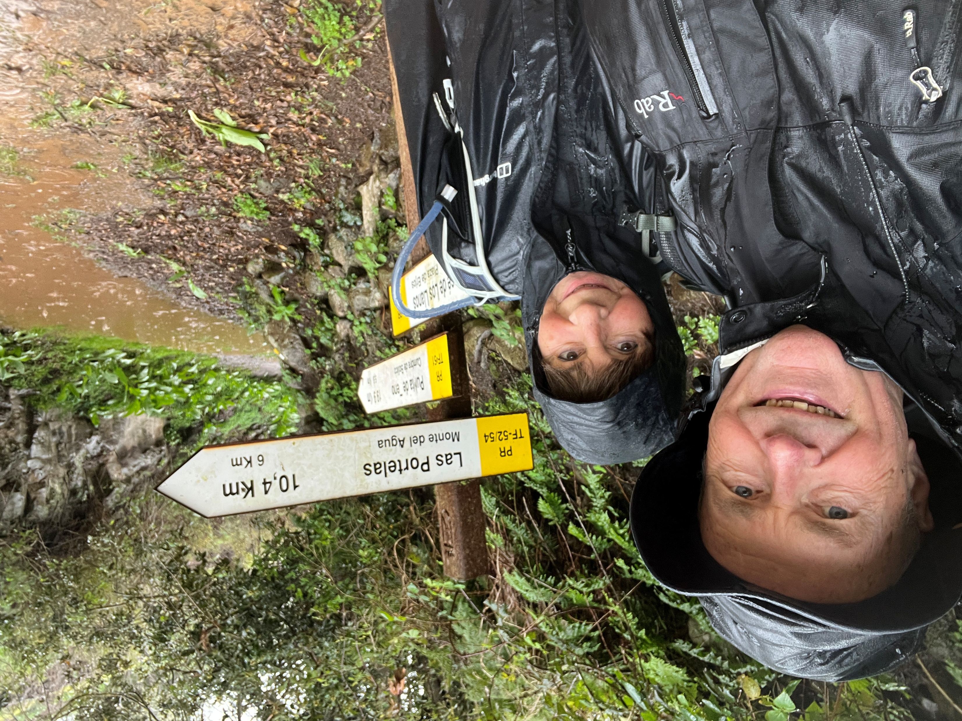
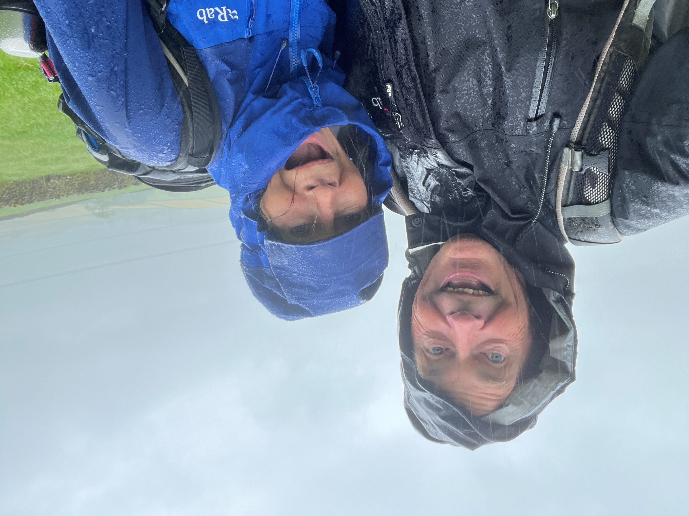
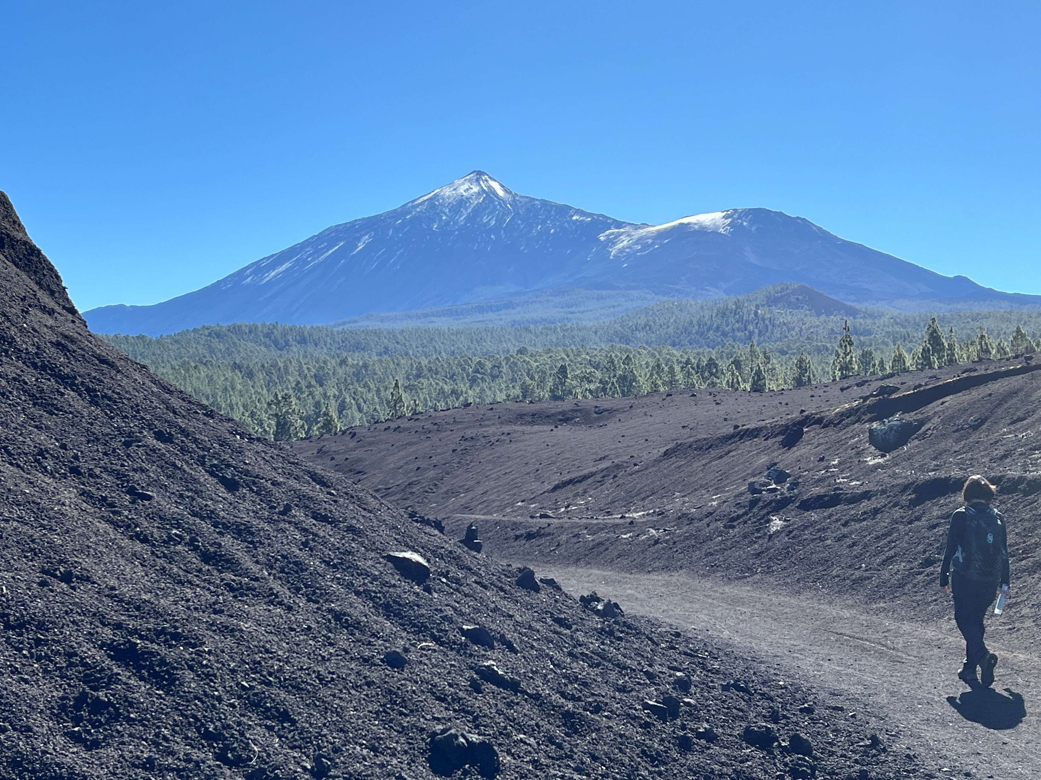
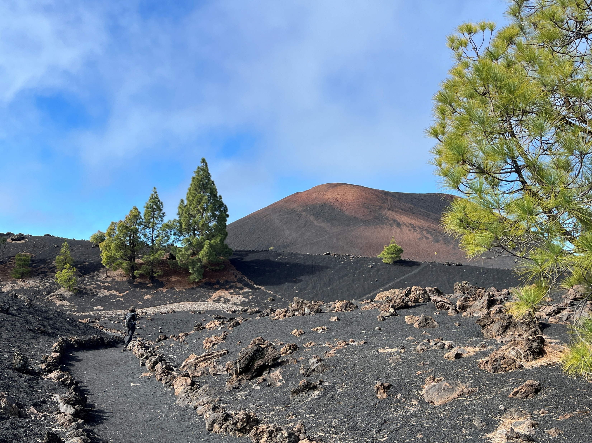
Mark and Ruth in Tenerife
What is the difference between Tenerife Left & the Lake District above?
The signs are in Spanish!
Arenas Negras volcano to left, last erupted 1706, with Teide in the distance with some snow
Walk through beautiful forest then circumnavigate Chinyero
Last erupted 1909

Slide 10
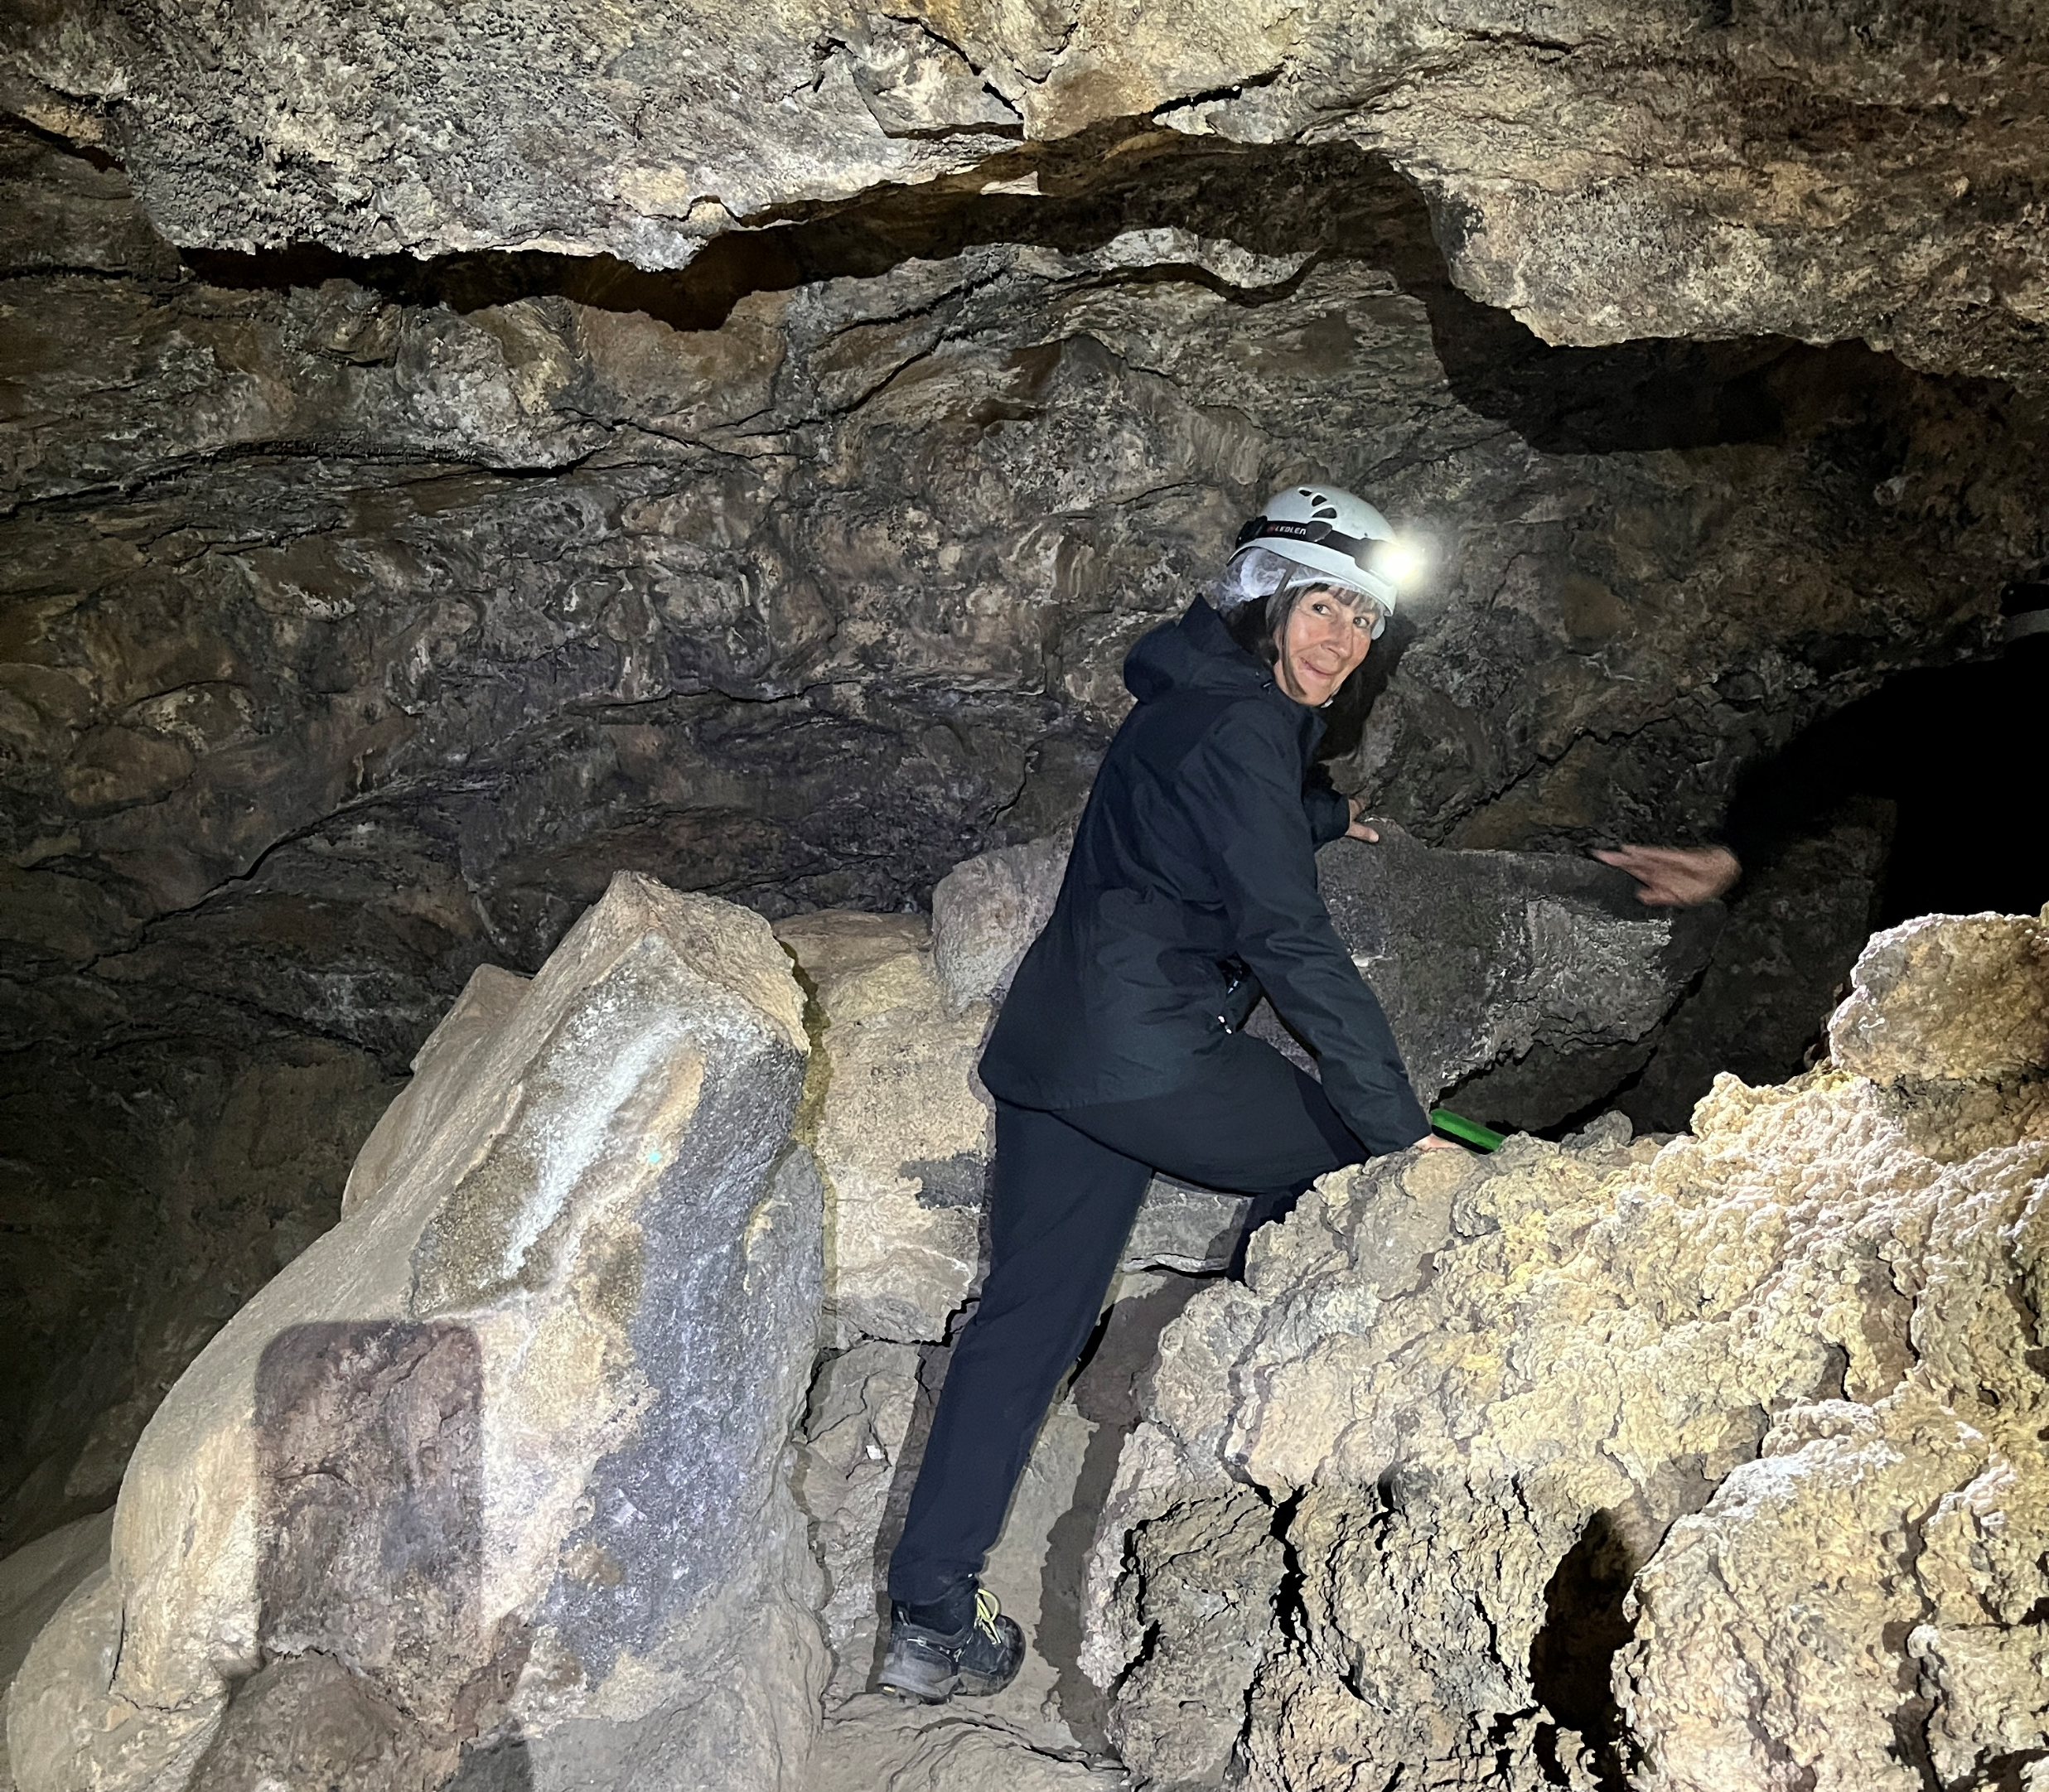
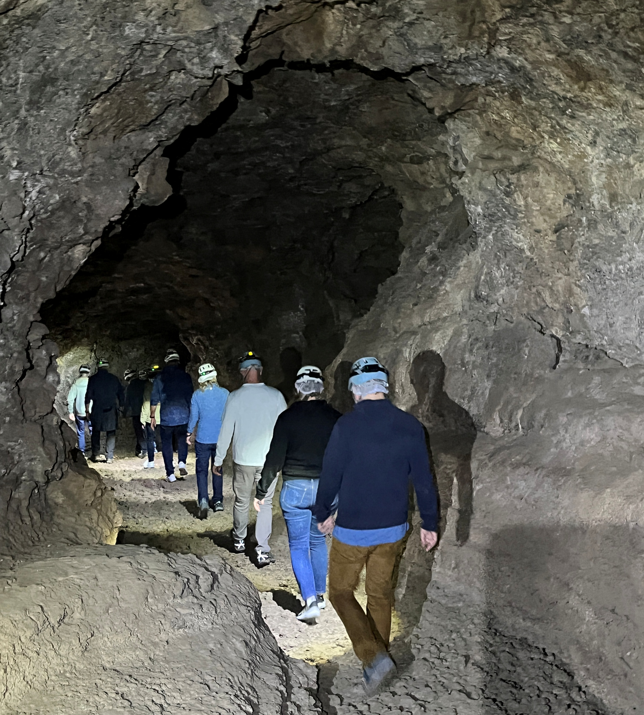
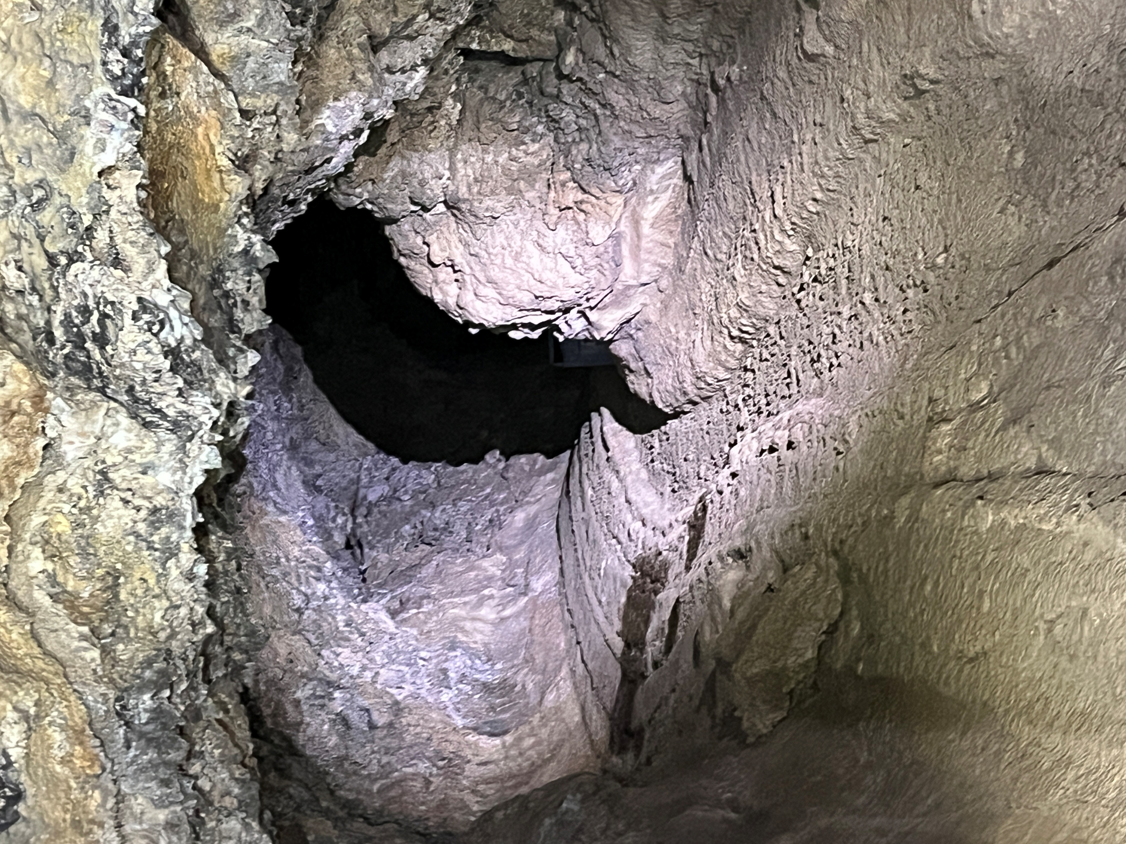

Cueva del Viento
Lava Tubes form as a result of volcanic activity. During an eruption basalt rock may be at 800$°c$ forming the rocks and boulders of lava. At 1200$°c$ the lava becomes liquid. Once in contact with cool air a crust forms and hardens. Inside the liquid lava still flows. When the eruption finishes the liquid lava continues to pour out leaving a hollow tube or cave. The tubes here are 17km long and second only to larger caves in Hawaii.
Small groups can explore a section here in Tenerife
Mark

Slide 11
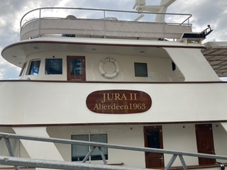
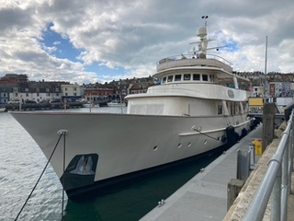
Shipping News: Jura 11
Every so often an interesting boat with a story arrives in the harbour. On the 4th March, Weymouth Harbour was halted temporarily by the arrival of the classic gentleman’s yacht Jura 11, a 36.58m elegant motor vessel built in 1963, pirouetting to berth in front of the Harbour Master’s office. What caught our eye particularly was the fact that Jura 11 was flying the flag of the Cook Islands, a Pacific State, with a special understanding “free association” with New Zealand. We had seen this flag in New Zealand.
A little bit of research revealed Jura 11 is owned by Cameron McColl, who was born and raised in Scotland, he graduated from Edinburgh University with a BSc in electrical engineering. Fresh out of university he emigrated to Australia where he helped develop the world’s first portable ultrasound scanner. His subsequent career moves saw him work in engineering and marketing roles for a range of companies, before he founded the UK’s first computer-networked call centre and has been involved in the launching of at least three other multi-million-pound start-ups.
Constructed in a trawler style by Hall Russell in Aberdeen, Jura 11 was first owned by Hotel Cipriani as a party boat in Italy. It was then renamed with every new owner: the Walanka, then Gin Tonic, Miss Evie, Sea Crest, before being purchased by McColl in 2021, renaming it Jura11. He sailed from Genoa to Rome, and then to Turkey, where an extensive refit took place at the Bodrum Aganlar shipyards over 11 months during lockdown.
Having sold off most of his businesses, McColl is now based in the British Virgin Islands, having developed the Nanny Cay marina complex with 320 slips, a 52 bedroom hotel, 32 town houses and 40 associated businesses. With Jura 11 relaunched in 2024, it’s steel hull and wooden rails gleam. It’s an ocean crossing vessel, with the capability to fuel oceanic crossings, due to its low stress engines that cruise at a stately 12 knots. She offers guest accommodation for up to 12, with 7 crew to ensure a relaxed luxury cruising experience. It is not listed for sale; Cameron McColl has spent much of time retirement cruising on Jura 11 around Britain, via the Caledonian Canal, then onto the Mediterranean, Suez Canal, and across to the Maldives before heading into the South Pacific.
It is now listed for charter: £65,000 a week, with crew.
Key reference: “Boats Internation” magazine Elizabeth

Slide 12
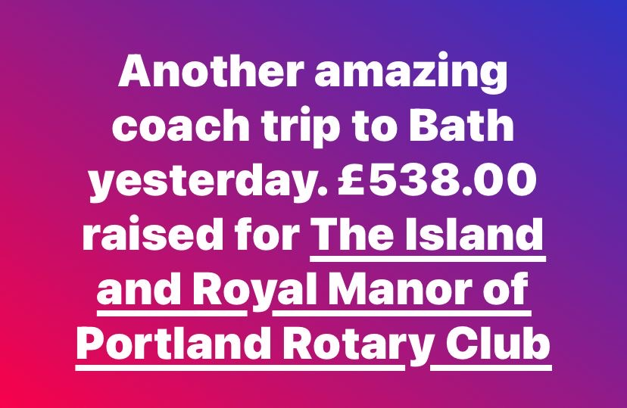

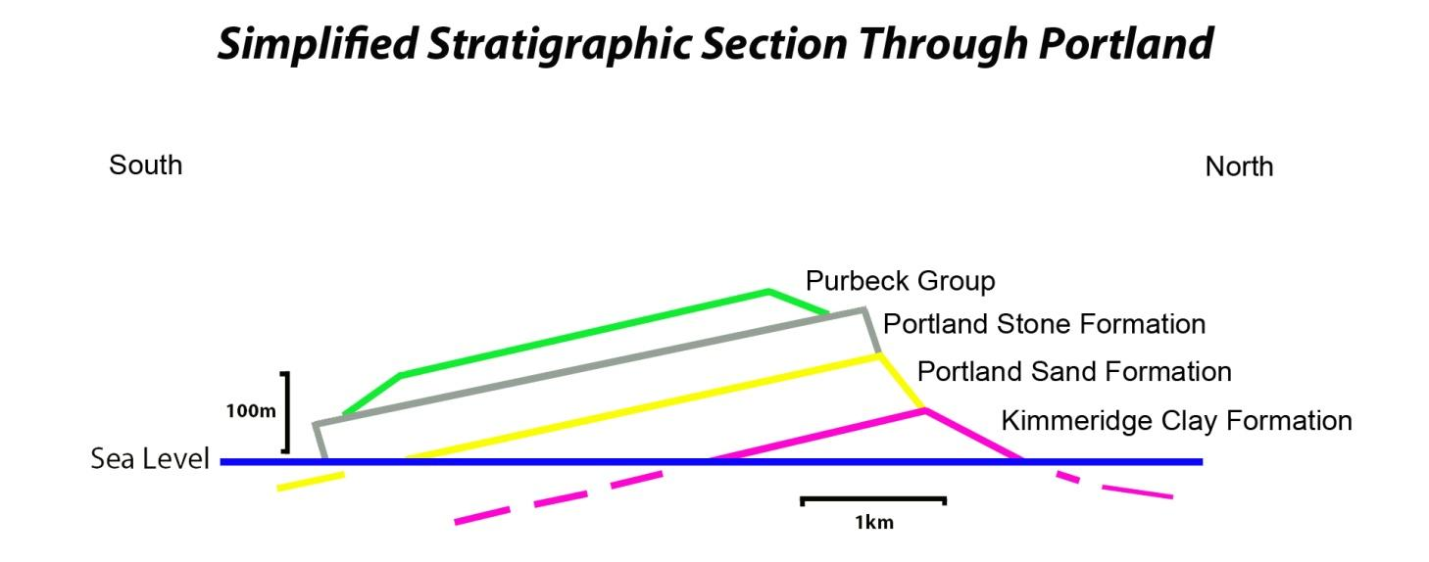
Is the Isle of Portland a sinking ship?
Our geology is reassuringly solid.
If you look at the Island of Portland from the side, can you see it is tilting or dipping southwards? Should we be worried, you may well ask? Is the island sinking? Will the Bill slip into the sea, and the lighthouse gradually submerge under the waves?
Probably not, as this Jurassic coastline is made up of layers of resistant limestones and clays tilted millions of years ago. This jaunty angle, or downward tilt was caused by a massive slow-motion crash, creating a ripple or folding action in the earth’s crust. The cause of the collision was due to the African and European plates moving towards each other. This all happened very slowly, between 65 and 2.5 million years ago, however the earth’s crust and its plates are still moving, pressure is still building in this area, but not at the current rate of say, the San Andreas fault movement.
It appears therefore that Portland is unlikely to experience earthquakes, or tilt further in our lifetime. Although, you never know. We did have an earthquake in 2012 off the Dorset Coast, epicentre Weymouth Bay, measuring 2 on the Richter Scale. This was thought to be due to the expansion of the Atlantic Ocean plates, pushing Europe to the east, impacting with Africa to the south. Although another explanation is that the quake could have been caused by a local submarine landslip.
Bath Coach Trip
Well done, Janet, another brilliant effort!
Tabletop Sale for Read Easy
Raised £300
Well done, everyone!
With thanks to Mark Godden (Albion Stone) for providing this simplified cross section through the Isle of Portland.
Elizabeth Campbell
12th April will be for Portland Youth Council/ICA

Slide 13




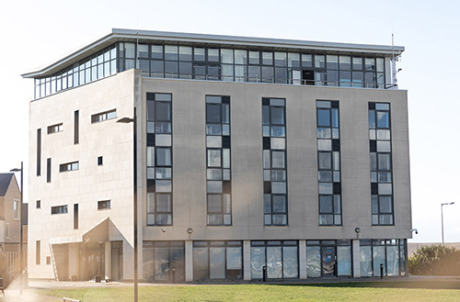
What Do Rotarians Do?
Come and find out!
You are cordially invited to a presentation evening on
Tuesday 15th.April 6.30 p.m.
At the RYA Centre Portland House
Mulberry Ave. Portland DT5 1FA
Presentations to show our work
A glass (or two) of wine and Canapés
Plus, the opportunity to meet the Portland Rotarians and learn what we are doing locally, and in the International Community.
R.S.V.P. please to Keith Barnard-Jones (kbeejay13@gmail.com) to help us with numbers for catering.
We look forward to seeing you in April.
Any friends you know that might like to come?
Since the launch of North Star in 2023, there has been a massive appetite from clubs wanting to engage in corporate membership. It offers huge, untapped, potential to expand our reach and increase our impact.
That’s why Rotary is launching Corporate 1000 to support our efforts to reach 60,000 members by 2028.
The aim is simple: to bring in 1000 new corporate members to Rotary GB&I from 1st April to 30th June 2025.
From Rotary GB&I

Slide 14





Community
& Youth
Committee
Membership
& Club Service
Information Evening
Final preparations being made for 15th April
Tabletops
The next Tabletop will be on 8th March for Read Easy. Janet is kindly running this table as Sarah is away and there is a good uptake of tables.
Competitions
St George's primary School is interested in introducing a poetry or short story competition, with the topic being wonderful water which is the district theme. Age group 8 to 10-year-old and have a winner from each age group. We could present the winners with a book or book voucher on a Rotary evening and also have them attend handover at the end of the Rotary year.
RYLA
Two places for candidates have been reserved by Sarah through Robert Fry and Hayley Ridge – Evans, District 1150. either 20th to 25th of July, 3rd to 8th August or 10th to 15th August
Will contact The Compass Learning Centre in Weymouth and the Drop In
Tall Ships. Harry has a placement on the Tall Ships for 6th July 2025 out of Portsmouth and we have also been successful with a bursary for him
Drop In
Jo attended a Bingo night held 1st February at their new premises and said it was an excellent evening. Jo noticed that they had a multiway games table there and it was explained that due to Martin's kind donation they were able to have a table at both premises.
Rotary Children's Fun Day Out.
Everything in hand for 11th June 2025
Dog Show
Sweet Hill Farm have kindly confirmed 29th June 2025
Sarah
International
& Foundation
Foundation feeds - Ongoing
Nepal
£2600 paid to enable work to start on Gahateri. Should have commenced by time of meeting
Coach trip
Bath 28th March
Vire programme
Friday 13 June
Reception and afternoon tea Mark & Ruth
Skittles Swan Abbotsbury Meal Booked
Saturday14 June
Visit Pallington Sculpture (book in advance)
Picnic lunch booked subject to weather
Dinner Portland Hotel. Room Booked
Sunday 15 June
Departure brunch Sarah and Brian
Speakers
May 27th Stan contacting the pest control man
Jun 24th Peter Nott, Taunton RC Court Leet
Jul 22nd Ian McQuade, General Manager, Portland Port Mark

Slide 15


What do
Rotarians do?
FPN entry April
organisation. The recipient that month provides cakes as well, and
these. are sold with tera or coffees
All the profits from the table hire and refreshments go to the specific recipient that month and, of course, there is no hall hire change for them to pay. The more support an organisation can drum up from its friends, members and from the public, and the more cakes (sponges and gateaux seem to go best), the more an organisation can raise.
Last Saturday we supported Read Easy and I think we probably had more visitors than any other month – at least that is the impression I got and I am delighted for this great charity that helps so many people. Certainly there was a lot of noise and laughter, and people were having fun.
If you have not experienced it, why not come along to the next one on 12th April when we will be supporting I.C.A. – an organisation that also helps so many people in the area. As well as helping a great cause, you might even enjoy it!! If anyone is interested in learning more, in having a table, or becoming a beneficiary, please contact Carolyn at carolynhumphreys@live.co.uk
Next month we are having an open evening when we have invited some members of the local community to come and see what we do – an evening of presentations and displays as well as the chance to chat to and ask questions of, our members.
Rotary is all about communicating. This is to be a P.R./communication evening to show people more about the wider world of Rotary. We are not a secret society and the more people know about us , the more likely they are to support us.
We would of course like to invite all of Portland to come along but that is not a realistic proposition so, at the time of writing we are hoping that the Mayor will be free to grace us with a civic presence as well as other invited members representing the businesses on and around the island. Who knows?
If it goes well, it might even become a regular event?
Keith
Well, the first answer is that they try and live up to our motto of Service Above Self – i.e. helping others in whatever way we can.
Secondly, they have a lot of fun in helping others. Perhaps I can explain that by saying that I heard a comment about this on Saturday at the Tabletop Sale because of the laughter and fun being shown in the kitchen where we were trying to cope with a flood of people wanting bacon butties (we sold them all!) as well as organising teas, coffees and cakes.
Rotary is a big, usually happy, family with one and a quarter million members in most countries of the world. As many of you know, I have seen Rotary, and the fun associated with our organisation, all over the world, but Rotary is
community-based and the support we get from our local community is massive and very much appreciated by all the Rotarians
Someone asked me again recently how the Tabletop Sales system works so I will repeat briefly. Instead of Rotarians simply sitting down at the end of each year and making donations to local causes, we pay for the hire of the C2000 Hall in Easton on the second Saturday each month for 9 or 10 months each year and the different benefitting organisations each month get two or three tables for their own use.
Other organisations or individuals pay a small amount for a table from which they can sell whatever they want for themselves or their own

Slide 16









Tabletop Sales 2025
Community 2000,
All Saints Church
Saturdays 9:30 till 12:30
Opportunity to Display Upcoming Events in the Community
Dear Mark,
I was passed on your details by Ian McPheat, Coco Property are looking to start a community window in our office and want to put up some posters of some upcoming events. I was wondering for you may be able to send me across some posters that we could display in our window to inform residents of the island of upcoming community events that they may wish to attend?
I look forward to hearing from you.
Kind regards,
Maddi
Maddi Price
Property Manager
Coco Property Group Limited
91 Fortuneswell, Portland, DT5 1LY. T: 01305 824455
18a High West Street, Dorchester, DT5 1UY. T: 01305 237755
  8th February
  8th March
  12th April
  10th May
  12th July
  13th Sept
  11th October
  8th November
Sanctuary Crisis
Intervention Hub
Read Easy
I C A
Friends Of
Victoria Gardens
Hedgehog Friendly
Portland
Portland Carers
Support
St John
Ambulance
Julia’s House
We have sent a poster of the Tabletops for this year.
Please send any posters to Maddi
lettings@cocoproperty.co.uk

Slide 17

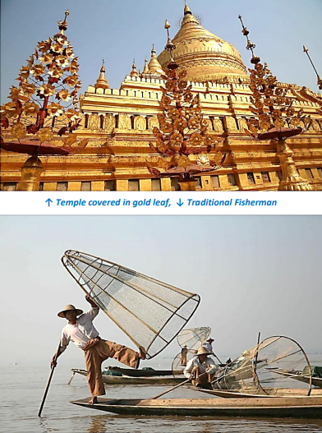
From Porthole April 2015 Myanmar
Before the start of the Rohingya genocide

Slide 18



We now have five Districts (of which I believe we are one) whose membership is below 1100, the cut-off point for re-Districting, though nobody at our HQ in Evanston, just north of Chicago, is interested in re-Districting GB and I until we know the result of the North Star Pilot project.
The same thing applies to Australia, New Zealand and the Pacific Islands who are running the other North Star pilot project. However, if our numbers do not increase within the next 2-3 years, not only will the funding that we are getting from RI fold, but we will probably be re-Districted The last time this was suggested (which we fought), we were going to have a District stretching up to Coventry and Worcester. Just imagine having to drive to, say, Gloucester, for a District meeting – crazy. So Rotary is changing!!
Final facts – 23% of our members are now female
And our average age has dropped to 71.
Yes, Rotary is changing, and some people have labelled us as the change-makers. It is up to you to decide whether we have earned that title
Keith
Changes are coming
I have just switched off from a Zoom meeting talking to senior Rotary leaders and the Secretariat. This was an updating session to tell us how North Star is going. You all know about North Star from avidly reading your R.I.B.I. (Sorry, R.G.B.I.) magazines – the programme that is going to double the number of Rotarians in these islands within a few years. The pundits are saying that it is already showing signs or working – well, the steady decline that has happened over the last ten years (since I was President!!!!) has stopped. So I thought you might like some ?relevant facts and figures.
Total number of Rotarians in GB & I = 33-34,000 (depending on which month’s figures you take. This will probably drop at the end of our Rotary year in June as there are always some members who do not wish to renew their subscriptions.
There are now 1530 clubs (10 years ago it was roughly 1800)
There are 315 Direct members i.e. those who log on-line but do not represent any club. (Don’t ask me how they work on projects)
There are 87 Corporate members i.e. named by businesses.
We have just taken on our second Enterprise business = another 60 members
So the actual number of members in clubs has dropped by 1808.
There have only been 5 new clubs this year – it used to be 30 – 20 p.a..
Many towns are joining their clubs together (as we do with Frome Rotary which has three clubs).
It has been suggested that clubs which are having a problem getting Chairs or Secretaries might use just one Secretary etc. E.g. We could have a secretary who deals with all the correspondence for Weymouth and Portland (or even add in Bridport).
Keith

Slide 19




Puzzle for April
Easter egg hunt
Anna, Bethany and Charlotte have been on an Easter egg hunt. Charlotte has found one more egg than Anna, but luckily Bethany found three times as manty as Anna. If Bethany were to eat one of hers, she would have twice as many eggs as Charlotte.
Calendar
Future Meetings & Events
Here is a link to the Future Meetings and Events on our Club website page
Click here for the Calendar
How many eggs does Anna have? Answer next month
Member Duty Rota for April/May
Solution for March
Long division. All the numbers have been erased except the numeral 1. What numbers does each x represent ?
 | Greeter, Setting up, Thought for the day | Setting up | Finance
 |  |  | 1 | x | x | x
x | x | x | x | x | x | 1
 |  | x | x
 |  | x | 1 | x
 |  | 1 | x | x
 |  |  | x | x | x
 |  |  | x | x | x
 |  |  |  | 1 | 1 | 1
 |  |  |  | 1 | 1 | 1
01/04/2025
08/04/2025 | Sarah Curtis | Elizabeth Campbell | Carolyn Humphreys
15/04/2025
22/04/2025 | David Hayes | Janet Kench | Ian McPheat
29/04/2025
06/05/2025
13/05/2025 | Robert Grigsby | Diane Parry | Trevor Primett
20/05/2025
27/05/2025 | Margaret Thomas | Garry Urwin | Jo Way
Answer 58571 / 37
You can work out the rest!
Here is the Rota to the end of the Rotary year. You will need to be logged in FIRST before being taken to this members only page
Click here for the Rota

